Slide 1
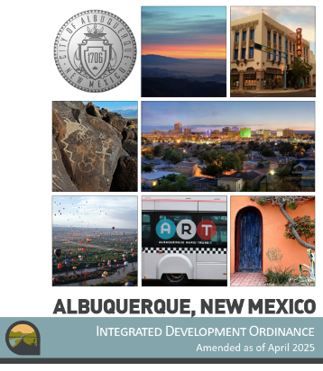
Transportation
+ Land use
Integrated
Development
Ordinance
https://abq-zone.com
UNM Presentation
February 2026
Mikaela Renz-Whitmore
Division Manager
mrenz@cabq.gov

Slide 2


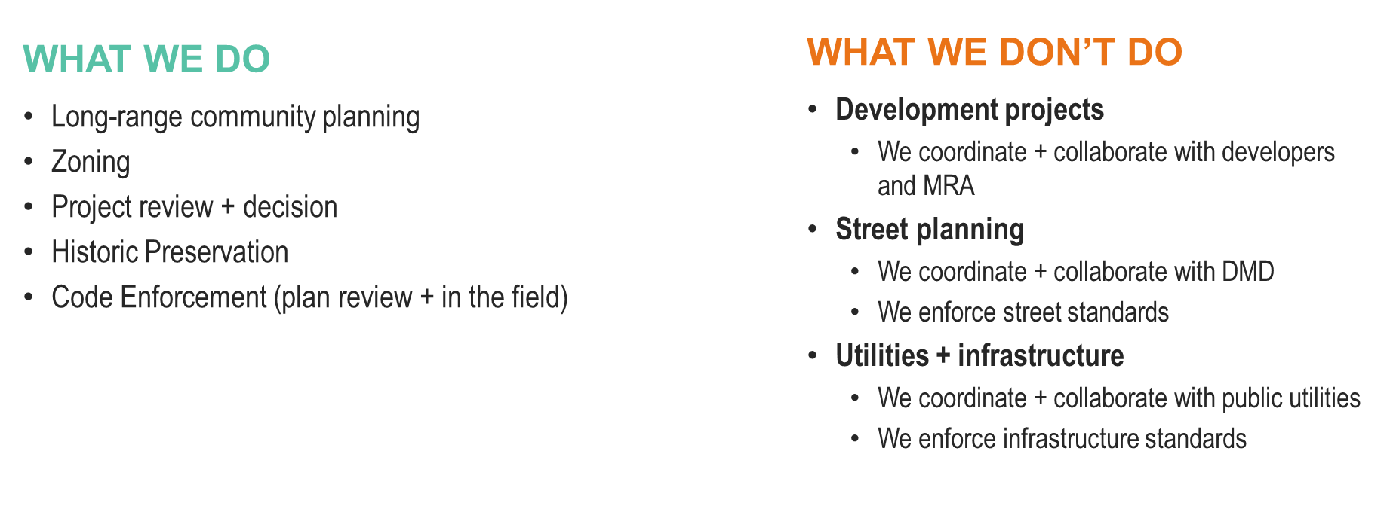
MRA = CABQ’s Metropolitan Redevelopment Agency
DMD = CABQ’s Department of Municipal Development
https://www.cabq.gov/planning

Slide 3
What we do
What we don’t do
Long-range community planning
Zoning
Project review + decision
Historic Preservation
Code Enforcement (plan review + in the field)
Development projects
  We coordinate + collaborate with developers and MRA
Street planning
  We coordinate + collaborate with DMD
  We enforce street standards
Utilities + infrastructure
  We coordinate + collaborate with public utilities
  We enforce infrastructure standards
MRA = CABQ’s Metropolitan Redevelopment Agency
DMD = CABQ’s Department of Municipal Development
https://www.cabq.gov/planning

Slide 4
What Makes
a great city?
Distinct neighborhoods
Historic districts
Multicultural identity
Iconic views
Special places
Natural resources
Quality of life
Parks & open space
Landscape
Resilience
Housing choices
Jobs
Transportation options
Services

Slide 5
What Makes
a Walkable city?
Distinct neighborhoods
Historic districts
Services
Destinations
Context
Access
Parks & open space
Landscape
Streetscape
Views
Where you live
Where you work
Where you play
Transportation options

Slide 6

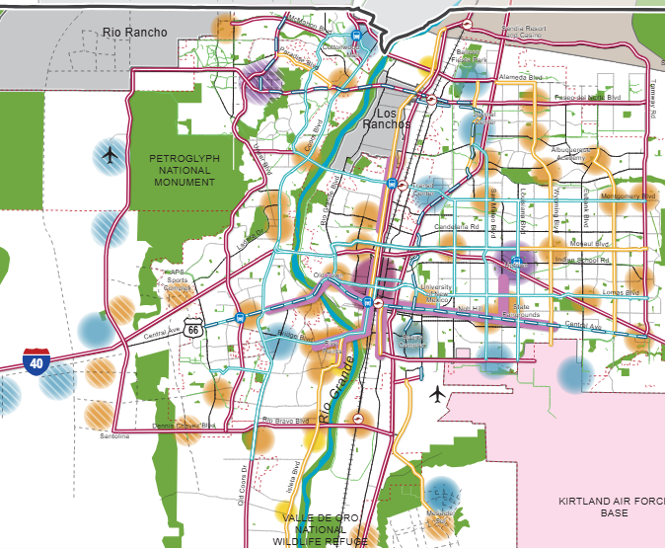

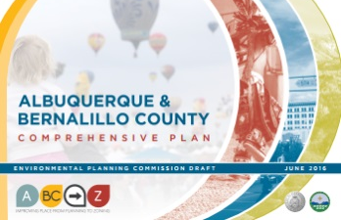
Planning + Zoning
ABC Comprehensive Plan
Integrated development ordinance
What we want + why:
  Where to direct growth
  What to protect
  What actions to take
  How to measure progress
How to get there:
  Tailored rules
    Centers + Corridors
    Areas of Consistency
    Overlay Zones
    Special places
  Transitions / Edge Protections
    Between Areas of Change + Consistency
    Next to neighborhoods
Vision
Centers + Corridors
Policies
Regulations
compplan.abq-zone.com
https://abq-zone.com
Notes:
In theory, at its best, zoning is a legal tool to implement our best plans
The WHY and the HOW
Why = goal/aspiration
How = minimum standards

Slide 7











Comp Plan
elements
Parks + Open Space
Housing
Heritage Conservation
Infrastructure + Community Facilities
Economic Development
Resilience + Sustainability
Urban Design
Community Identity
Transportation
Land Use

Slide 8
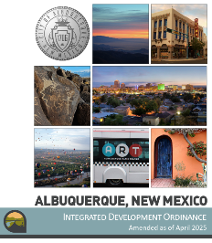

What is Zoning?
Vision
Goals & Policies
Zoning
a system of laws that establishes rights and limits on property
Albuquerque
Bernalillo
County
Comprehensive Plan
U.S Constitution
5th Amendment: Property Rights
14th Amendment: Due Process
10th Amendment: Police Power
for public health, safety, and welfare
  “a person may not be deprived of property by the government without due process of law”
“nor shall any State deprive any person of life, liberty, or property, without due process of law”
Notes:
.

Slide 9
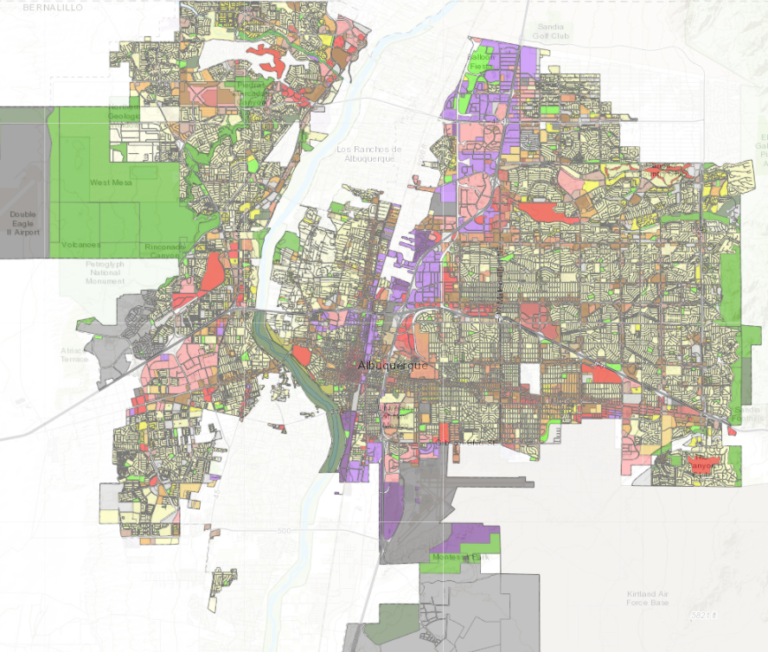
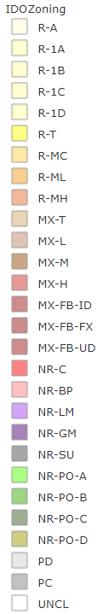

Zone Districts
Residential
Zone Districts
Mixed-use
Zone Districts
Non-residential
Zone Districts
Planned Development
Zone Districts
https://tinyurl.com/IDOzoningmap
Unclassified

Slide 10

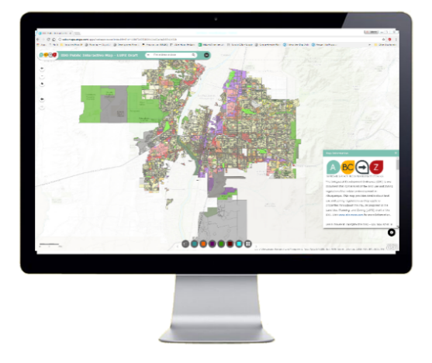

contents
1. General Provisions
Zone Districts
Overlay Zones
4. Use Regulations
Allowable Use Table
Use-specific Standards
Development Standards
      Dimensional Standards Tables
      General Regulations
6. Administration & Enforcement
7. Definitions & Acronyms
https://ido.abq-zone.com
IDO Zoning Map
Uses
Zones
Standards
Processes
https://tinyurl.com/IDOzoningmap

Slide 11

Levers for regulations
Overlay Zones
Character, Historic, View Protections
Context
Incentives
Zoning
Residential
Mixed-use
Non-residential
Edge buffers
Centers & Corridors
Small-area & Area of Consistency rules
Distance separations
Proximity to residential
Planned Development
Development types
Uses
Building design standards
Edge buffers
https://ido.abq-zone.com
IDO Zoning Map
https://tinyurl.com/IDOzoningmap
Notes:
Improved description of how rules are applied in Part 1. (Section 14-16-1-8)
Any update to improve quality standard citywide WON’T apply to tailored standard. (Sometimes that’s good, sometimes that’s not. Need to review carefully!)
Tradeoff is additional complexity for extra protections.
Zoning is not easy, but it IS more predictable now under the IDO.

Slide 12
Finding the balance
Strategy
Encourage development in Centers & Corridors to relieve market pressures on neighborhoods, special places, and open space
Protecting
Neighborhoods, special places,
& City open space
Incentivizing
High-quality development
in appropriate areas

Slide 13
Finding the balance
Strategy
Create the right rules for the places you want
Tailored
Rules for small areas
Citywide
Standardized rules
Additional complexity
Harder to enforce
Less complexity
Easier to enforce

Slide 14
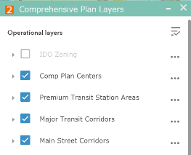

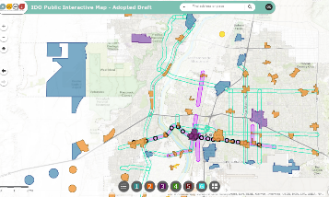


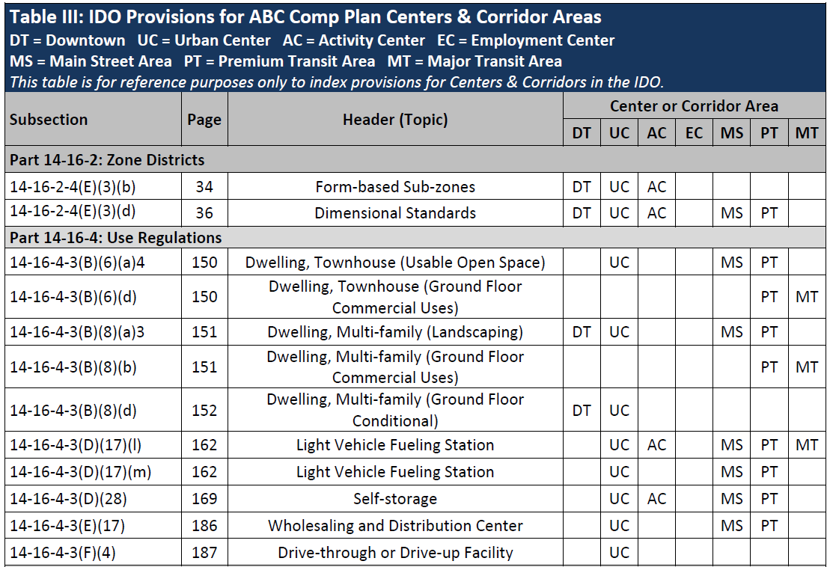


Implementing the Comp Plan
https://tinyurl.com/IDOzoningmap
Incentives:
Higher building heights
Lower parking requirements
Higher Standards:
More building design & buffering requirements
More walkable site design requirements
2025 Update
(coming soon):
NO parking minimums
LOWER parking maximums
IDO Zoning Map
UC
EC
MT
MS
AC
Table III
DT
DT = Downtown
UC = Urban Center
AC = Activity Center
EC = Employment Center
MS = 660 feet from Main Street
PT = 660 feet from Premium Transit station
MT = 660 feet from Major Transit
Center/Corridor
Index

Slide 15
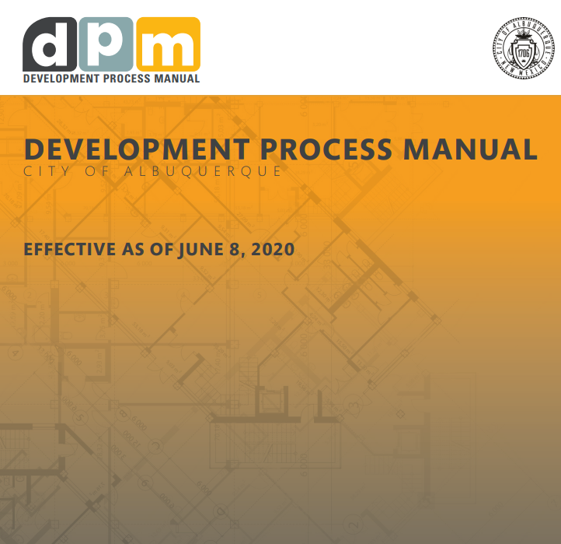
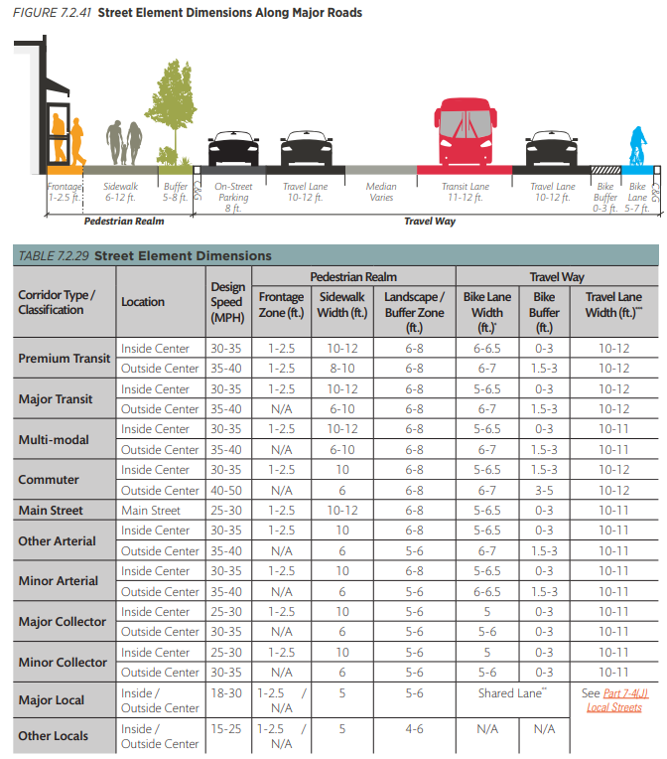
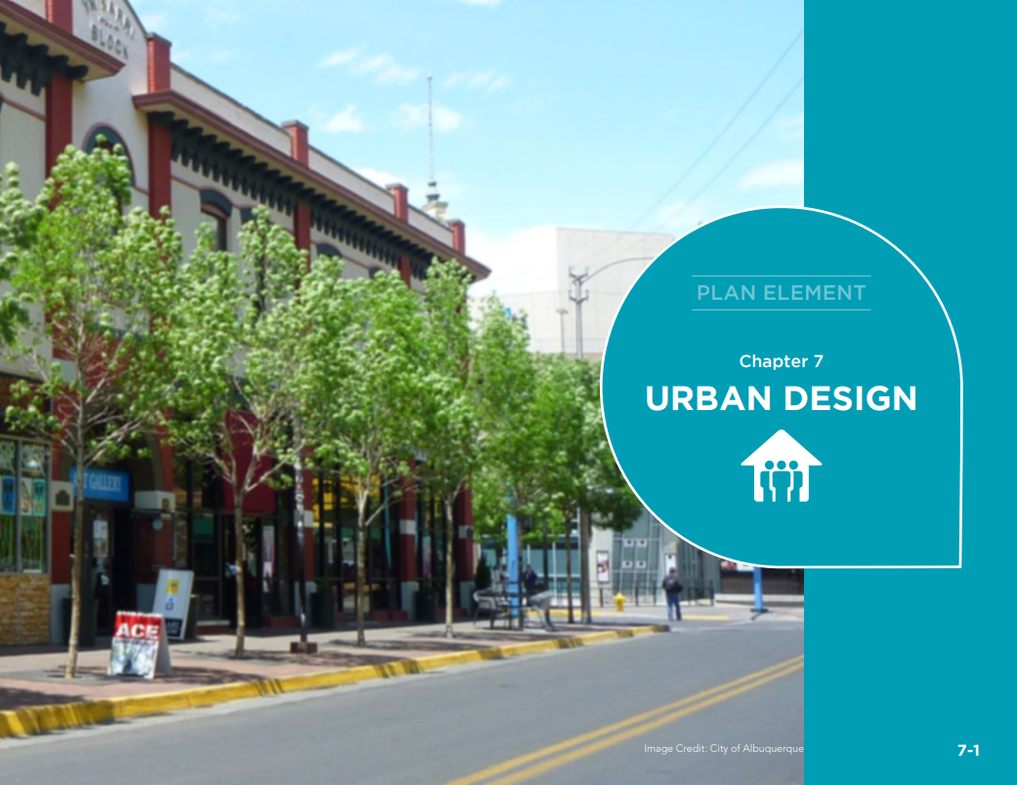
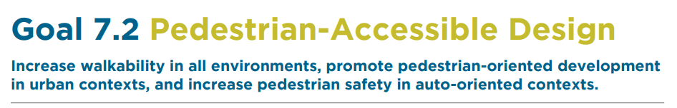
Urban Design
compplan.abc-zone.com
http://tinyurl.com/DPM-CABQ

Slide 16
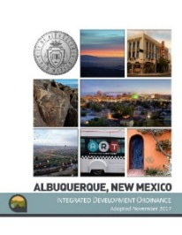
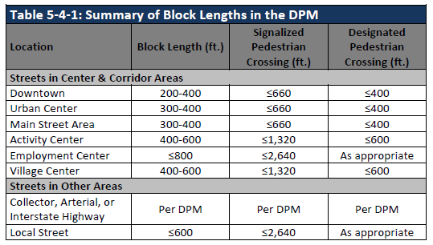

Urban Design
http://tinyurl.com/DPM-CABQ
ido.abq-zone.com

Slide 17
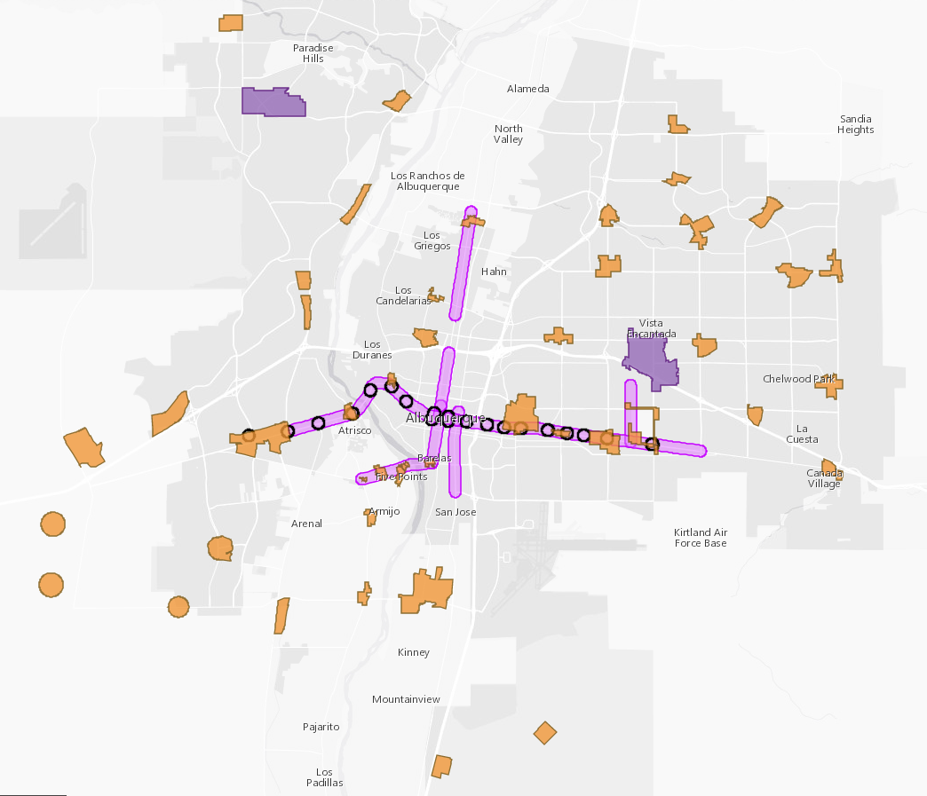
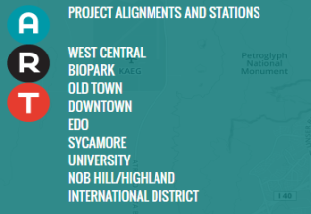

Implementing the
Comp Plan vision
Centers & Corridors
Regulatory Tools
Higher building heights
Lower parking requirements
No parking between buildings & the street
More building design standards
More walkable site design requirements
AC = Activity Center
UC = Urban Center
MS = 660 feet from Main Street
PT = 660 feet from Premium Transit station

Slide 18
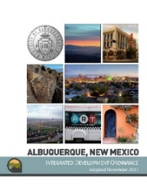

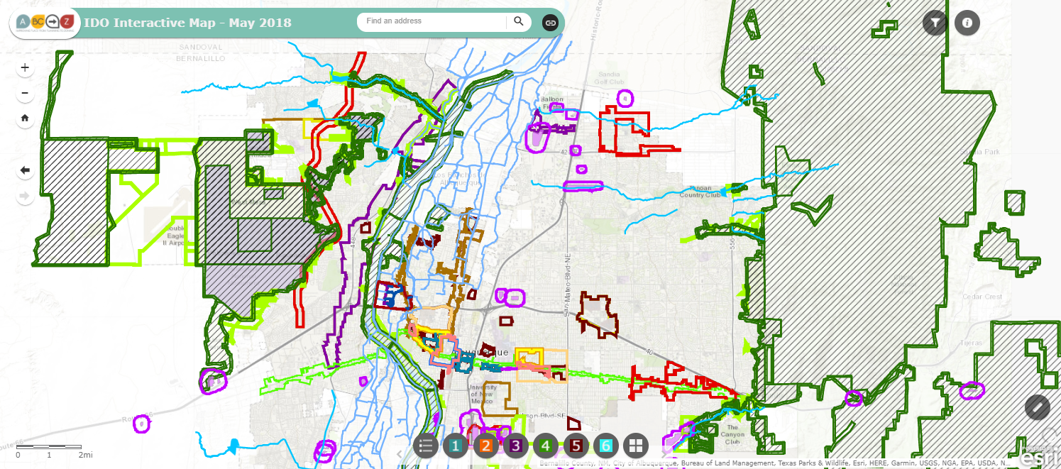

IDO Part 5
Development Standards
Context Rules
Rules that set quality standards for development
5-1 Dimensional Standards
5-2 Site Design + Sensitive Lands
5-3 Access + Connectivity
5-4 Subdivision of Land
5-5 Parking + Loading
5-6 Landscaping, Buffering, + Screening
5-7 Walls + Fences
5-8 Outdoor + Site Lighting
5-9 Neighborhood Edges
5-10 Solar Access
5-11 Signs
https://tinyurl.com/CABQ-IDO-2023-07-27
https://tinyurl.com/IDOzoningmap
Notes:
Between uses: Group Homes, Pawn Shops, Bail Bonds, Payday Loans, etc.
From Residential Uses: Retail Liquor, Heavy/Special Manufacturing, Auto repair, etc.

Slide 19
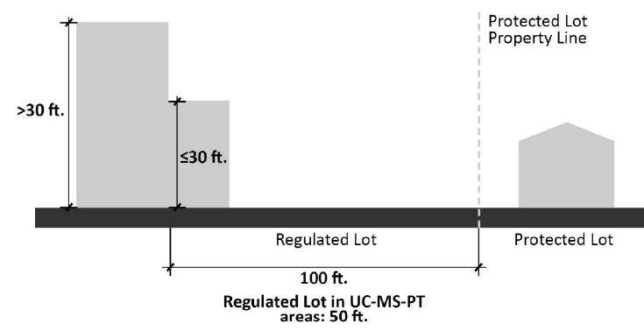
Density Factors
Part 5
Citywide
CONTEXTUAL
Building height
Setbacks
Required usable open space
Required parking
Required landscaping
Building design standards
Use-specific standards
  Distance from residential
Neighborhood Edges
Edge Buffers
Major Public Open Space Edge
In general:
More urban = more walkable, transit-oriented
More suburban = more auto-oriented
Notes:
Areas of Change and Consistency for Edge Buffers

Slide 20
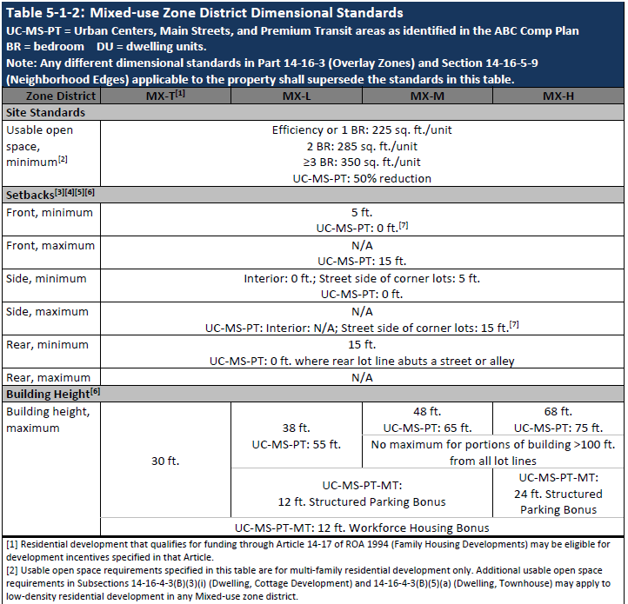
Dimensional Standard Tables:
By Zone Categories
Acronyms
Zones
(By intensity)
5-1
Standards
Center Provisions
2025 Update
(coming soon):
AC-MT Building Heights
AC-MT Bonuses
Notes:
Be ready to define terms

Slide 21
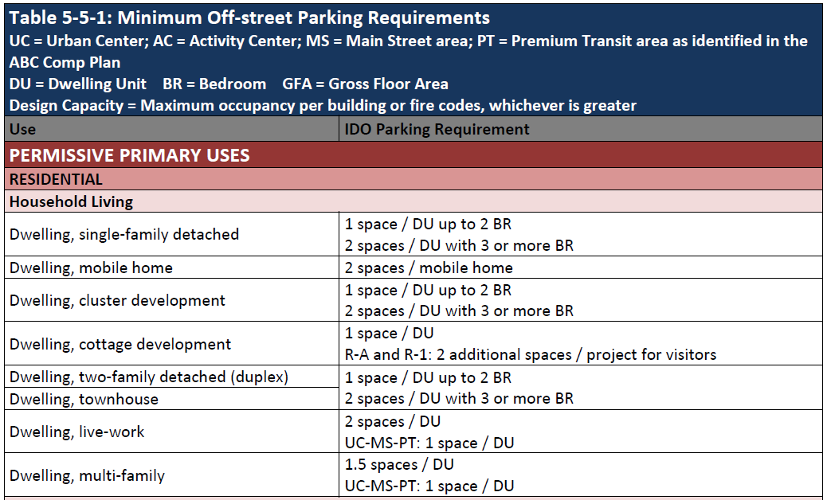
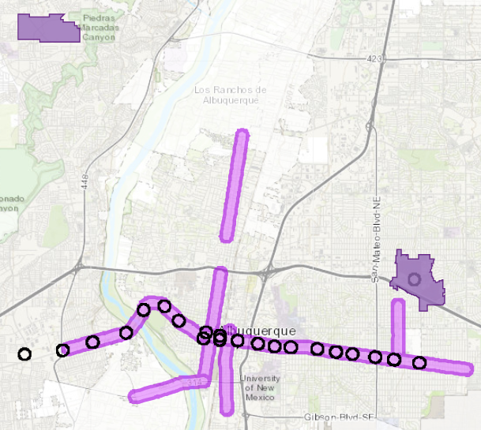
parking
Minimum Requirements
5-5
https://tinyurl.com/IDOzoningmap
Reductions in centers & Corridors
TABLE BY ALLOWABLE USE
Center Provisions
UC = Urban Center
MS = 660 feet from Main Street
PT = 660 feet from Premium Transit station

Slide 22
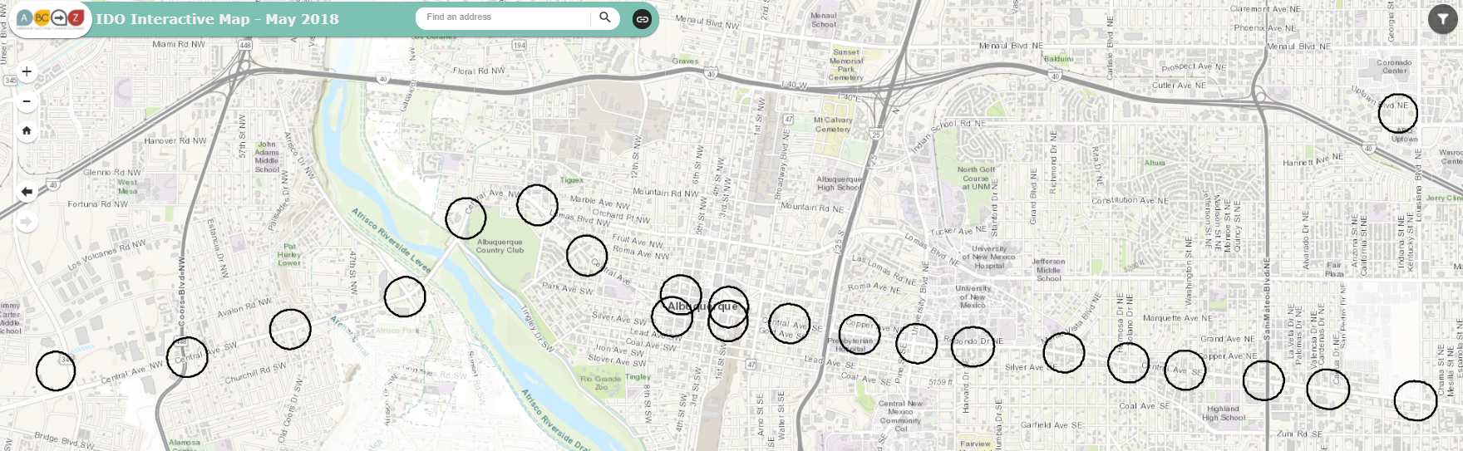
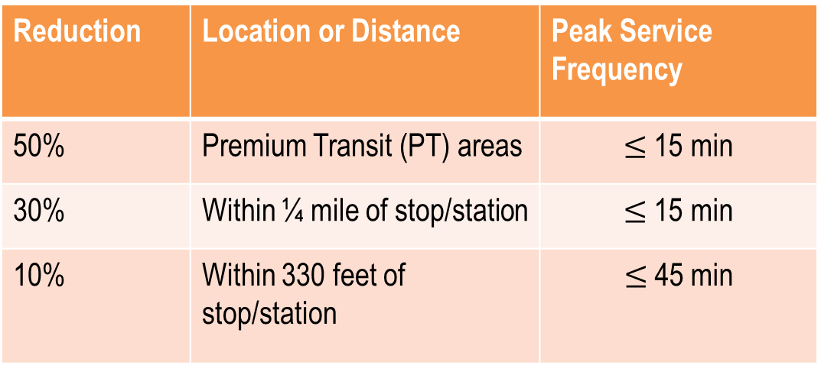
parking
Incentives
5-5
Table by Allowable Use
Reductions for Transit
Reduction | Location or Distance | Peak Service Frequency
50% | Premium Transit (PT) areas | $≤$ 15 min
30% | Within ¼ mile of stop/station | $≤$ 15 min
10% | Within 330 feet of stop/station | $≤$45 min
ido.abc-zone.com
Atrisco
Unser
Coors
Broadway
University
San Mateo
Louisiana
https://tinyurl.com/IDOzoningmap

Slide 23
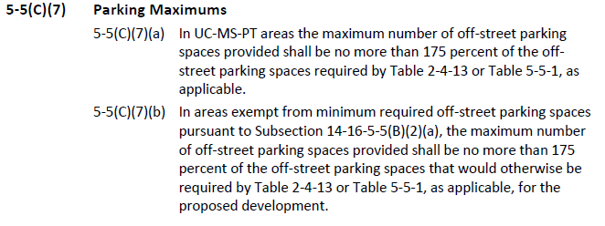
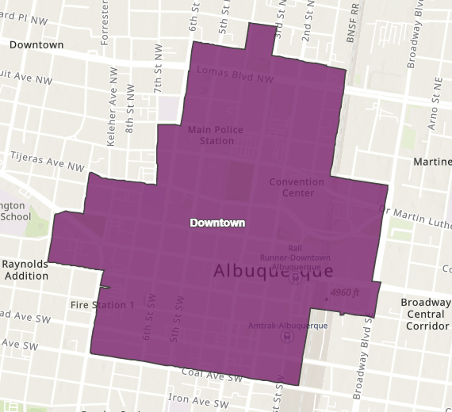
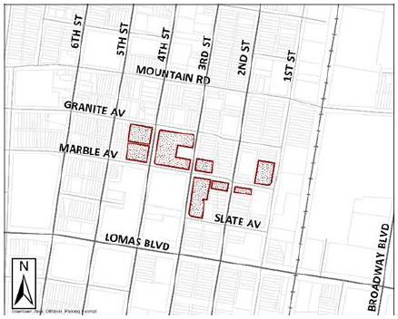
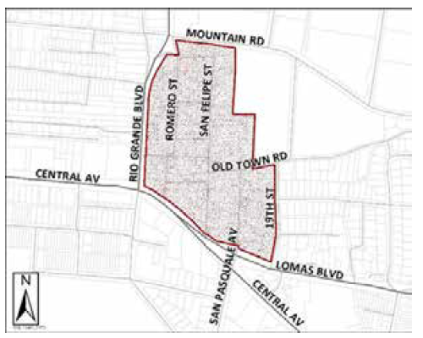
Parking
Minimum & Maximum Requirements
5-5
IDO Text
Purpose
Discourages surface parking lots Encourages transit-supported and transit-supportive development
Exempt from minimum parking requirements:
Downtown Center
McCllelan Park Small Area
Old Town – HPO-5
UC
MS
PT
Notes:
Needs a condition (or editorial) to remove reference to “Table 5-5-1” in the new (a). Will have condition to include underground parking in exemption.

Slide 24
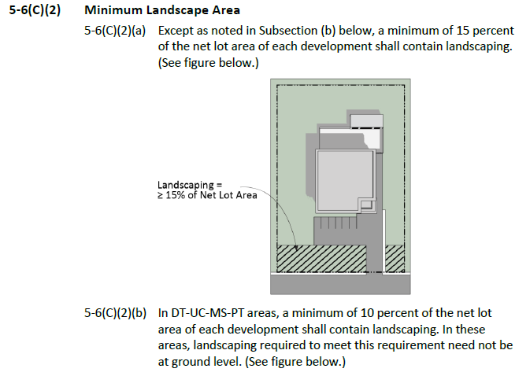
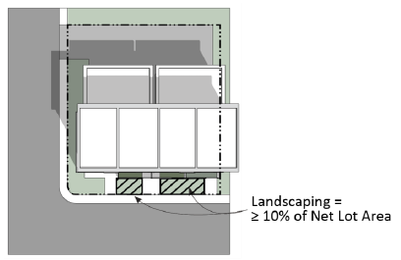
Landscaping
5-6

Slide 25
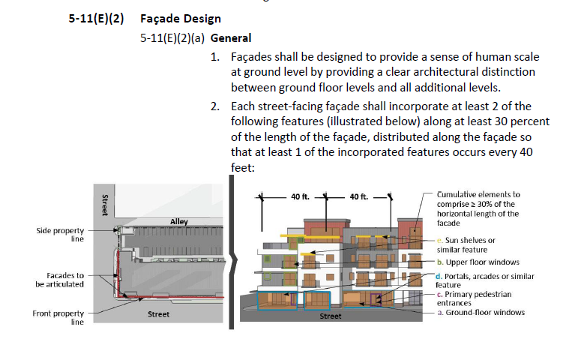
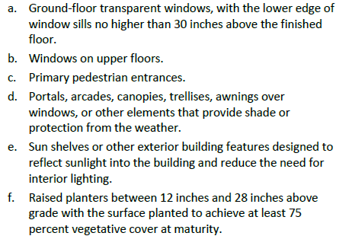
building Design
5-11

Slide 26
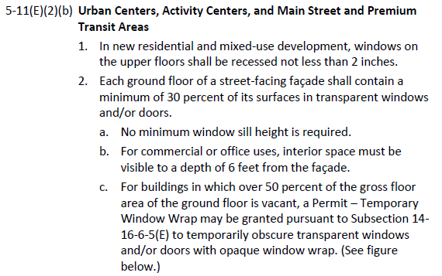
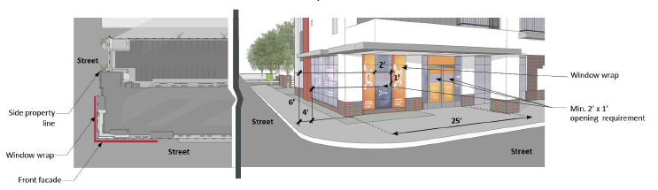
building Design
5-11

Slide 27


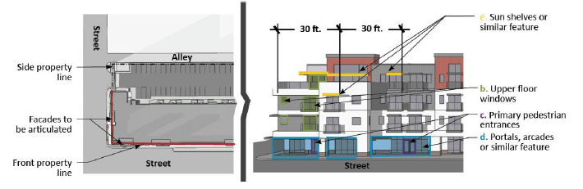
building Design
5-11

Slide 28
Get Involved
2025 IDO Update
Get to Know Your IDO
Handout (PDF)
Presentation (PDF)
Video
https://abq-zone.com/ido-updates-2025
IDO Online
Next Hearing @ City Council
Environmental
Planning
Commission
Land
Use
Planning
Zoning
City Council
https://ido.abq-zone.com
Date | Time
Wed, Feb. 18 | 5:00 pm
October 2025
January 2026
February 2026
Changes are legislative, so talk to your Councilor!
https://www.cabq.gov/council/find-your-councilor
Council’s
Hearing Agenda and Commenting Instructions
https://cabq.legistar.com/Calendar.aspx
Committee

Slide 29
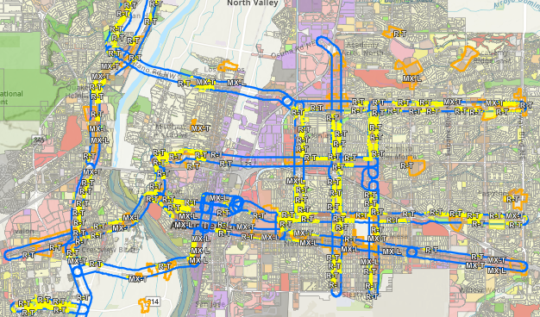
Increase Housing Choices
Take bold but gentle action to create more housing choices for families
Legislative Zoning Conversions for Major Transit (MT) and Activity Centers (AC)
  R-1 → R-T – Adds townhouses as permissive (up to 3 units)
  R-T → MX-T – Adds multi-family and non-residential as permissive
  R-ML → MX-L – Adds non-residential as permissive
MT = 660 feet from Major Transit Corridor
AC = Activity Center
https://abq-zone.com/node/1937

Slide 30
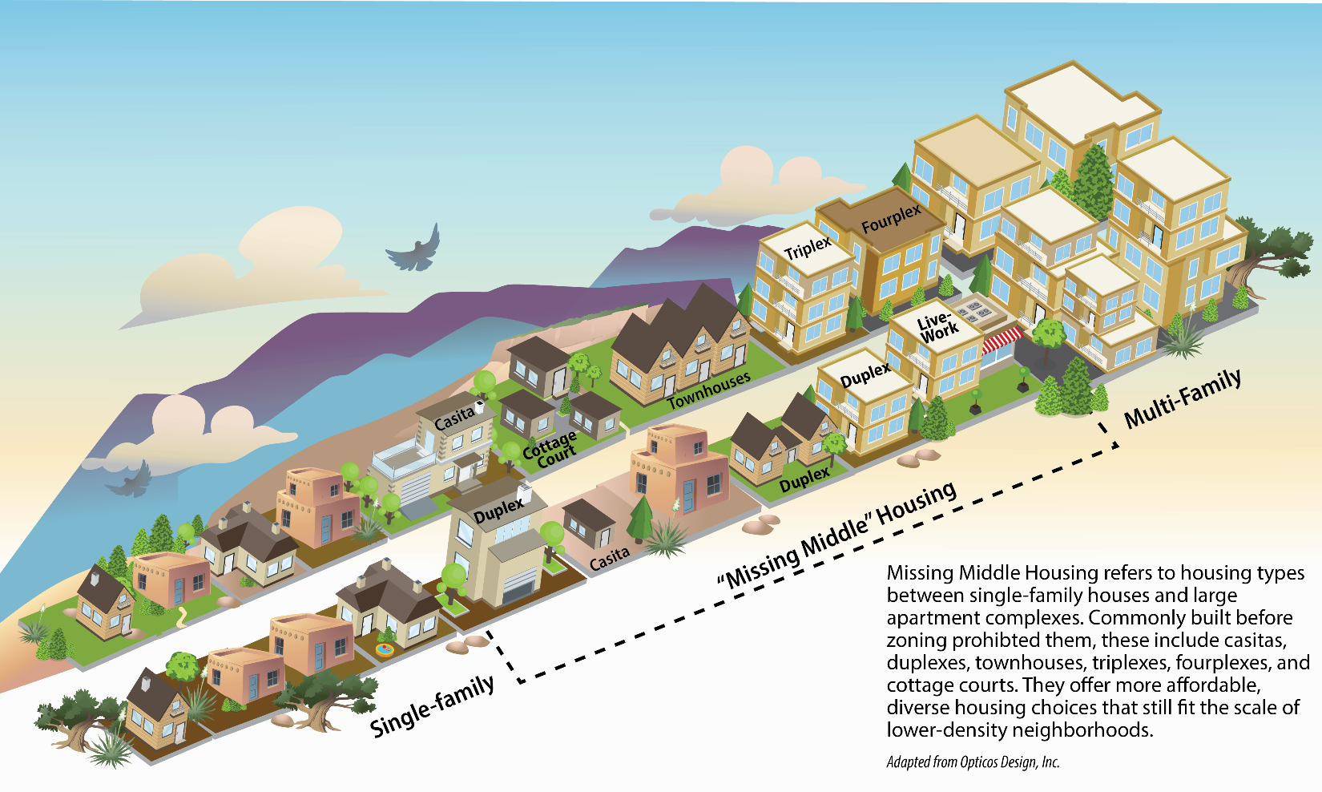
Increase Housing Choices
Take bold but gentle action to create more housing choices for families
Dormitory – Makes co-living permissive in R-ML and MX-T (already allowed in R-MH and the other Mixed-use zones)
Cottage courts – Allows multiple small single-family or duplexes citywide on lots 10,000+ s.f.
Duplex – Allows duplexes citywide in R-1
Townhouse – Allows townhouses citywide in R-1 (up to 3 units)
Accessory Dwelling Units (ADUs) / Casitas – Allows attached ADUs citywide
Safe Outdoor Space – Removes requirements for plumbing and 24/7 security

Slide 31
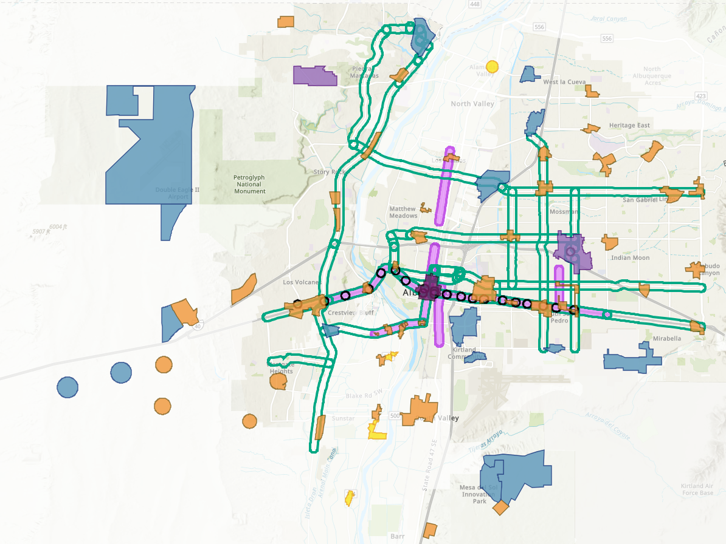
Lower Costs per Housing Unit
Require less land/parking to leave more money for constructing housing units
R-1 Dimensional Standards – Removes subzones with larger minimum lot sizes and setbacks
Accessory Dwelling Units (ADUs) / Casitas
  Height
    Changes maximum building height to 18 feet, or as tall as the primary structure, whichever is higher
    Allows casitas constructed over a detached garage up to the allowed height of the zone district
  Size: Changes maximum size to be a footprint of 750 s.f. to allow flexibility for lofts and 2-story casitas
Building Heights
  R-ML and R-MH and Mixed Use Zone Districts
    Adds a new tier of higher building height in Major Transit and Activity Centers
    Bumps up building height in Urban Center, Premium Transit, and Main Street areas accordingly
Parking
  Citywide Parking Minimums
    Reduces minimum requirements for multi-family and adds a built-in reduction for workforce housing (1 space / DU)
    Decreases parking minimums by 20% for most uses (some exceptions – like single-family).
  Centers and Corridors:
    Eliminates parking minimums
    Reduces/establishes parking maximums for non-residential development only in Centers and Corridors
DT = Downtown
UC = Urban Center
AC = Activity Center
EC = Employment Center
MS = 660 feet from Main Street
PT = 660 feet from Premium Transit station
MT = 660 feet from Major Transit

Slide 32
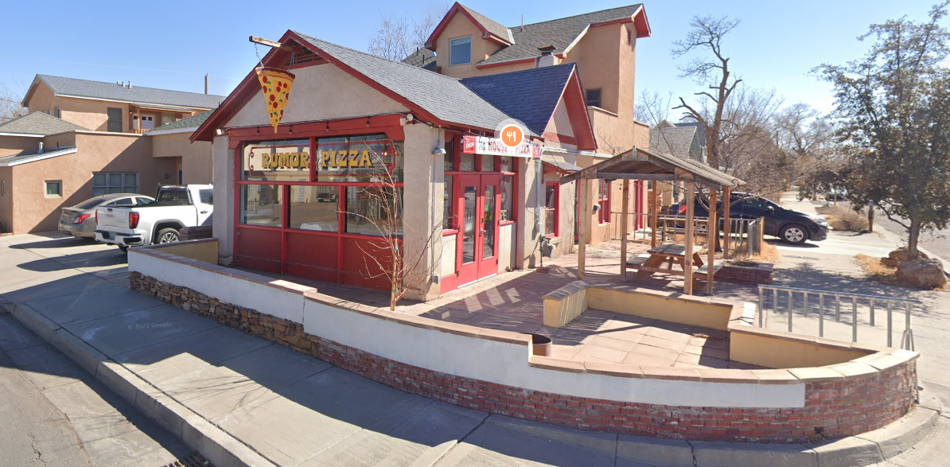
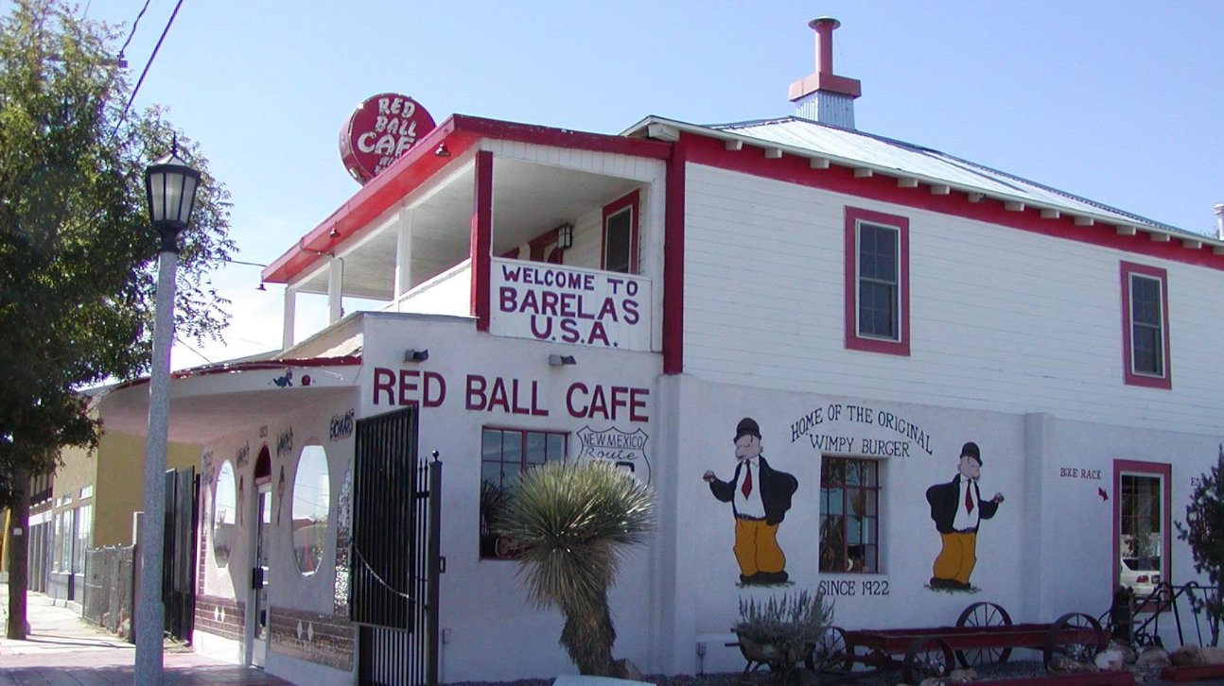
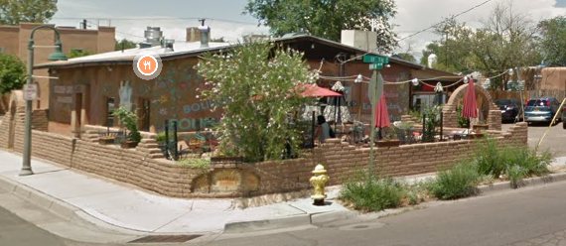
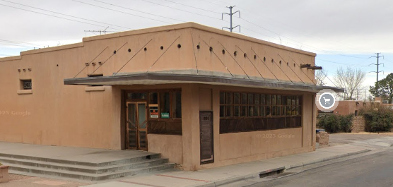
Allow Food near Neighborhoods
Create opportunities for small businesses, encourage walkability, and provide important daily goods such as food, household items, and medicine closer to the places where people
Bodegas / Tienditas: Allows retail, restaurant, grocery, and live-work on corner lots 5,000+ s.f. in residential zones
  Conditional on local streets
  Permissive on arterial / collectors
  Not allowed to sell alcohol, cannabis, or nicotine

Slide 33

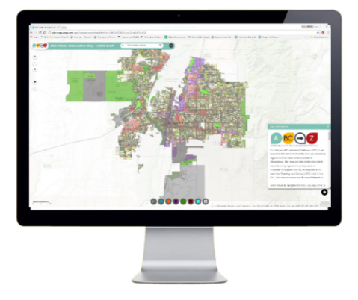
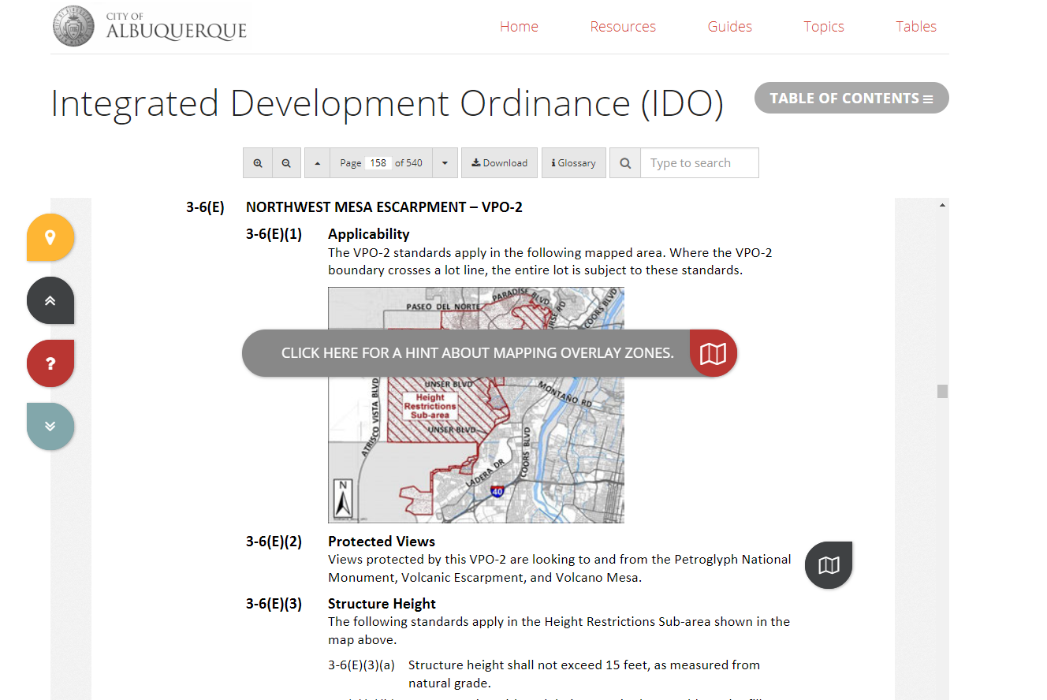
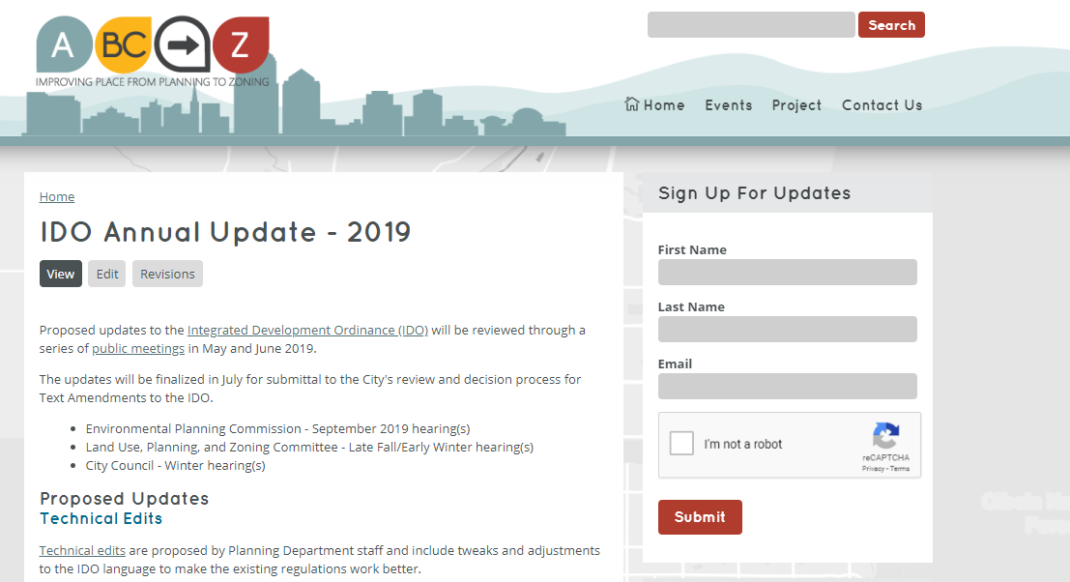


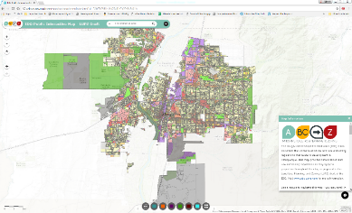
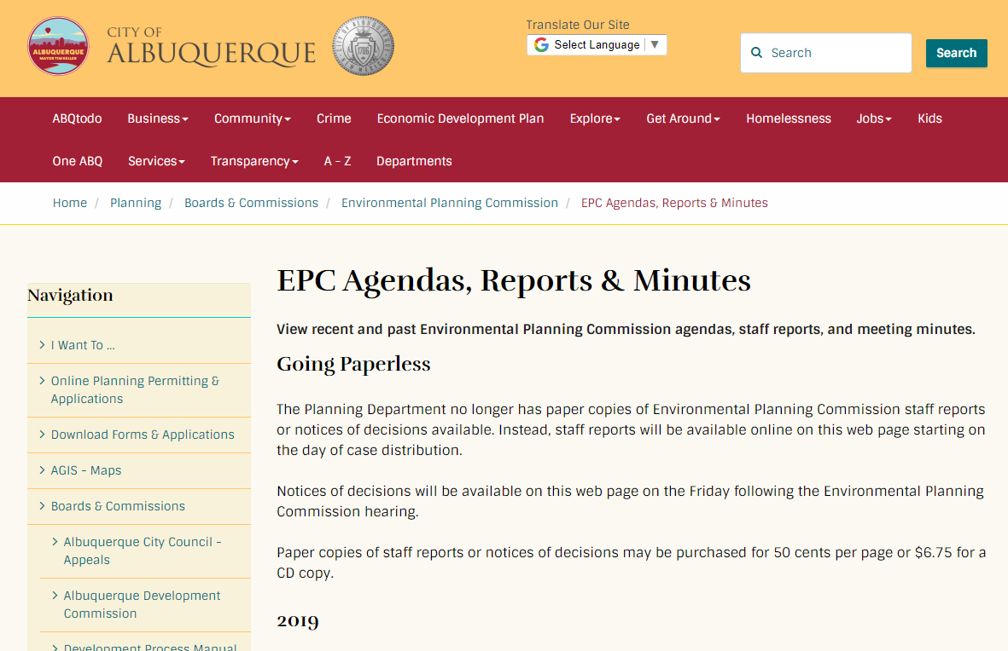

Interactive IDO
Project Webpage
ido.abc-zone.com
abc-zone.com
Resources
IDO Zoning Map
Planning Webpage
Mikaela Renz-Whitmore
Urban Design + Dev. Division Manager
mrenz@cabq.gov
Kate Clark
IDO/Regulatory Team Lead
mvos@cabq.gov
ABC-Z Project
abctoz@cabq.gov
tinyurl.com/idozoningmap
cabq.gov/planning
ABC Comp Plan
compplan.abc-zone.com

