Slide 1

Integrated Development Ordinance
IDO Online
https://ido.abq-zone.com
UNM SAAP
March 2026
Site Plans + Subdivisions (oh my!)
Mikaela Renz-Whitmore
Division Manager
mrenz@cabq.gov

Slide 2
Planning Department
5 Divisions of the Planning Department
Planning*
A
Administration
B
Building Safety
C
Code Enforcement
D
Development Review Services
* Urban Design + Development
Notes:
Not for students – use for neighbor groups if needed

Slide 3
Planning Department
Planning & Zoning Entitlement
Community / Project Planning
Landmarks Commission
Engineering & Zoning Review
Development Hearing Officer
Development Review Services
Building Permit Review
Uniform Housing Code
International Building Code
Zoning Review / Code Enforcement
Development Projects
Zoning Enforcement Officer
Environmental Planning Commission
Building Safety
Zoning Hearing Examiner
Notes:
Not for students – use for neighbor groups if needed

Slide 4

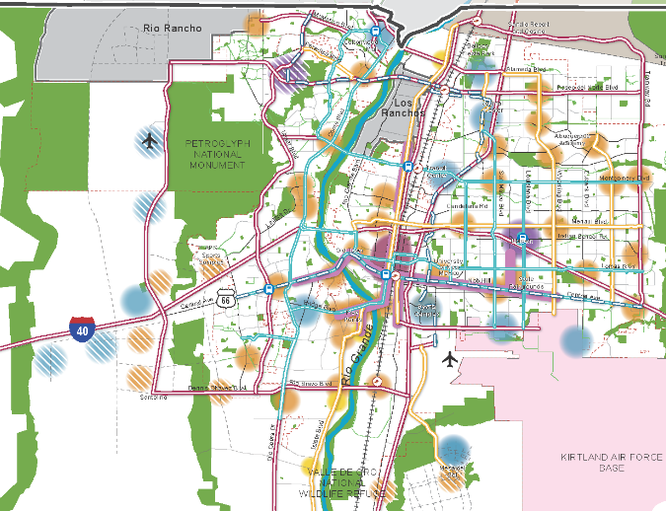
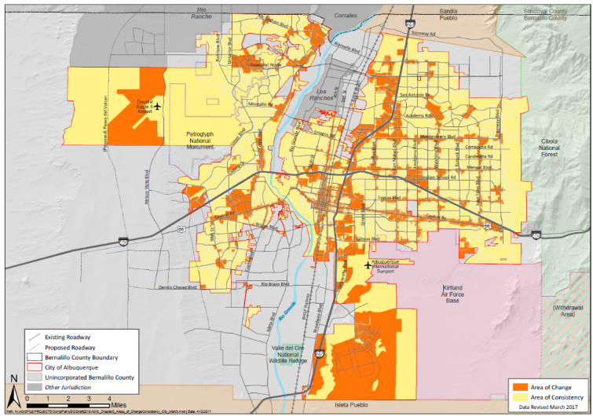
Planning + Zoning
ABC Comprehensive Plan
Integrated development ordinance
What we want + why:
Where to direct growth
What to protect
What actions to take
How to measure progress
How to get there:
Tailored rules
Centers + Corridors
Areas of Consistency
Overlay Zones
Special places
Transitions / Edge Protections
Between Areas of Change + Consistency
Next to neighborhoods
Policies
Vision
Centers
&
Corridors
Areas of Change
&
Consistency
Regulations
compplan.abc-zone.com
ido.abc-zone.com
Notes:
The WHY and the HOW

Slide 5

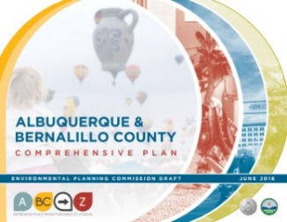
What is Zoning?
Vision
Goals & Policies
Zoning
a system of laws that establishes rights and limits on property
Albuquerque
Bernalillo
County
Comprehensive Plan
U.S Constitution
5th Amendment: Property Rights
14th Amendment: Due Process
10th Amendment: Police Power
for public health, safety, and welfare
“a person may not be deprived of property by the government without due process of law”
What is a taking?
A regulatory taking is when a zoning regulation limits the use of private property to the extent that it effectively deprives the owner of all economic value.
“nor shall any State deprive any person of life, liberty, or property, without due process of law”
Notes:
.

Slide 6
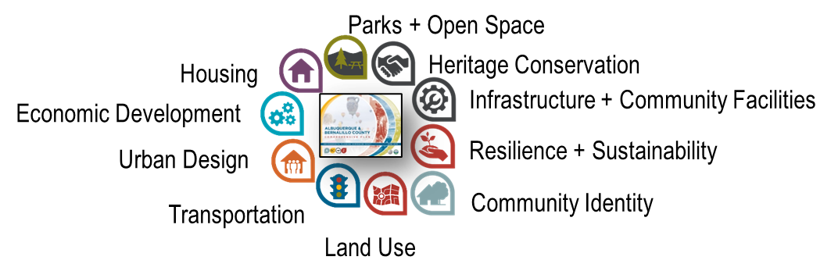

What is Zoning?
Implements policies
Establishes rights and limits on private property to protect public health, safety, and welfare
Land uses
(homes, offices, factories, etc.)
Development standards
(building heights, setbacks, parking, landscaping, etc.)
Review/approval processes
(decision-makers, required notice, etc.)
Vision
Goals & Policies
Zoning
Albuquerque
Bernalillo
County
Comprehensive Plan
Notes:
.

Slide 7
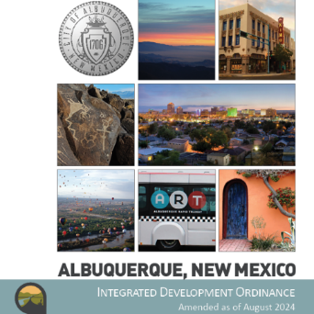
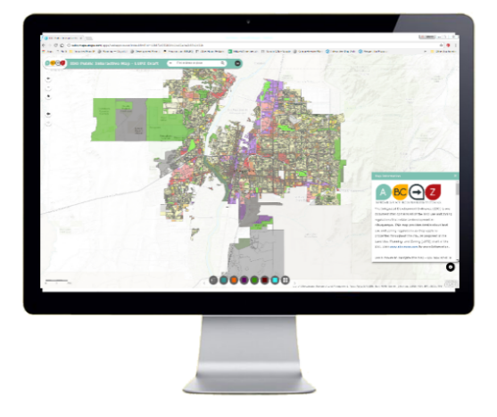

structure
1. General Provisions
Zone Districts
Overlay Zones
4. Use Regulations
Allowable Use Table
Use-specific Standards
Development Standards
Dimensional Standards Tables
General Regulations
6. Administration & Enforcement
7. Definitions & Acronyms
https://abq-zone.com
IDO Zoning Map
Uses
Zones
Standards
Processes
https://tinyurl.com/IDOzoningmap

Slide 8

Due Diligence
What’s the zoning on this property?
Is it in an overlay zone?
What use or uses will be on this property?
Is the use allowed in this zone?
In this area? Any special regs?
What are the development standards?
In this zone?
In this area? Any special regs?
What is the review/decision process?
In this area? Any special procedures?
Part 2/3
https://abq-zone.com
IDO Zoning Map
Uses
Zones
Standards
Part 4
Part 5
Processes
https://tinyurl.com/IDOzoningmap
Part 6

Slide 9
Finding the balance
Protecting
Neighborhoods, special places,
& City open space
Incentivizing
High-quality development
in appropriate areas

Slide 10
Finding the balance
Tailored
Rules for small areas
Citywide
Standardized rules
Additional complexity
Harder to enforce
Less complexity
Easier to enforce

Slide 11

Hierarchy of rules
In the order applied
Overlay Zones
Character, Historic, View Protections
Context
Incentives
Zoning
Residential
Mixed-use
Non-residential
Edge buffers
Centers & Corridors
Small-area & Area of Consistency rules
Distance separations
Proximity to residential
Planned Development
Development types
Uses
Building design standards
Edge buffers
https://tinyurl.com/CABQ-IDO-12-2022
IDO Zoning Map
https://tinyurl.com/IDOzoningmap
Notes:
Improved description of how rules are applied in Part 1. (Section 14-16-1-8)
Any update to improve quality standard citywide WON’T apply to tailored standard. (Sometimes that’s good, sometimes that’s not. Need to review carefully!)
Tradeoff is additional complexity for extra protections.
Zoning is not easy, but it IS more predictable now under the IDO.

Slide 12


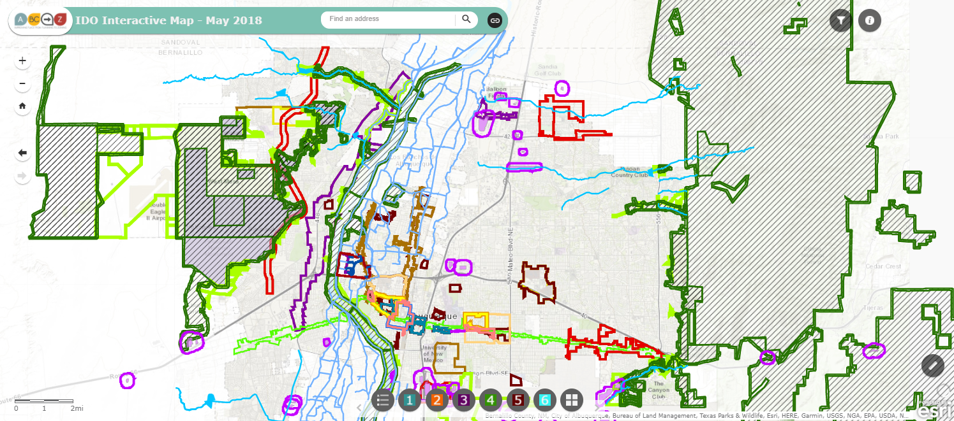


IDO Part 5
Development Standards
Context Rules
Rules that set quality standards for development
5-1 Dimensional Standards
5-2 Site Design + Sensitive Lands
5-3 Access + Connectivity
5-4 Subdivision of Land
5-5 Parking + Loading
5-6 Landscaping, Buffering, + Screening
5-7 Walls + Fences
5-8 Outdoor + Site Lighting
5-9 Neighborhood Edges
5-10 Solar Access
5-11 Signs
https://ido.abq-zone.com
https://tinyurl.com/IDOzoningmap
Notes:
Between uses: Group Homes, Pawn Shops, Bail Bonds, Payday Loans, etc.
From Residential Uses: Retail Liquor, Heavy/Special Manufacturing, Auto repair, etc.

Slide 13
IDO Part 5
Development Standards
Context Rules
Rules that set quality standards for development
5-1 Dimensional Standards
5-2 Site Design + Sensitive Lands
5-3 Access + Connectivity
5-4 Subdivision of Land
5-5 Parking + Loading
5-6 Landscaping, Buffering, + Screening
5-7 Walls + Fences
5-8 Outdoor + Site Lighting
5-9 Neighborhood Edges
5-10 Solar Access
5-11 Signs
Subdivision Review
Notes:
Between uses: Group Homes, Pawn Shops, Bail Bonds, Payday Loans, etc.
From Residential Uses: Retail Liquor, Heavy/Special Manufacturing, Auto repair, etc.

Slide 14
IDO Part 5
Development Standards
Context Rules
Rules that set quality standards for development
5-1 Dimensional Standards
5-2 Site Design + Sensitive Lands
5-3 Access + Connectivity
5-4 Subdivision of Land
5-5 Parking + Loading
5-6 Landscaping, Buffering, + Screening
5-7 Walls + Fences
5-8 Outdoor + Site Lighting
5-9 Neighborhood Edges
5-10 Solar Access
5-11 Signs
Site Plan Review
(Not more rules but more detail related to the phase of the project)
Notes:
Between uses: Group Homes, Pawn Shops, Bail Bonds, Payday Loans, etc.
From Residential Uses: Retail Liquor, Heavy/Special Manufacturing, Auto repair, etc.

Slide 15
Finding the Balance
Community Input
Early tribal consultation
& more public notice
Streamlined Approval Process
More administrative review
Intent
If we get the rules right – and we need to continually work to get the rules right – and projects follow those rules, they get approved quickly.
Asking for exceptions means more notice, more public input, and a longer process.

Slide 16
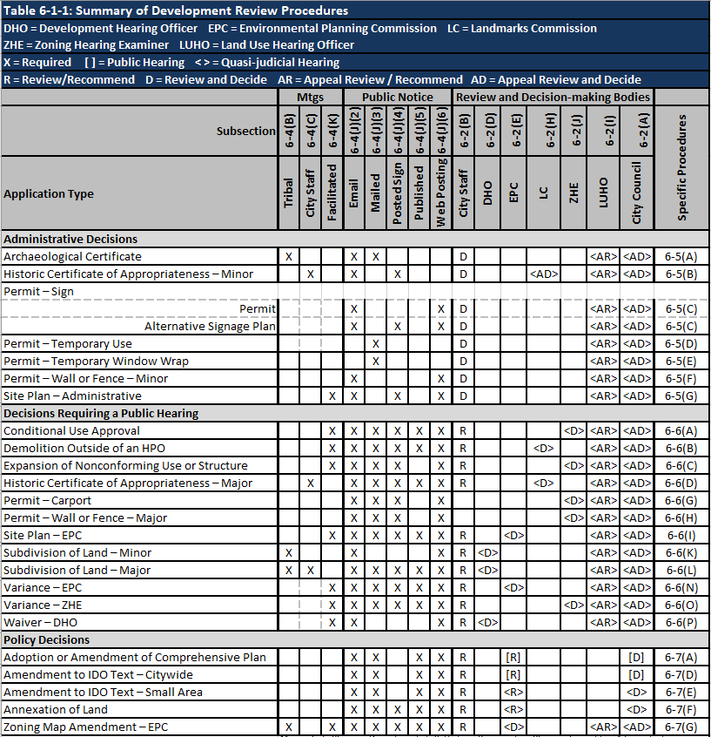



Review/decision
Table 6-1-1
Part 6
Predictable
Some public notice.
Administrative review.
Decided on IDO rules only.
No discretion.
https://abq-zone.com
More public notice.
Public hearing.
Decided on IDO rules only.
Some discretion in decision criteria.
https://compplan-abq-zone.com
Lots of public notice.
Public hearing.
Rules decided case-by-case.
Comp Plan AND IDO apply.
Discretionary.
Flexible

Slide 17
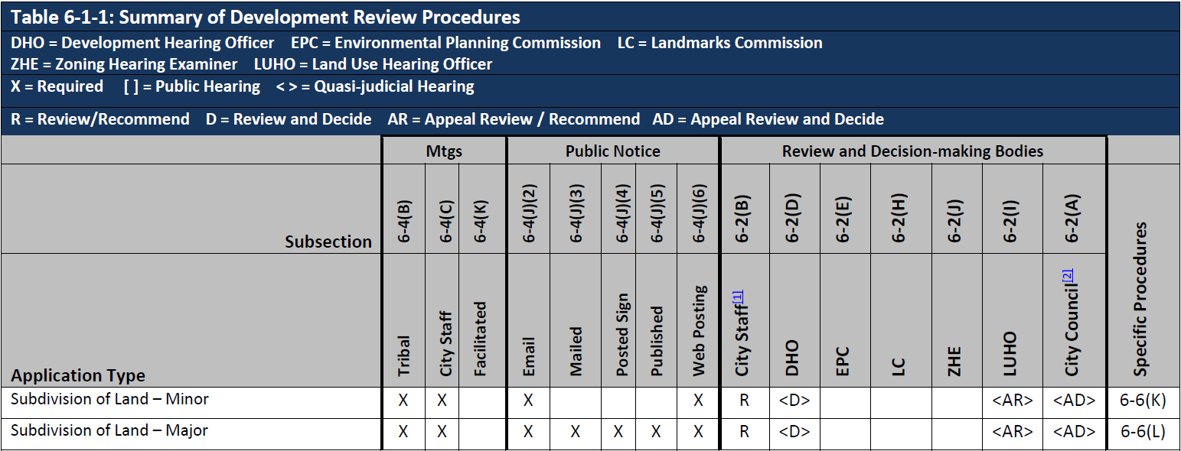

Table 6-1-1

Slide 18
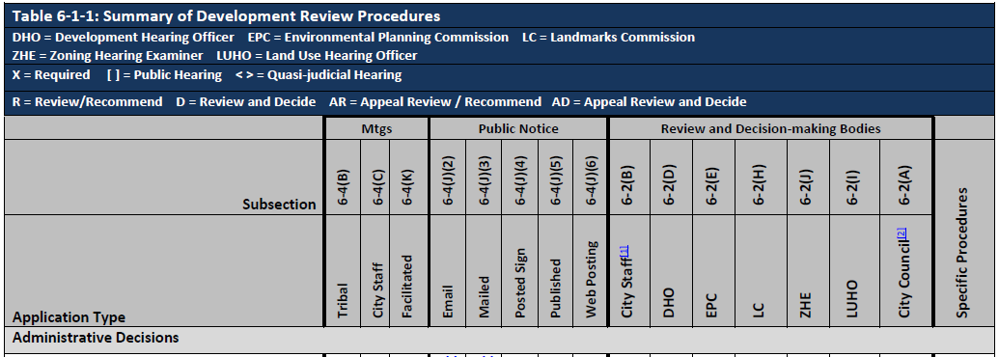
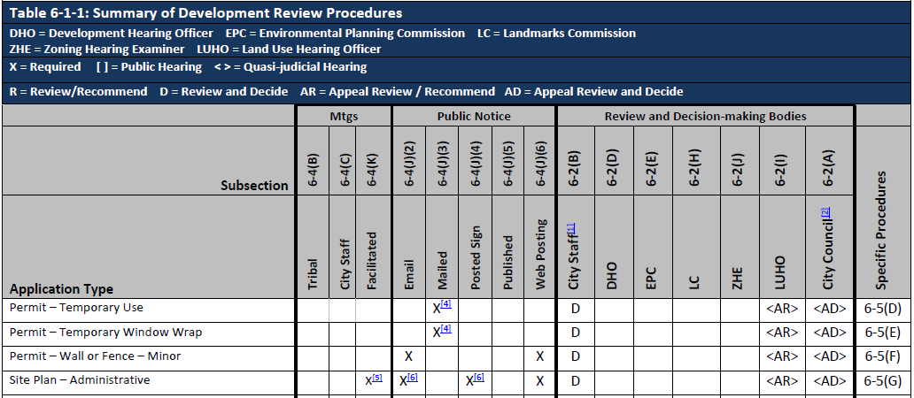
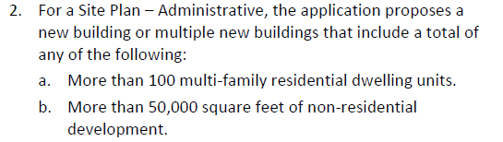
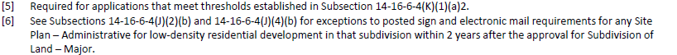
Table 6-1-1
6-4(K)(1)(a)2

Slide 19
Pre-submittal Tribal meeting
6-4(B)
Subsection | 6-4(B) | 6-2(B) | 6-2(D) |  | 6-2(E) | Specific Procedures
Application Type | Tribal | City Staff | DHO |  | EPC
Administrative Decision
Archaeological Certificate | X | D |  |  |  | 6-5(A)
Decisions Requiring a Public Hearing
Master Development Plan | X | R |  |  | <D> | 6-6(F)
Site Plan – EPC | X | R |  |  | <D> | 6-6(I)
Subdivision of Land – Minor | X | R | <D> | <D> |  | 6-6(K)
Subdivision of Land – Major | X | R | <D> | <D> |  | 6-6(L)
Policy Decisions
Zoning Map Amendment – EPC | X | R |  |  | <D> | 6-7(G)
Zoning Map Amendment – Council | X | R |  |  | <R> | 6-7(H)
Mailed / emailed offer of meeting to tribal representatives
Timing
Tribal reps have 30 days to respond yes/no
Meeting must be scheduled w/in 30 days of yes
Facilitated by neutral 3rd party
Report emailed to all who participated
Applicant responds to discussion/concerns in submittal
https://www.cabq.gov/planning/codes-policies-regulations/integrated-development-ordinance-1/pre-submittal-tribal-meeting-request

Slide 20
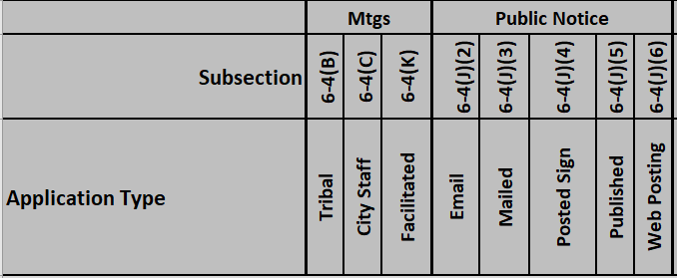
Public Notice
https://www.cabq.gov/planning/urban-design-development/public-notice
Before application
Emailed notice to Neigh. Assoc/Coalitions
Mailed notice to Property Owners
Table 6-1-1
6-4(J)2
6-4(J)3
After Application
Posted Sign (Applicant)
Published notice (CABQ)
[i.e., legal ad in ABQ Journal]
Web Posting (CABQ)
6-4(J)4
6-4(J)5
Coming in September: ABQ-PLAN Online Case Tracking
https://cityofalbuquerquenm-energovweb.tylerhost.net/apps/selfservice#/home
6-4(J)6

Slide 21
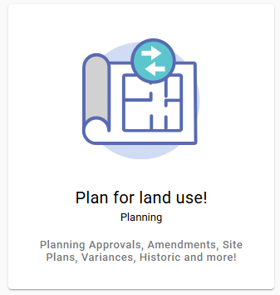
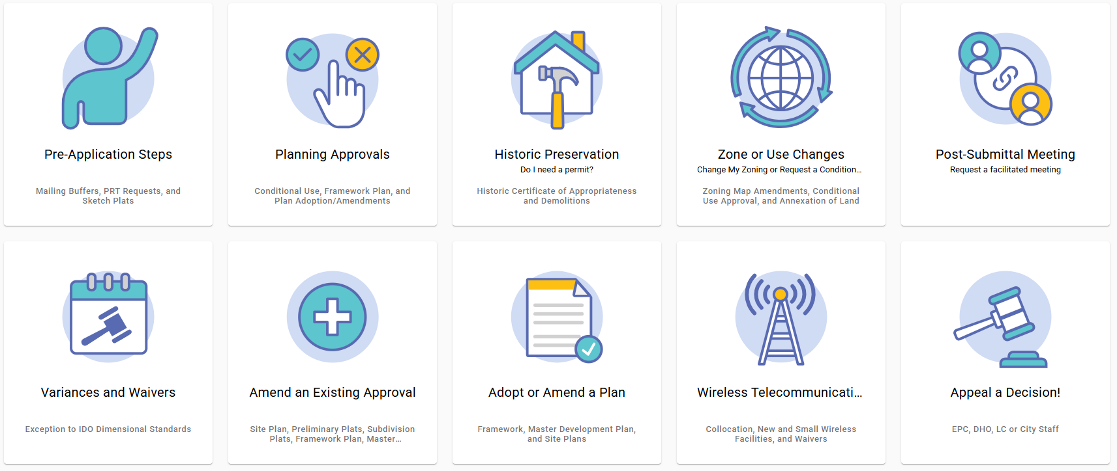
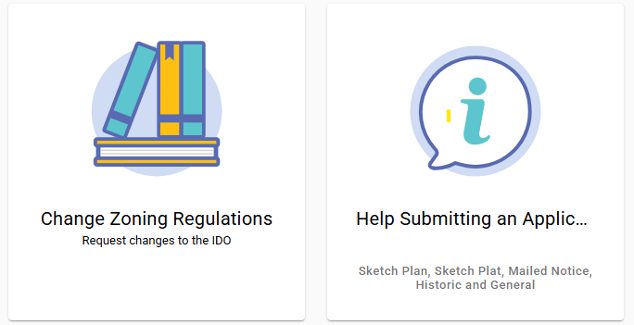
ABQ-PLAN
https://www.cabq.gov/abq-plan

Slide 22
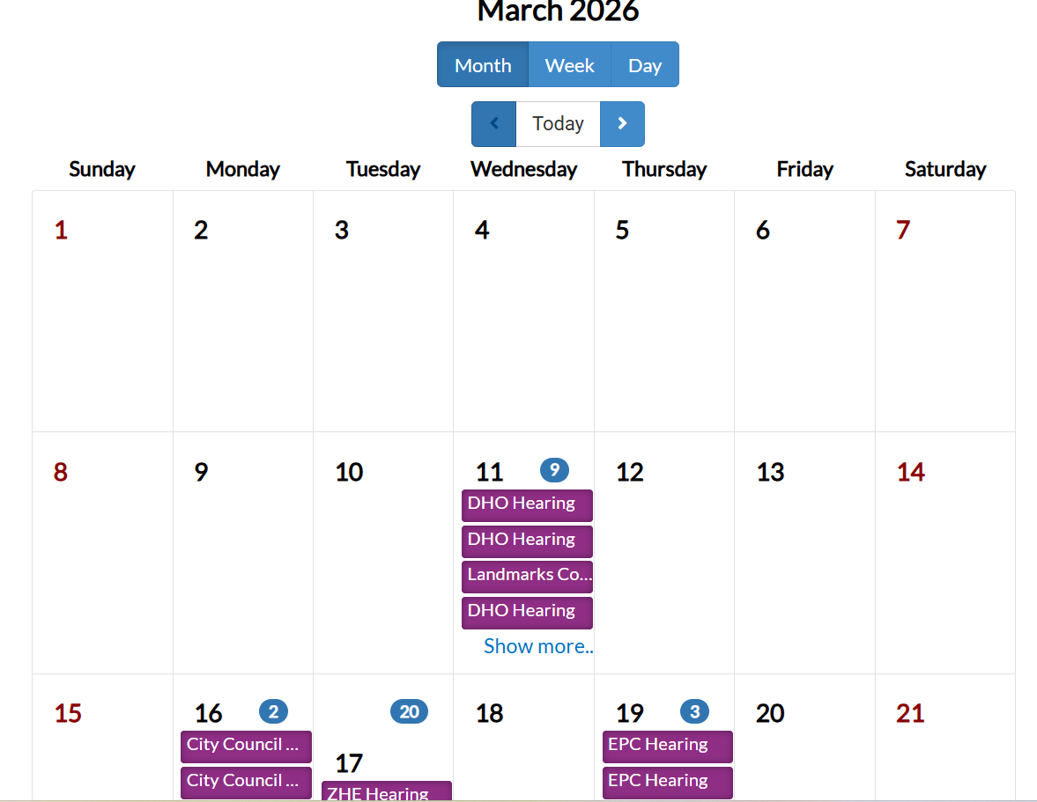
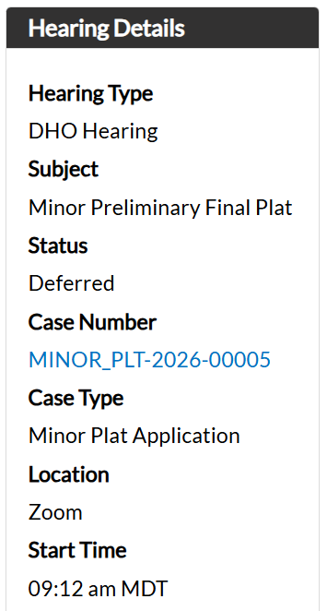
ABQ-PLAN

Slide 23
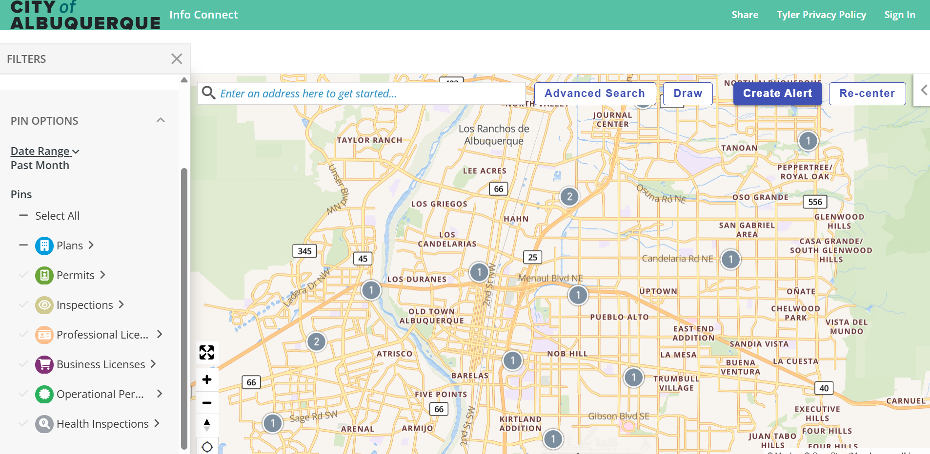
ABQ-PLAN

Slide 24


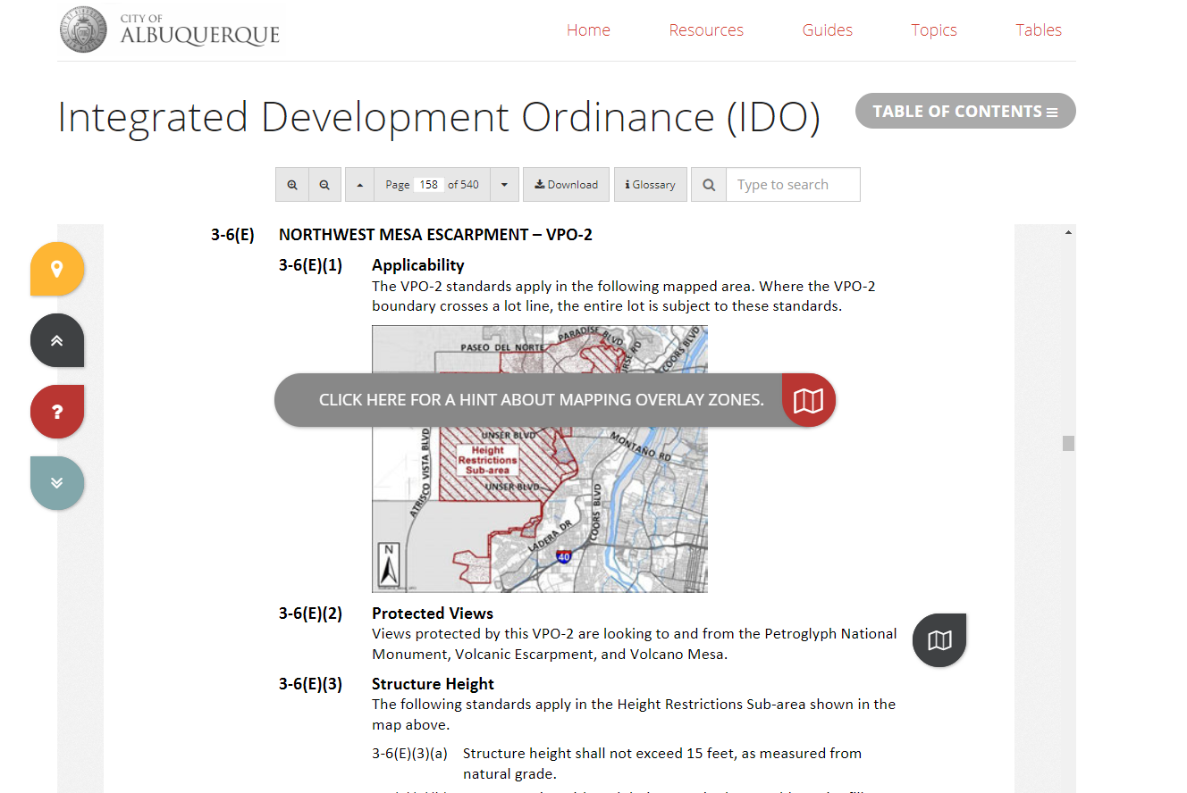
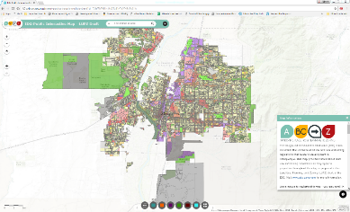



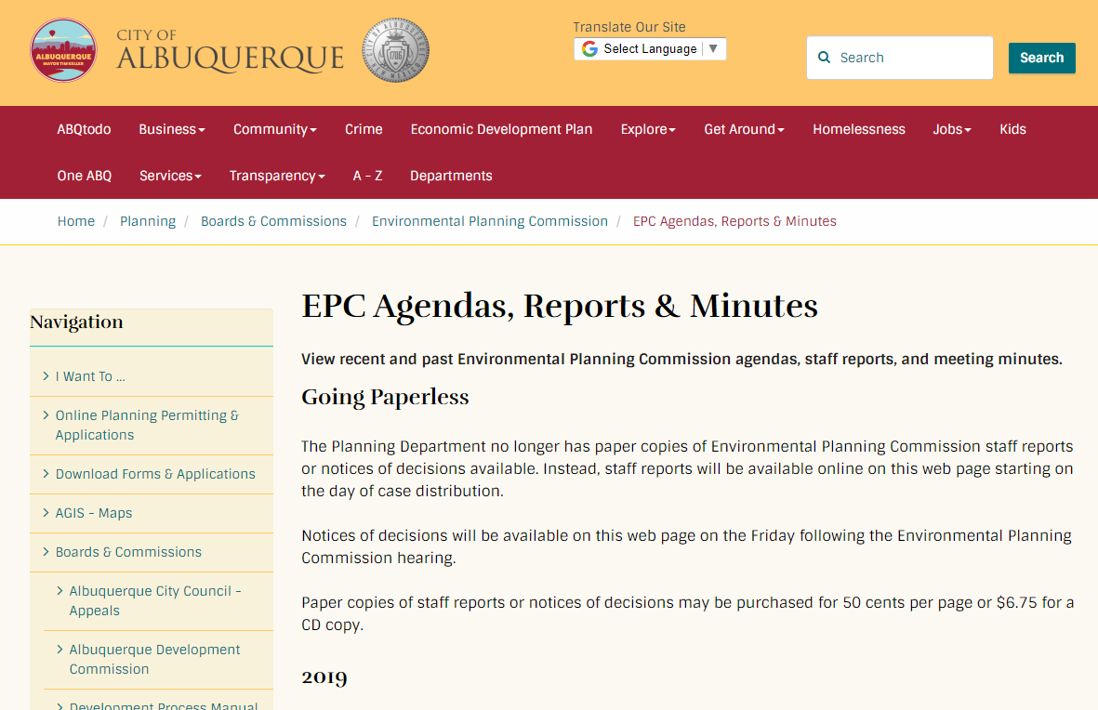
Interactive IDO
IDO Zoning Map
Resources
abq-zone.com
tinyurl.com/idozoningmap
Mikaela Renz-Whitmore
Urban Design + Dev. Division Manager
mrenz@cabq.gov
Need Help?
abctoz@cabq.gov
devhelp@cabq.gov
ABC Comp Plan
Planning Webpage
compplan.abq-zone.com
cabq.gov/planning

