Slide 1

Integrated Development Ordinance
IDO Online
https://ido.abq-zone.com
UNM SAAP
February 2026
Site Plans
Mikaela Renz-Whitmore
Division Manager
mrenz@cabq.gov

Slide 2

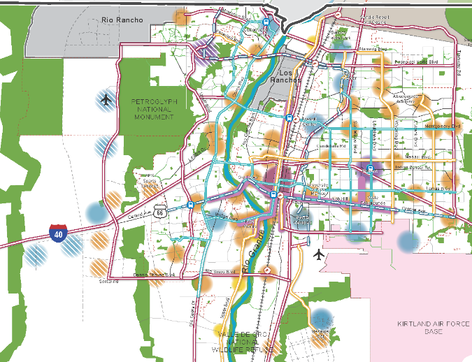
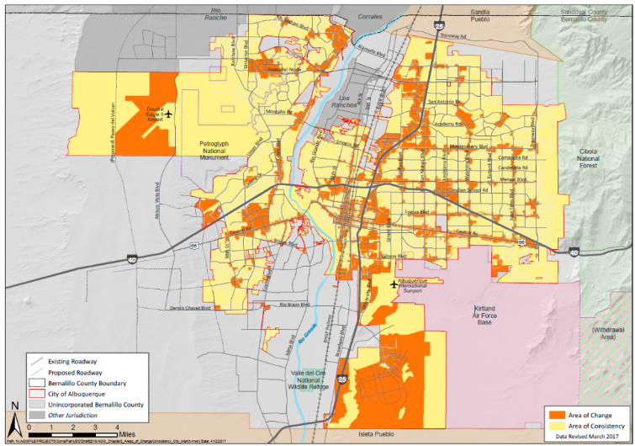
Planning + Zoning
ABC Comprehensive Plan
Integrated development ordinance
What we want + why:
Where to direct growth
What to protect
What actions to take
How to measure progress
How to get there:
Tailored rules
Centers + Corridors
Areas of Consistency
Overlay Zones
Special places
Transitions / Edge Protections
Between Areas of Change + Consistency
Next to neighborhoods
Policies
Vision
Centers
&
Corridors
Areas of Change
&
Consistency
Regulations
compplan.abc-zone.com
ido.abc-zone.com
Notes:
The WHY and the HOW

Slide 3
Finding the balance
Protecting
Neighborhoods, special places,
& City open space
Incentivizing
High-quality development
in appropriate areas

Slide 4
Finding the balance
Tailored
Rules for small areas
Citywide
Standardized rules
Additional complexity
Harder to enforce
Less complexity
Easier to enforce

Slide 5
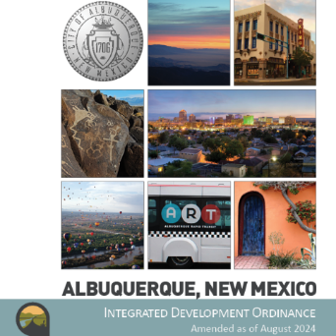
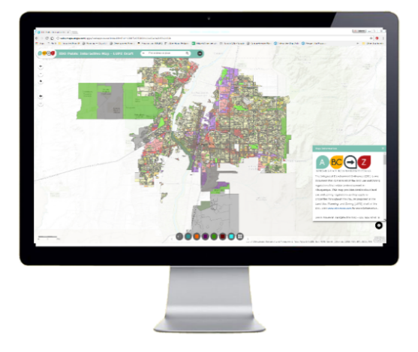

structure
1. General Provisions
Zone Districts
Overlay Zones
4. Use Regulations
Allowable Use Table
Use-specific Standards
Development Standards
Dimensional Standards Tables
General Regulations
6. Administration & Enforcement
7. Definitions & Acronyms
https://abq-zone.com
IDO Zoning Map
Uses
Zones
Standards
Processes
https://tinyurl.com/IDOzoningmap

Slide 6

Due Diligence
What’s the zoning on this property?
Is it in an overlay zone?
What use or uses will be on this property?
Is the use allowed in this zone?
In this area? Any special regs?
What are the development standards?
In this zone?
In this area? Any special regs?
What is the review/decision process?
In this area? Any special procedures?
Part 2/3
https://abq-zone.com
IDO Zoning Map
Uses
Zones
Standards
Part 4
Part 5
Processes
https://tinyurl.com/IDOzoningmap
Part 6

Slide 7

Hierarchy of rules
Overlay Zones
Character, Historic, View Protections
Context
Incentives
Zoning
Residential
Mixed-use
Non-residential
Edge buffers
Centers & Corridors
Small-area & Area of Consistency rules
Distance separations
Proximity to residential
Planned Development
Development types
Uses
Building design standards
Edge buffers
https://tinyurl.com/CABQ-IDO-12-2022
IDO Zoning Map
https://tinyurl.com/IDOzoningmap
Notes:
Improved description of how rules are applied in Part 1. (Section 14-16-1-8)
Any update to improve quality standard citywide WON’T apply to tailored standard. (Sometimes that’s good, sometimes that’s not. Need to review carefully!)
Tradeoff is additional complexity for extra protections.
Zoning is not easy, but it IS more predictable now under the IDO.

Slide 8
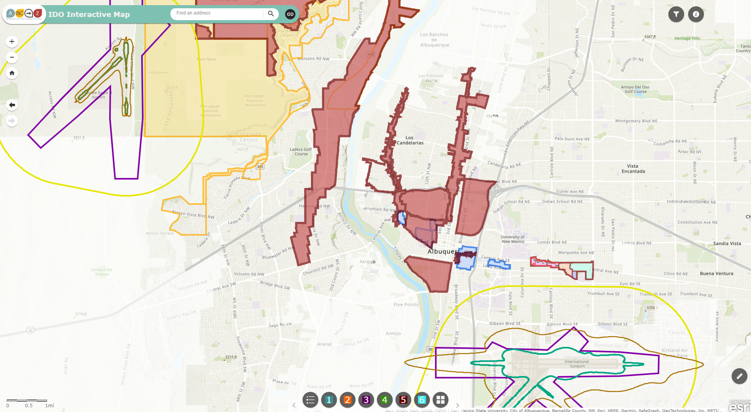
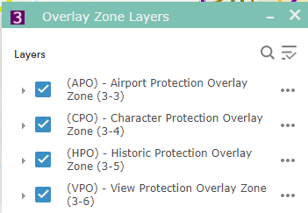



overlay zones
Part 3
ido.abq-zone.com
https://tinyurl.com/IDOzoningmap

Slide 9

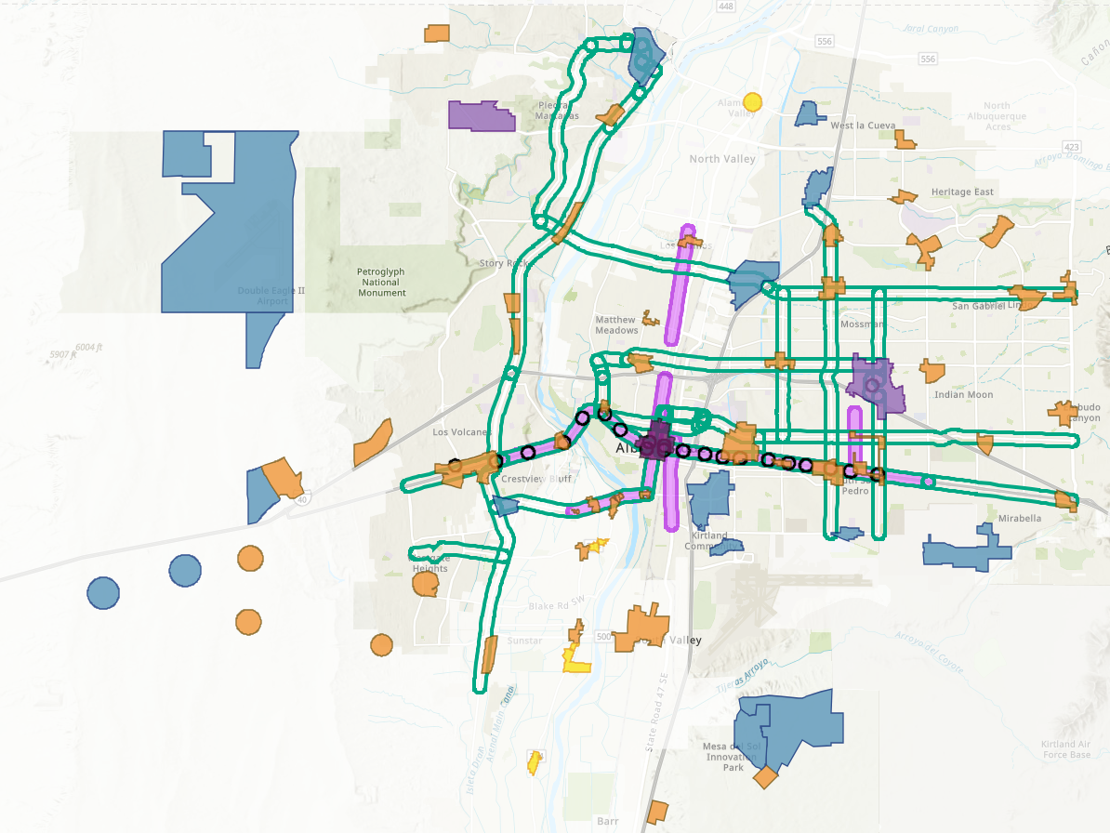

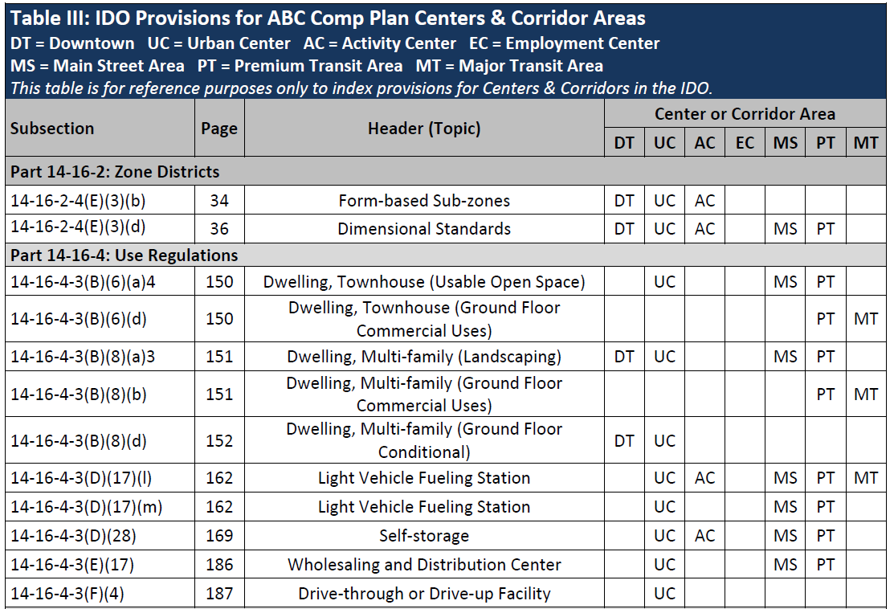

Implementing the Comp Plan
Incentives:
Higher building heights
Lower parking requirements
Development Standards:
More building design & buffering requirements
More walkable site design requirements
Centers +
Corridors
Table III
https://tinyurl.com/IDOzoningmap
DT = Downtown
UC = Urban Center
AC = Activity Center
EC = Employment Center
MS = 660 feet from Main Street
PT = 660 feet from Premium Transit station
MT = 660 feet from Major Transit
Center/Corridor
Index

Slide 10
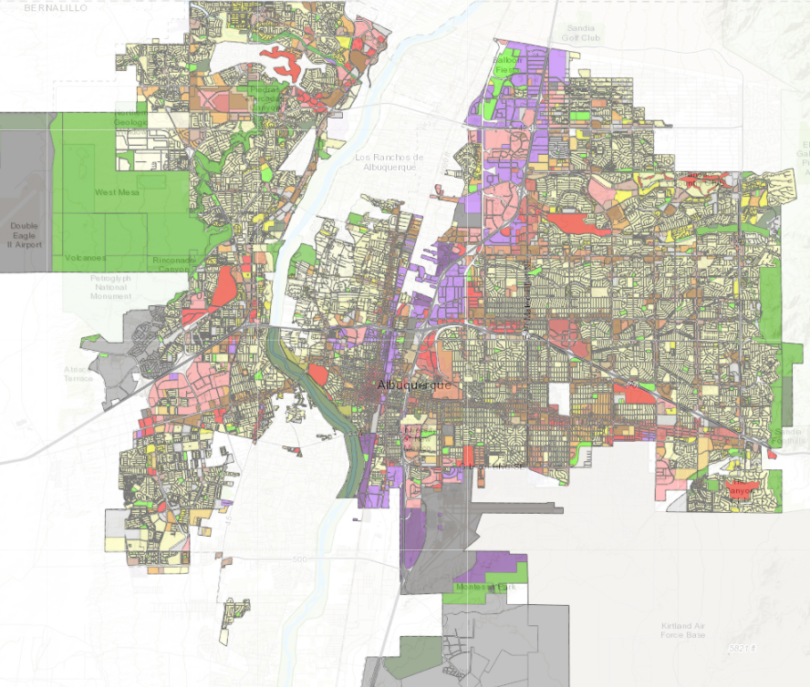
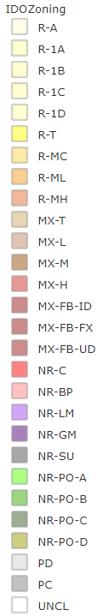
Zoning
Residential
Zone Districts
Mixed-use
Zone Districts
Non-residential
Zone Districts
Planned Development
Zone Districts
https://tinyurl.com/IDOzoningmap
Unclassified

Slide 11
Table 4-2-1
Table 4-2-1: Allowable Uses P = Permissive Primary C = Conditional Primary A = Permissive Accessory CA = Conditional Accessory CV = Conditional if Structure Vacant for 5+ years T = Temporary CT = Conditional Temporary Blank Cell = Not Allowed
Zone District >> Land Uses | Residential |  |  |  |  |  | Mixed-use |  |  |  | Non-residential |  |  |  |  |  |  |  | Use-specific Standards
 | R-A | R-1 | R-MC | R-T | R-ML | R-MH | MX-T | MX-L | MX-M | MX-H | NR-C | NR-BP | NR-LM | NR-GM | NR-SU | NR-PO
 |  |  |  |  |  |  |  |  |  |  |  |  |  |  |  | A | B | C
PRIMARY USES THAT MAY BE ACCESSORY IN SOME ZONE DISTRICTS
RESIDENTIAL USES
Household Living
Group Living
CIVIC AND INSTITUTIONAL USES
COMMERCIAL USES
Agriculture and Animal-related
Food, Beverage, and Indoor Entertainment
Lodging
Motor Vehicle-related
Offices and Services
Outdoor Recreation and Entertainment
Retail Sales
Transportation
INDUSTRIAL USES
Manufacturing, Fabrication, and Assembly
Telecommunications, Towers, and Utilities
Waste and Recycling
Wholesaling and Storage
ACCESSORY AND TEMPORARY USES
ACCESSORY USES
TEMPORARY USES
7-1
Definitions
IDO Part 4
Allowable Uses
Use-
specific
Standards
Distance Separations
From Residential Uses: Liquor retail, Heavy Manufacturing, etc.
From Open Space: Car wash, Gas stations, Manufacturing, etc.
Between uses: Group Homes, Pawn Shops, Bail Bonds, etc.
Notes:
Between uses: Group Homes, Pawn Shops, Bail Bonds, Payday Loans, etc.
From Residential Uses: Retail Liquor, Heavy/Special Manufacturing, Auto repair, etc.

Slide 12


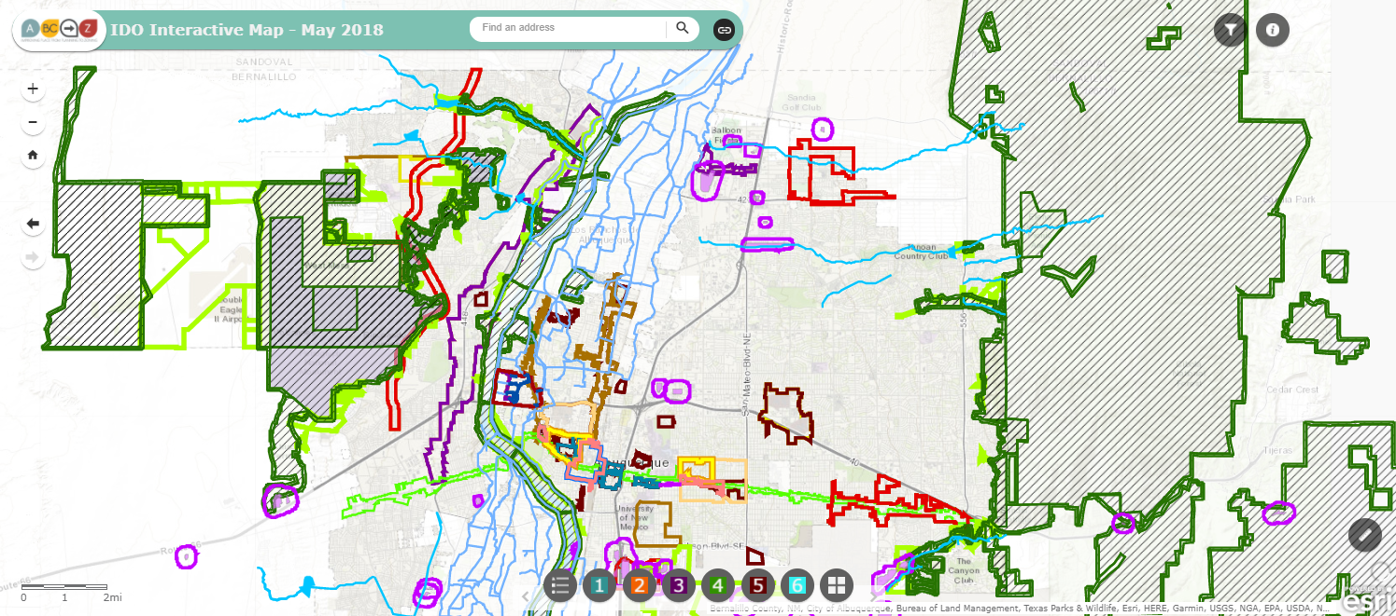

IDO Part 5
Development Standards
Context Rules
Rules that set quality standards for development
5-1 Dimensional Standards
5-2 Site Design + Sensitive Lands
5-3 Access + Connectivity
5-4 Subdivision of Land
5-5 Parking + Loading
5-6 Landscaping, Buffering, + Screening
5-7 Walls + Fences
5-8 Outdoor + Site Lighting
5-9 Neighborhood Edges
5-10 Solar Access
5-11 Signs
https://tinyurl.com/CABQ-IDO-12-2022
https://tinyurl.com/IDOzoningmap
Notes:
Between uses: Group Homes, Pawn Shops, Bail Bonds, Payday Loans, etc.
From Residential Uses: Retail Liquor, Heavy/Special Manufacturing, Auto repair, etc.

Slide 13
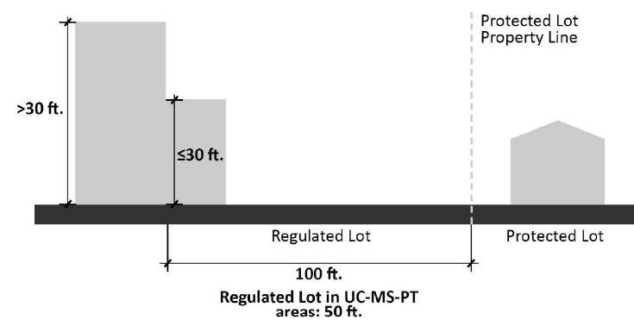
Limits on Density
Part 5
Citywide
CONTEXTUAL
Building height
Required usable open space
Required parking
Required landscaping
Building design standards
Use-specific standards
Distance from residential
Neighborhood Edges
Edge Buffers
Major Public Open Space Edge
Notes:
Areas of Change and Consistency for Edge Buffers

Slide 14
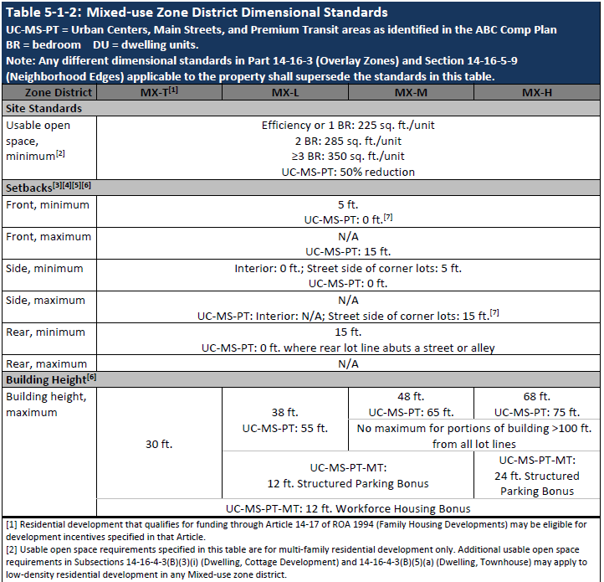
Dimensional Standard Tables: By Zone Categories
Acronyms
Zones
(By intensity)
5-1
Standards
Center Provisions
Notes:
Be ready to define terms

Slide 15
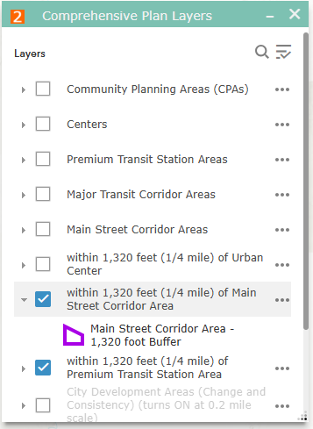
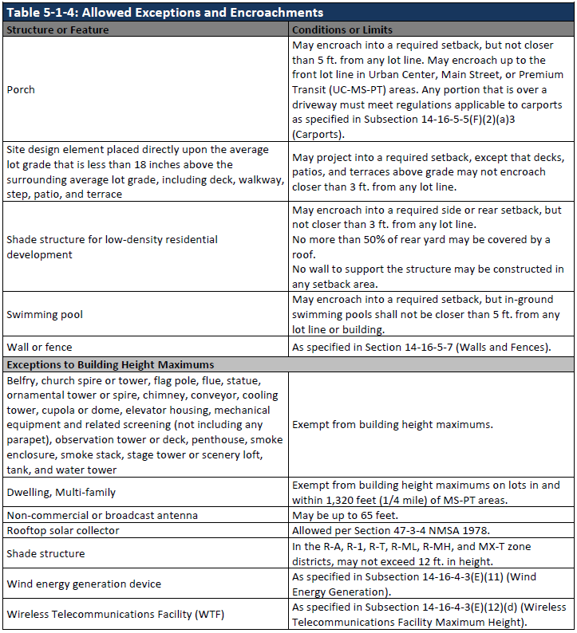
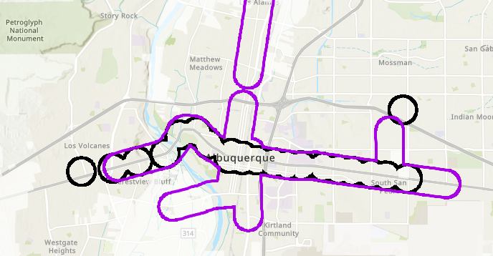
exceptions
Apartments
https://tinyurl.com/IDOzoningmap

Slide 16
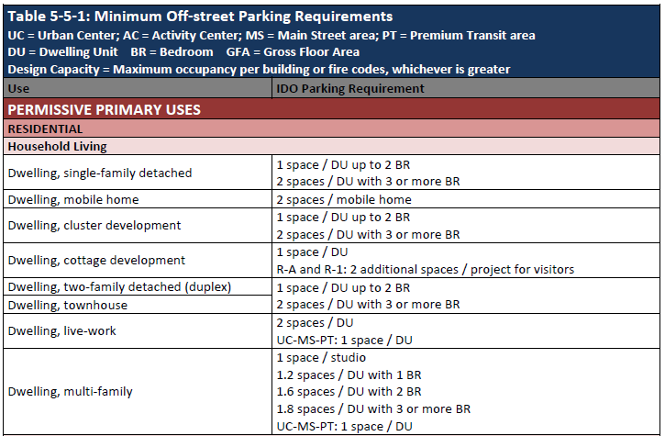
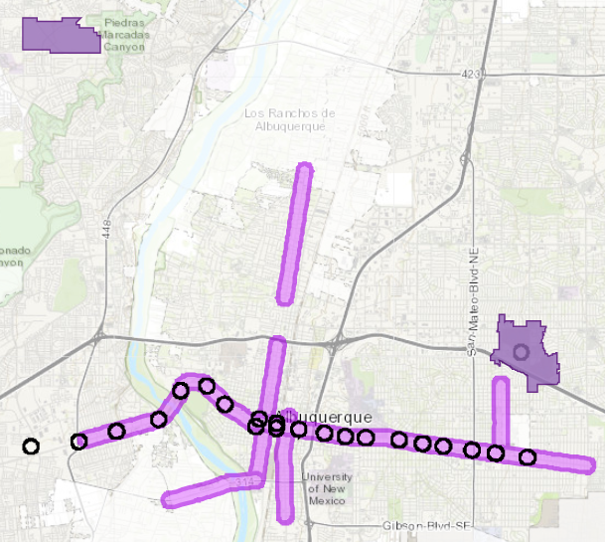
Off-street parking
Table 5-5-1
https://tinyurl.com/IDOzoningmap
Table by Allowable Use
Reductions in Centers + Corridors
https://abq-zone.com
UC = Urban Center
MS = 660 feet from Main Street
PT = 660 feet from Premium Transit station

Slide 17
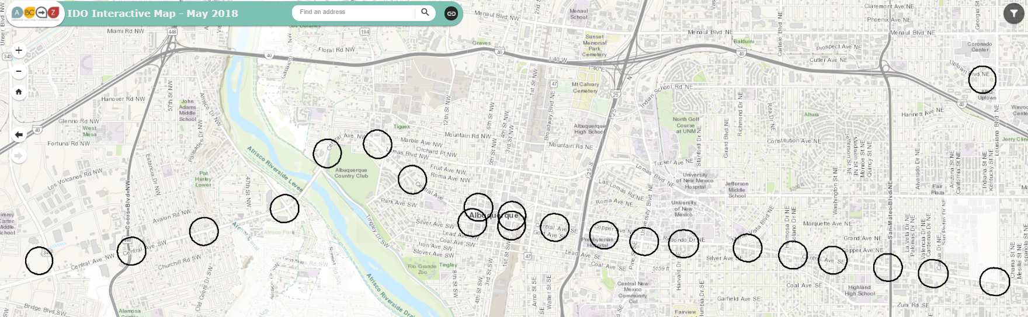
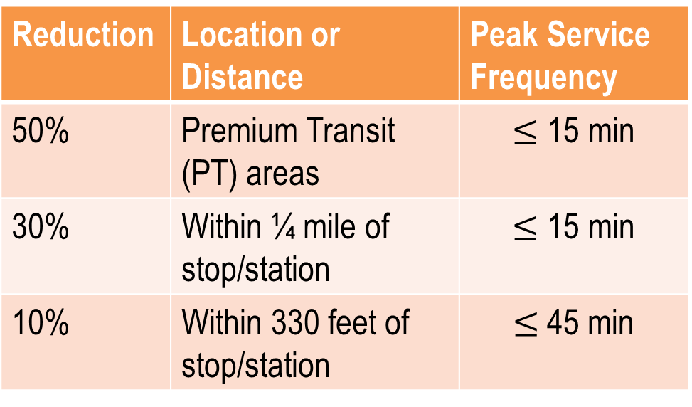
Off-street parking
Section 5-5(C)
Table by Allowable Use
Reductions for Transit
Reduction | Location or Distance | Peak Service Frequency
50% | Premium Transit (PT) areas | $≤$ 15 min
30% | Within ¼ mile of stop/station | $≤$ 15 min
10% | Within 330 feet of stop/station | $≤$45 min
Atrisco
https://abq-zone.com
Unser
Coors
Broadway
University
San Mateo
Louisiana
https://tinyurl.com/IDOzoningmap

Slide 18
standards
5-1 Dimensional Standards
5-2 Site Design + Sensitive Lands
5-3 Access + Connectivity
5-4 Subdivision of Land
5-5 Parking + Loading
5-6 Landscaping, Buffering, + Screening
5-7 Walls + Fences
5-8 Outdoor + Site Lighting
5-9 Neighborhood Edges
5-10 Solar Access
5-11 Signs
Part 5

Slide 19
Finding the Balance
Community Input
Early consultation
& more public notice
Streamlined Approval Process
More administrative review
Intent
If we get the rules right – and we need to continually work to get the rules right – and projects follow those rules, they get approved quickly.
Asking for exceptions means more notice, more public input, and a longer process.

Slide 20
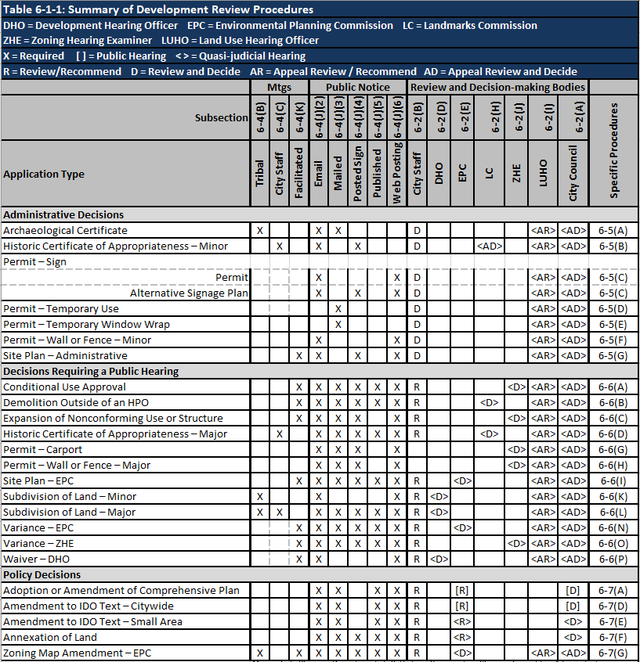



Review/decision
Table 6-1-1
Part 6
Predictable
Some notice.
Administrative review.
Decided on IDO rules only.
https://abq-zone.com
More notice.
Public hearing.
Decided on IDO rules only.
https://compplan-abq-zone.com
Lots of notice.
Public hearing.
Rules decided case-by-case.
Comp Plan AND IDO apply.
Flexible

Slide 21
Part 6
Finding the balance
Last Stage / Projects following rules:
Administrative decision
Some notice required
Rules decided annually during IDO update
Administrative Decisions
Early Stage / Projects requesting exceptions:
Public Hearing
Pre-application Tribal Meeting required
Lots of notice required
Rules decided annually during IDO Update
Decisions
Requiring a Public Hearing
Predictability
Discretionary Decisions:
Public Hearing
Pre-application Neighborhood Meeting required
Lots of notice required
Rules decided case-by-case (Comp Plan applies)
Policy Decisions
Flexibility
Notes:
Handout

Slide 22
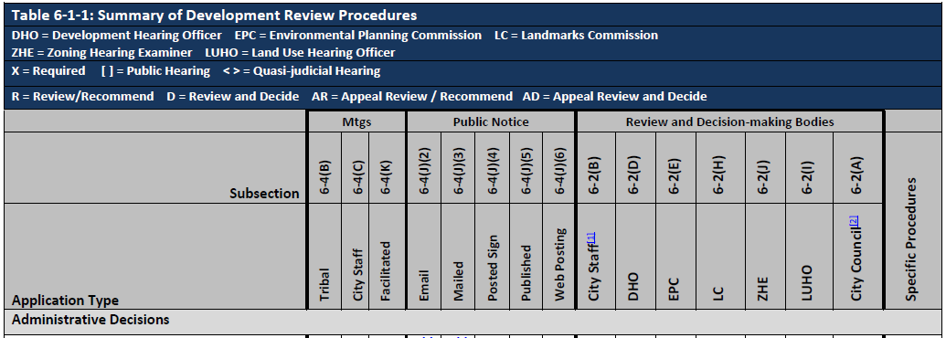
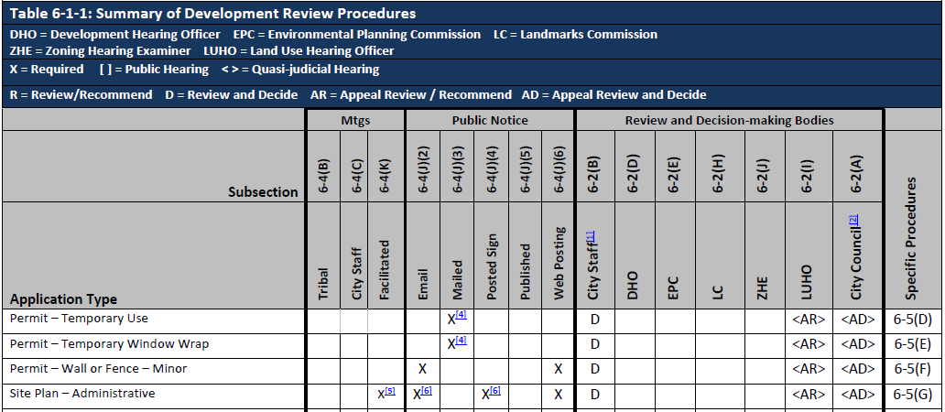

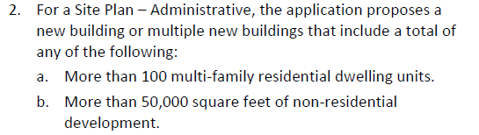
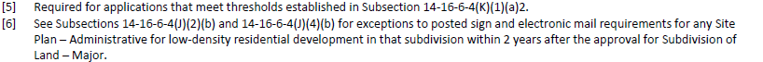
Table 6-1-1
6-4(K)(1)(a)2

Slide 23
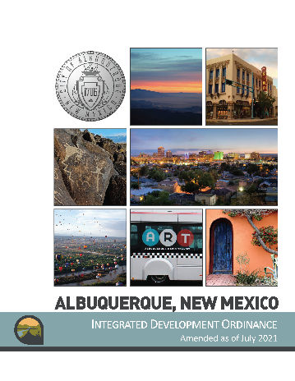

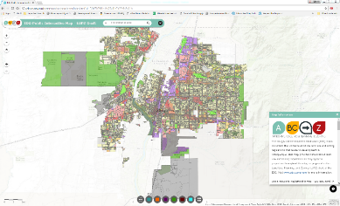

Get to Know Your IDO Training
IDO as of April 2025
Presentation (PDF)
Video
Presentation (PDF)
Video
https://abq-zone.com
2025 Update Webpage:
IDO Update Public Review Meetings
https://abq-zone.com/ido-updates-2025
IDO Zoning Map
tinyurl.com/idozoningmap

Slide 24
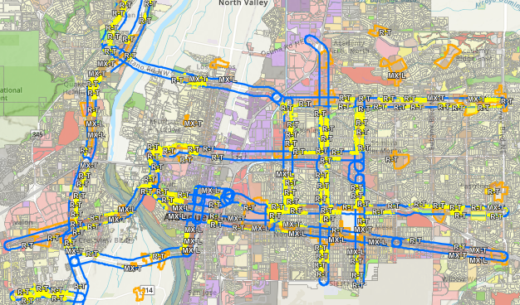
Increase Housing Choices
Take bold but gentle action to create more housing choices for families
Legislative Zoning Conversions for Major Transit (MT) and Activity Centers (AC)
R-1 → R-T – Adds townhouses as permissive (up to 3 units)
R-T → MX-T – Adds multi-family and non-residential as permissive
R-ML → MX-L – Adds non-residential as permissive
MT = 660 feet from Major Transit Corridor
AC = Activity Center
https://abq-zone.com/node/1937

Slide 25
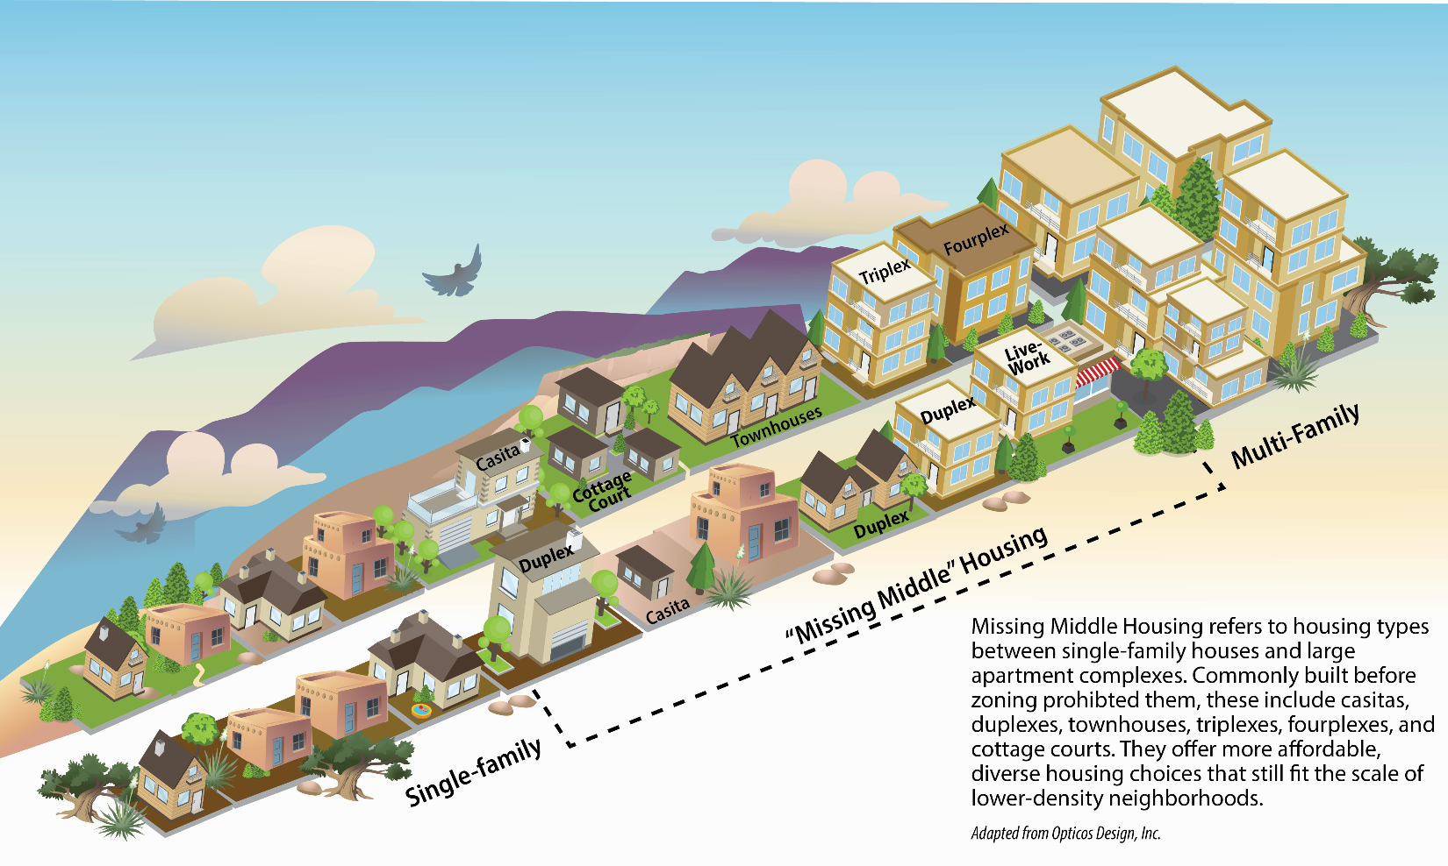
Increase Housing Choices
Take bold but gentle action to create more housing choices for families
Dormitory – Makes co-living permissive in R-ML and MX-T (already allowed in R-MH and the other Mixed-use zones)
Cottage courts – Allows multiple small single-family or duplexes citywide on lots 10,000+ s.f.
Duplex – Allows duplexes citywide in R-1
Townhouse – Allows townhouses citywide in R-1 (up to 3 units)
Accessory Dwelling Units (ADUs) / Casitas – Allows attached ADUs citywide
Safe Outdoor Space – Removes requirements for plumbing and 24/7 security

Slide 26
Lower Costs per Housing Unit
Require less land/parking to leave more money for constructing housing units
R-1 Dimensional Standards – Removes subzones with larger minimum lot sizes and setbacks
Accessory Dwelling Units (ADUs) / Casitas
Height
Changes maximum building height to 18 feet, or as tall as the primary structure, whichever is higher
Allows casitas constructed over a detached garage up to the allowed height of the zone district
Size: Changes maximum size to be a footprint of 750 s.f. to allow flexibility for lofts and 2-story casitas
Building Heights
R-ML and R-MH and Mixed Use Zone Districts
Adds a new tier of higher building height in Major Transit and Activity Centers
Bumps up building height in Urban Center, Premium Transit, and Main Street areas accordingly
Parking
Citywide Parking Minimums
Reduces minimum requirements for multi-family and adds a built-in reduction for workforce housing (1 space / DU)
Decreases parking minimums by 20% for most uses (some exceptions – like single-family).
Centers and Corridors:
Eliminates parking minimums
Reduces/establishes parking maximums for non-residential development only in Centers and Corridors
DT = Downtown
UC = Urban Center
AC = Activity Center
EC = Employment Center
MS = 660 feet from Main Street
PT = 660 feet from Premium Transit station
MT = 660 feet from Major Transit

Slide 27
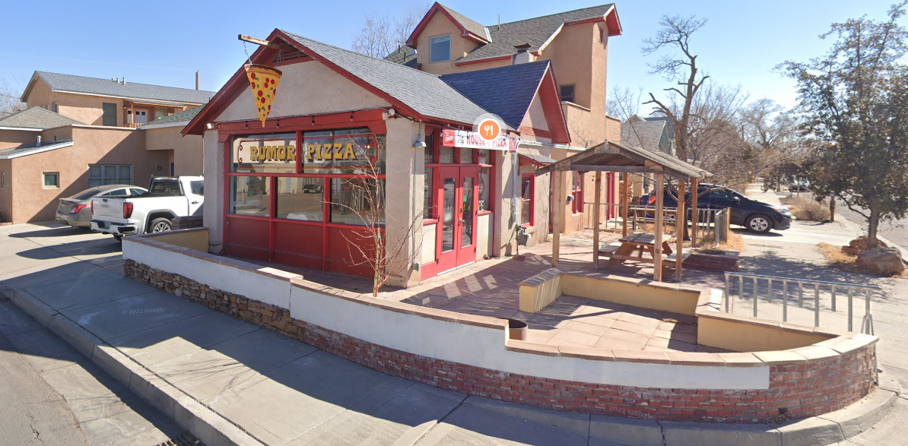
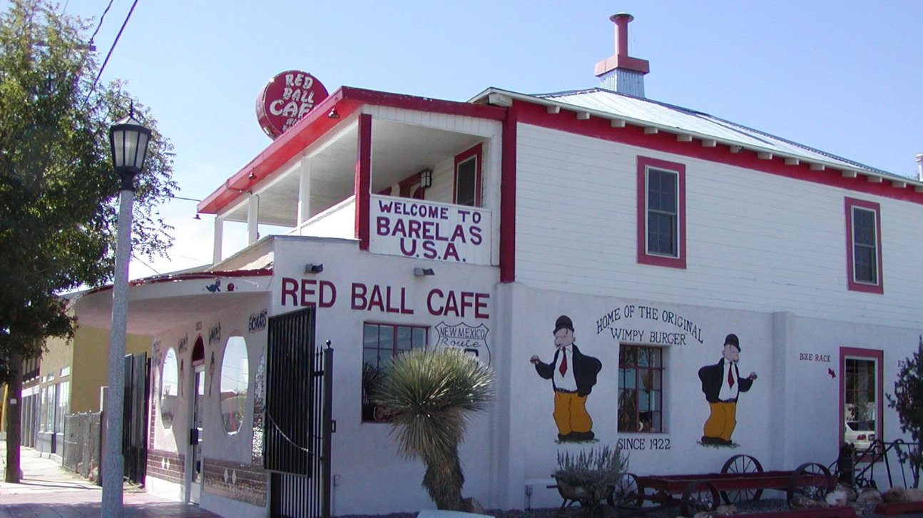
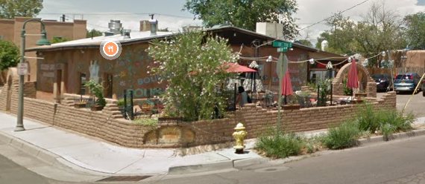
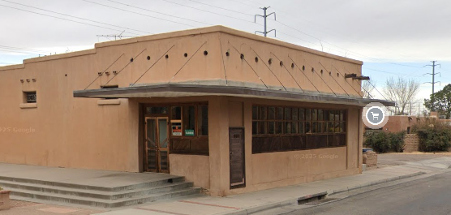
Allow Food near Neighborhoods
Create opportunities for small businesses, encourage walkability, and provide important daily goods such as food, household items, and medicine closer to the places where people
Bodegas / Tienditas: Allows retail, restaurant, grocery, and live-work on corner lots 5,000+ s.f. in residential zones
Conditional on local streets
Permissive on arterial / collectors
Not allowed to sell alcohol, cannabis, or nicotine

Slide 28
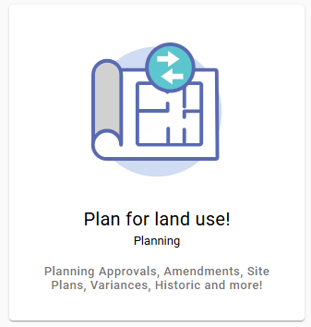
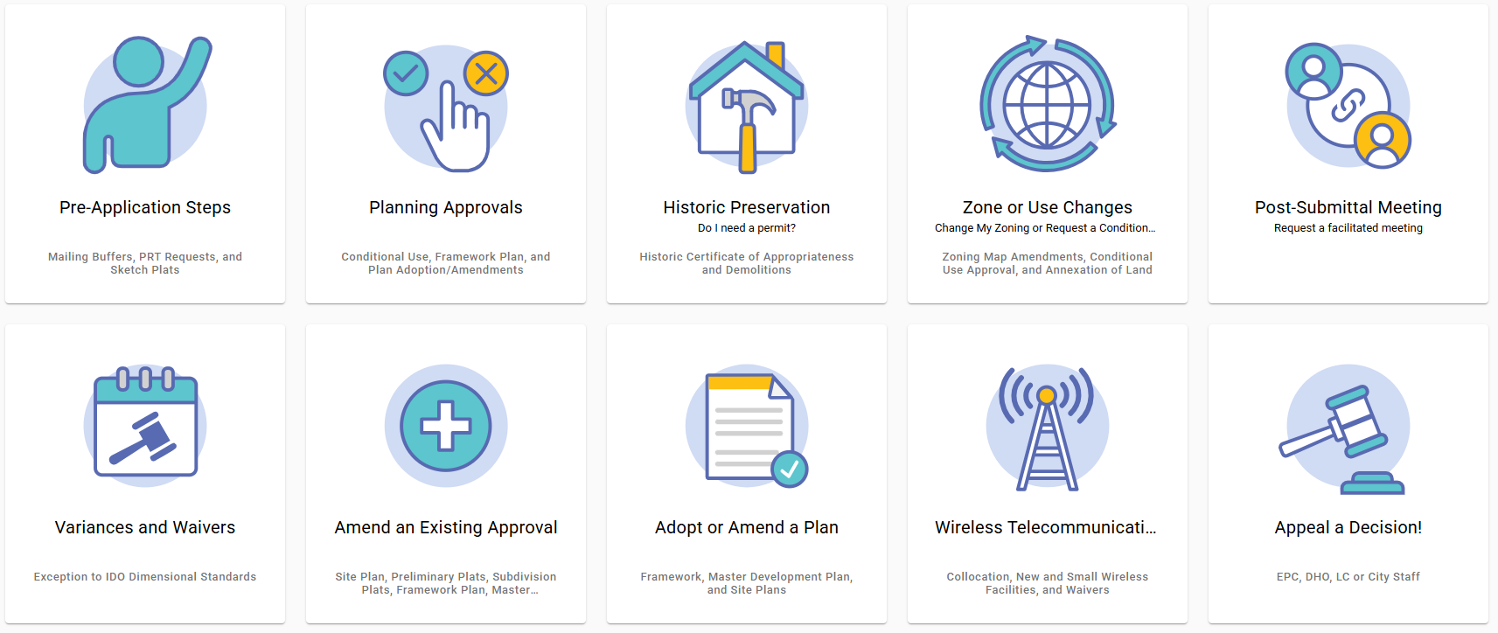
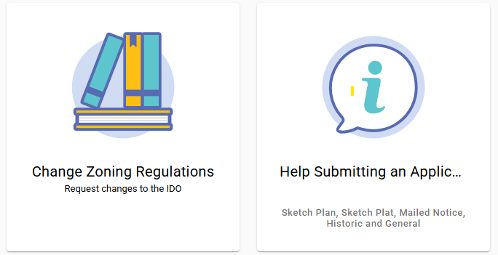
ABQ-PLAN
https://www.cabq.gov/abq-plan

Slide 29

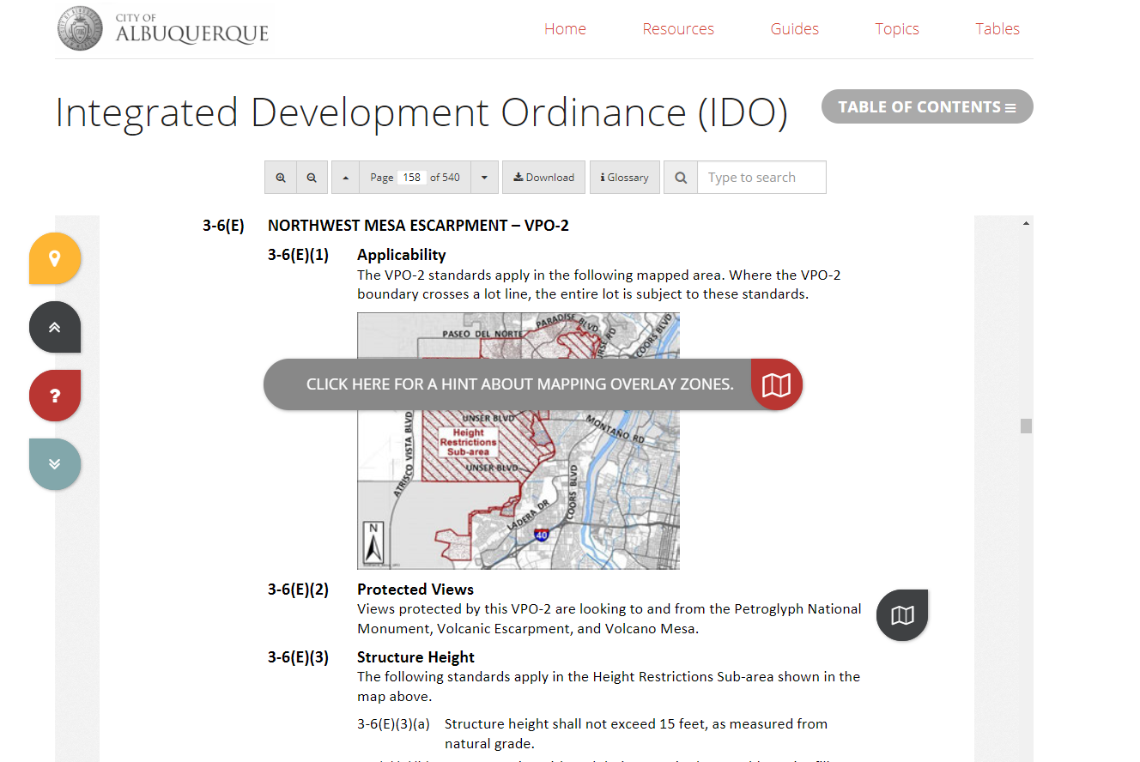


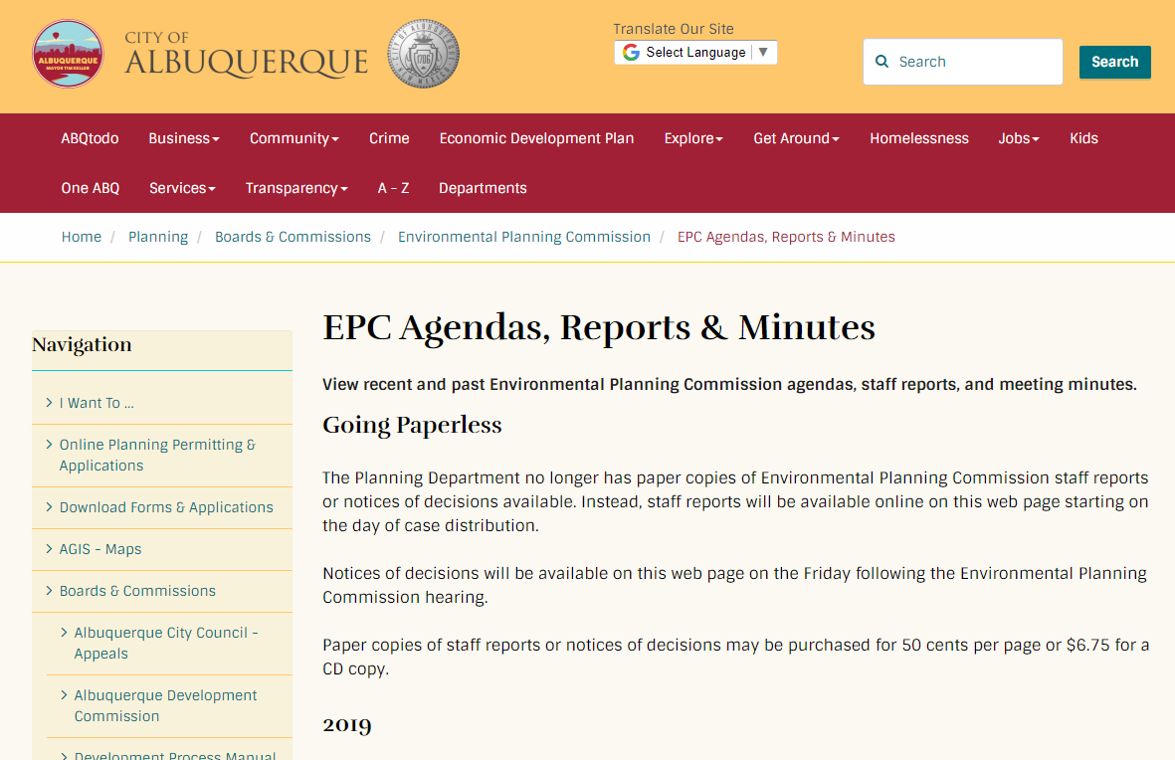
Interactive IDO
IDO Zoning Map
Resources
abq-zone.com
tinyurl.com/idozoningmap
Mikaela Renz-Whitmore
Urban Design + Dev. Division Manager
mrenz@cabq.gov
Kate Clark
Senior Planner
kclark@cabq.gov
Need Help?
abctoz@cabq.gov
devhelp@cabq.gov
ABC Comp Plan
Planning Webpage
compplan.abq-zone.com
cabq.gov/planning

