Slide 1
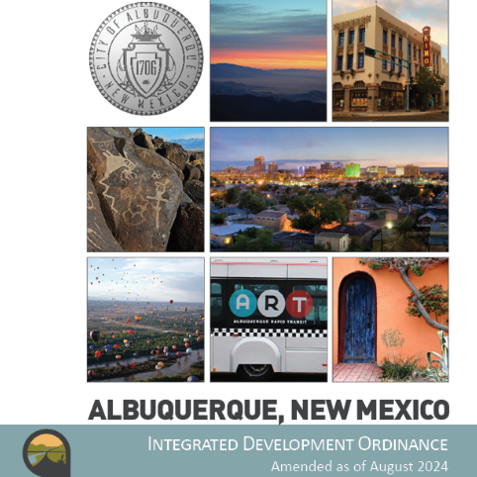
Integrated
Development
Ordinance
IDO as of August 2024
https://abq-zone.com
UNM SAAP
October 2024
Site Plans
Michael Vos
Principal Planner
mvos@cabq.gov

Slide 2

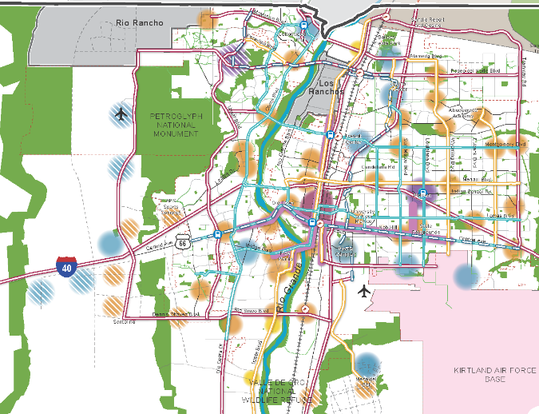
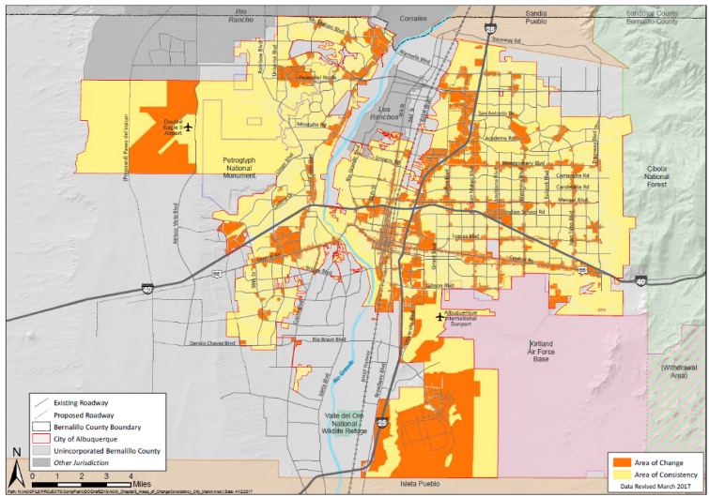
Planning + Zoning
ABC Comprehensive Plan
Integrated development ordinance
What we want + why:
  Where to direct growth
  What to protect
  What actions to take
  How to measure progress
How to get there:
  Tailored rules
    Centers + Corridors
    Areas of Consistency
    Overlay Zones
    Special places
  Transitions / Edge Protections
    Between Areas of Change + Consistency
    Next to neighborhoods
Policies
Vision
Centers
&
Corridors
Areas of Change
&
Consistency
Regulations
compplan.abq-zone.com
https://abq-zone.com
Notes:
The WHY and the HOW

Slide 3
Finding the balance
Protecting
Neighborhoods, special places,
& City open space
Incentivizing
High-quality development
in appropriate areas

Slide 4
Finding the balance
Tailored
Rules for small areas
Citywide
Standardized rules
Additional complexity
Harder to enforce
Less complexity
Easier to enforce

Slide 5

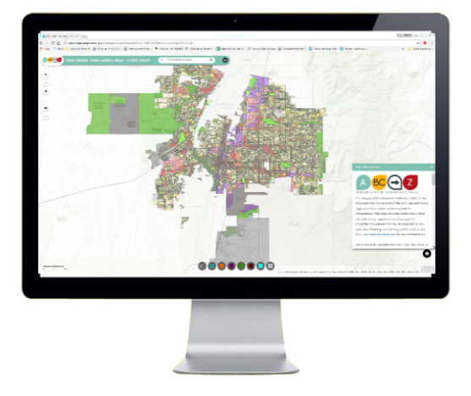

structure
1. General Provisions
Zone Districts
Overlay Zones
4. Use Regulations
Allowable Use Table
Use-specific Standards
Development Standards
      Dimensional Standards Tables
      General Regulations
6. Administration & Enforcement
7. Definitions & Acronyms
https://abq-zone.com
IDO Zoning Map
Uses
Zones
Standards
Processes
https://tinyurl.com/IDOzoningmap

Slide 6

Due Diligence
What’s the zoning on this property?
Is it in an overlay zone?
What use or uses will be on this property?
Is the use allowed in this zone?
In this area? Any special regs?
What are the development standards?
      In this zone?
      In this area? Any special regs?
What is the review/decision process?
In this area? Any special procedures?
Part 2/3
https://abq-zone.com
IDO Zoning Map
Uses
Zones
Standards
Part 4
Part 5
Processes
https://tinyurl.com/IDOzoningmap
Part 6

Slide 7

Levers for regulations
Hierarchy of Rules
Overlay Zones
Character, Historic, View Protections
Context
Incentives
Zoning
Residential
Mixed-use
Non-residential
Edge buffers
Centers & Corridors
Small-area & Area of Consistency rules
Distance separations
Proximity to residential
Planned Development
Development types
Uses
Building design standards
Edge buffers
1-8
https://abq-zone.com
IDO Zoning Map
https://tinyurl.com/IDOzoningmap
Notes:
Improved description of how rules are applied in Part 1. (Section 14-16-1-8)
Any update to improve quality standard citywide WON’T apply to tailored standard. (Sometimes that’s good, sometimes that’s not. Need to review carefully!)
Tradeoff is additional complexity for extra protections.
Zoning is not easy, but it IS more predictable now under the IDO.

Slide 8

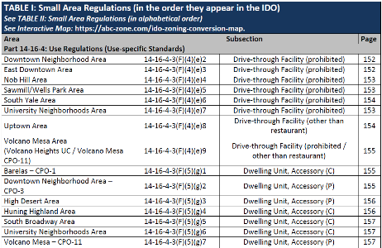

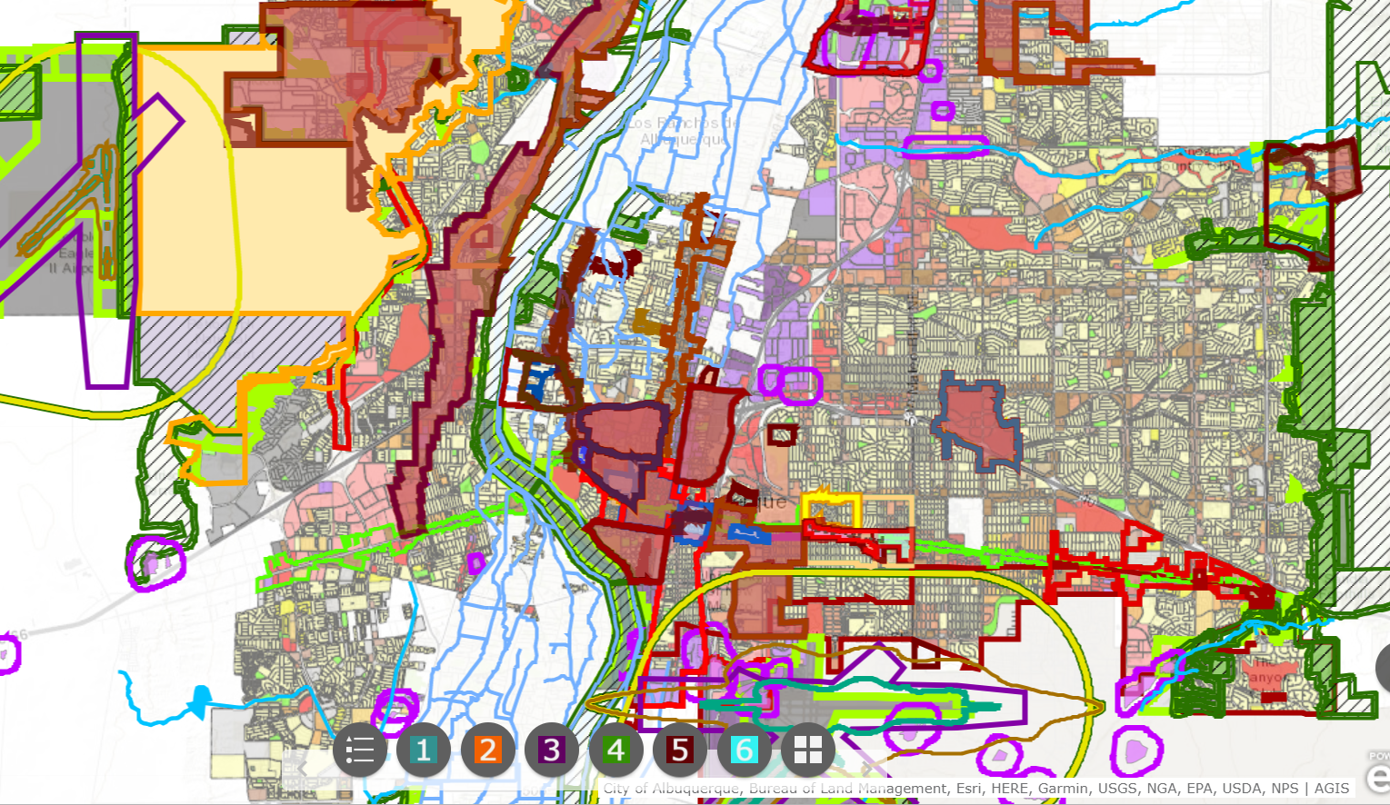

Tailored Protections
Table II
IDO Part 3
Overlay Zones
Table
I
Historic
View
Protection
Small Area
Indexes
Character
IDO Part 4
Allowable Uses
https://abq-zone.com
Use-
specific
Standards
IDO Zoning Map
IDO Part 5
Development Standards
Small Area
Standards
IDO Part 6
Admin & Enforcement
Review
Procedures
https://tinyurl.com/IDOzoningmap

Slide 9
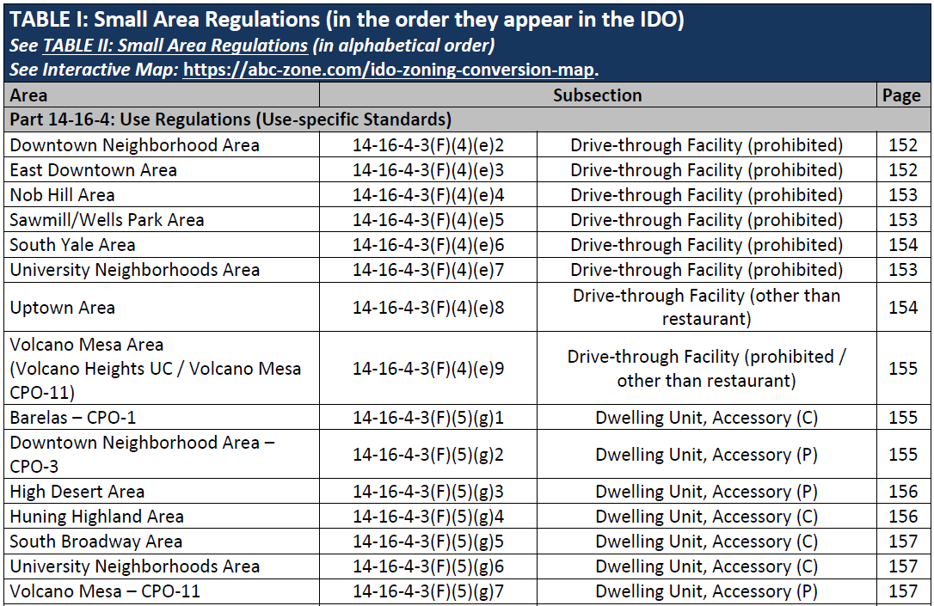
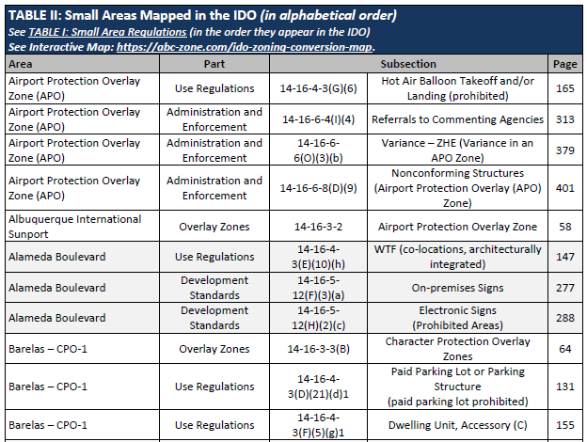
Small Areas
Table I: IDO Order
(for questions throughout the city)
Examples:
Where are drive-thoughs are prohibited in ABQ?
Where are ADUs with kitchens allowed in R-1?
Table II: Alphabetical Order
(for questions about 1 area)
Examples:
What are the special rules near the airport?
What special protections apply to Barelas?

Slide 10
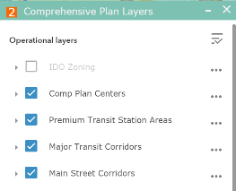
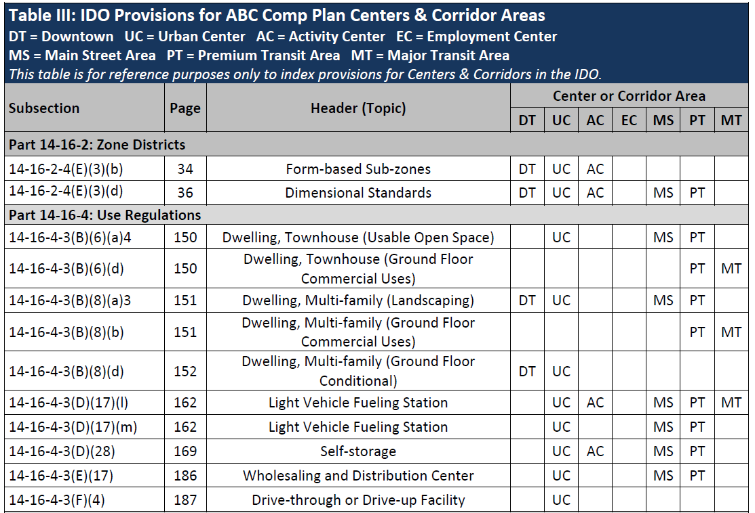

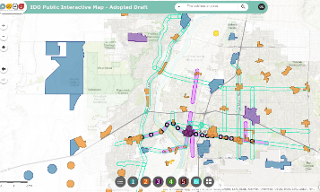




Implementing Centers & Corridors
Table III
https://abq-zone.com
IDO Zoning Map
Center/Corridor
Index
UC
EC
MT
MS
AC
DT
DT = Downtown
UC = Urban Center
AC = Activity Center
EC = Employment Center
MS = 660 feet from Main Street
PT = 660 feet from Premium Transit station
MT = 660 feet from Major Transit
https://tinyurl.com/IDOzoningmap

Slide 11
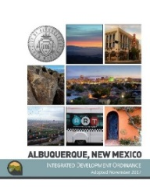

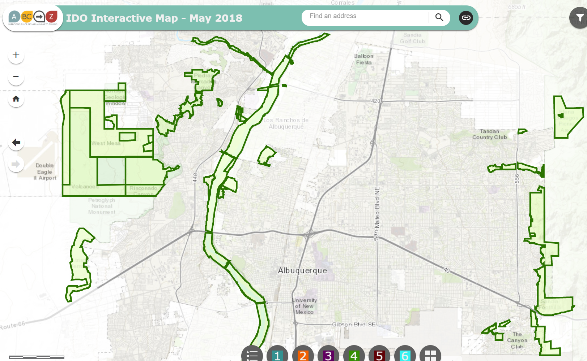

Major Public Open Space Edges
Section 5-2(J)
Single-loaded road required
  45 feet minimum OR landscaped buffer
Rules apply adjacent to MPOS
  Exception if separated by principal arterial or freeway (in which case w/in 330 feet rules apply)
  Existing vegetation can count toward landscape requirement
  For cluster development and multi-family, required to locate 25% of common open space or ground-level usable open space contiguous with MPOS
IDO Zoning Map
ido.abc-zone.com
https://tinyurl.com/IDOzoningmap

Slide 12
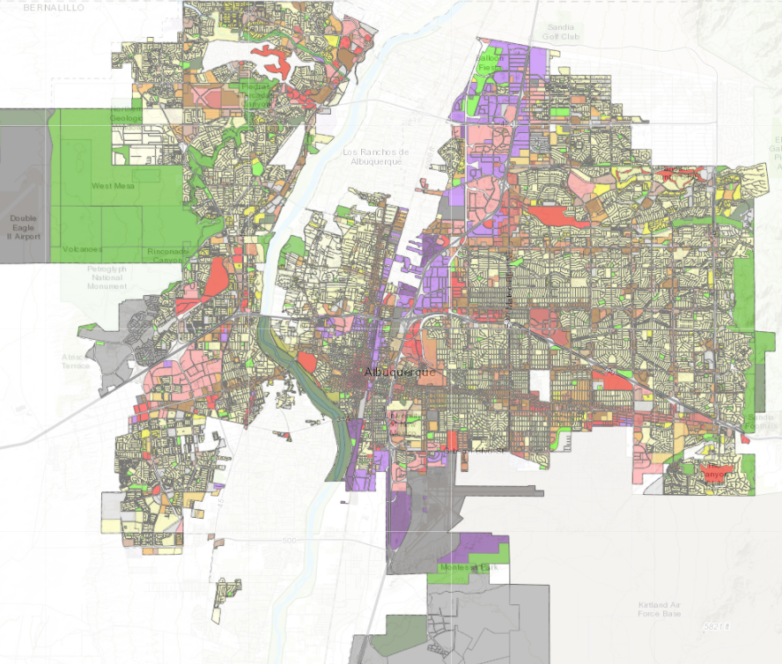
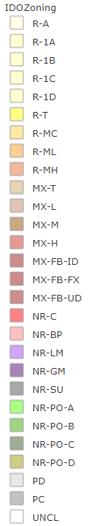
Zoning
Residential
Zone Districts
Mixed-use
Zone Districts
Non-residential
Zone Districts
Planned Development
Zone Districts
https://tinyurl.com/IDOzoningmap
Unclassified

Slide 13
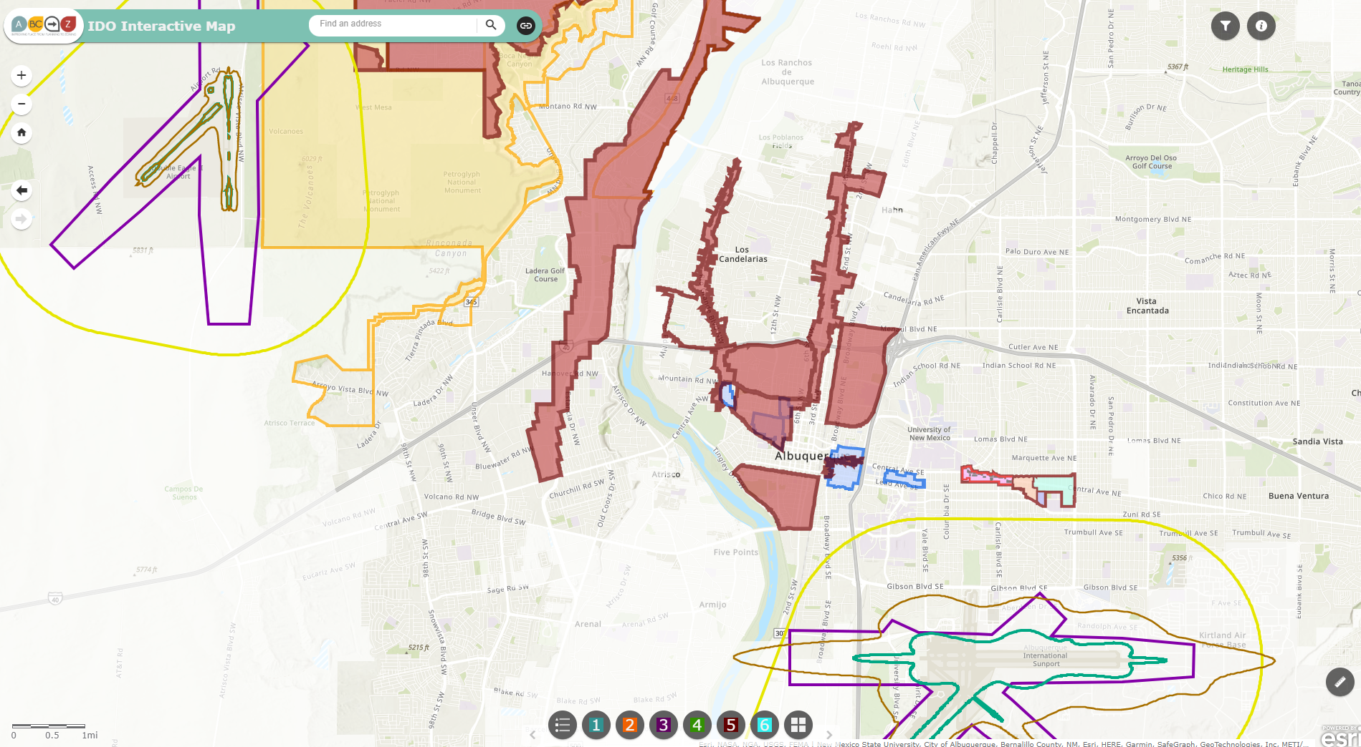
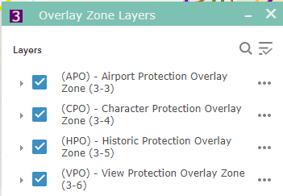

overlay zones
Part 3
ido.abc-zone.com
https://tinyurl.com/IDOzoningmap

Slide 14

IDO Part 4
Allowable Uses
Distance separations from residential and
Open Space areas and between uses
Use-
specific
Standards
https://abq-zone.com
IDO Zoning Map
  From Residential Uses: Liquor retail, Heavy Manufacturing, Auto repair, etc.
  From Open Space: Car wash, Gas stations, Manufacturing, Solid Waste, etc.
  Between uses: Group Homes, Pawn Shops, Bail Bonds, Payday Loans, etc.
https://tinyurl.com/IDOzoningmap
Notes:
Between uses: Group Homes, Pawn Shops, Bail Bonds, Payday Loans, etc.
From Residential Uses: Retail Liquor, Heavy/Special Manufacturing, Auto repair, etc.

Slide 15
Use table
Table 4-2-1: Allowable Uses P = Permissive Primary C = Conditional Primary A = Permissive Accessory CA = Conditional Accessory CV = Conditional if Structure Vacant for 5+ years T = Temporary CT = Conditional Temporary Blank Cell = Not Allowed
Zone District >> Land Uses | Residential |  |  |  |  |  | Mixed-use |  |  |  | Non-residential |  |  |  |  |  |  |  | Use-specific Standards
 | R-A | R-1 | R-MC | R-T | R-ML | R-MH | MX-T | MX-L | MX-M | MX-H | NR-C | NR-BP | NR-LM | NR-GM | NR-SU | NR-PO
 |  |  |  |  |  |  |  |  |  |  |  |  |  |  |  | A | B | C
PRIMARY USES THAT MAY BE ACCESSORY IN SOME ZONE DISTRICTS
RESIDENTIAL USES
Household Living
Group Living
CIVIC AND INSTITUTIONAL USES
COMMERCIAL USES
Agriculture and Animal-related
Food, Beverage, and Indoor Entertainment
Lodging
Motor Vehicle-related
Offices and Services
Outdoor Recreation and Entertainment
Retail Sales
Transportation
INDUSTRIAL USES
Manufacturing, Fabrication, and Assembly
Telecommunications, Towers, and Utilities
Waste and Recycling
Wholesaling and Storage
ACCESSORY AND TEMPORARY USES
ACCESSORY USES
TEMPORARY USES
Table
4-2-1
7-1
Definitions
Notes:
Delete USS in bottom of table

Slide 16
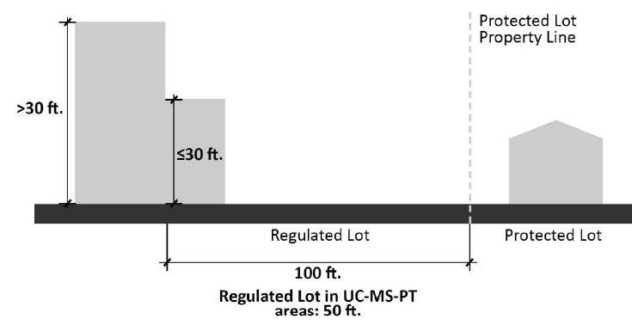
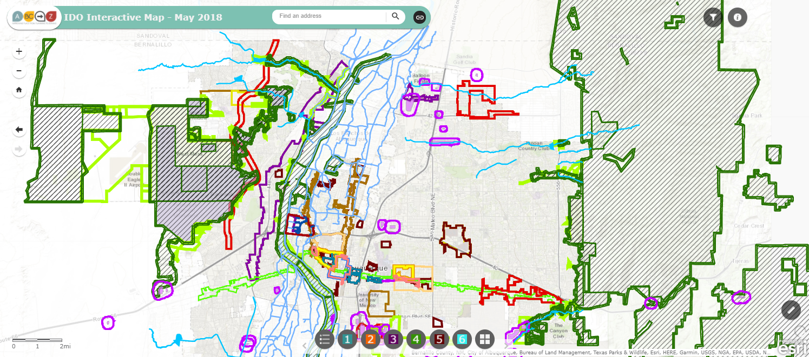
IDO Part 5
Development Standards
Context Rules
Rules that set quality standards for development
https://abq-zone.com
Transitions:
Neighborhood Edges, Edge Buffers
Major Public Open Space Edges
https://tinyurl.com/IDOzoningmap
Notes:
Between uses: Group Homes, Pawn Shops, Bail Bonds, Payday Loans, etc.
From Residential Uses: Retail Liquor, Heavy/Special Manufacturing, Auto repair, etc.

Slide 17
Limits on Density
Part 5
Citywide
CONTEXTUAL
Building height
Required usable open space
Required parking
Required landscaping
Building design standards
Use-specific standards
  Distance from residential
Neighborhood Edges
Edge Buffers
Major Public Open Space Edge
Notes:
Areas of Change and Consistency for Edge Buffers

Slide 18
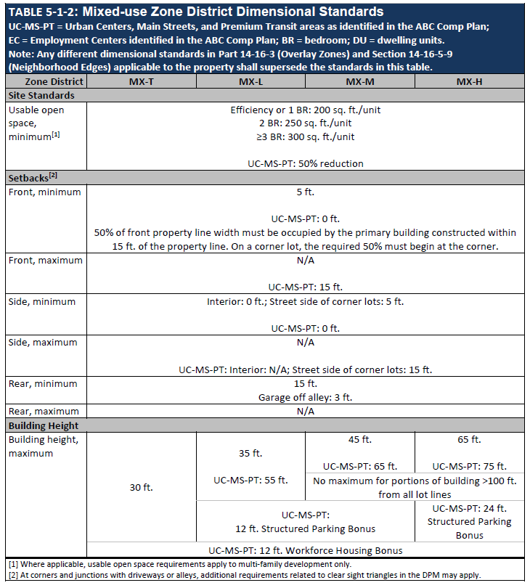
Dimensional Standard Tables:
By Zone Categories
Acronyms
Zones
(By intensity)
Center Provisions
5-1
Categories
Notes:
Be ready to define terms

Slide 19
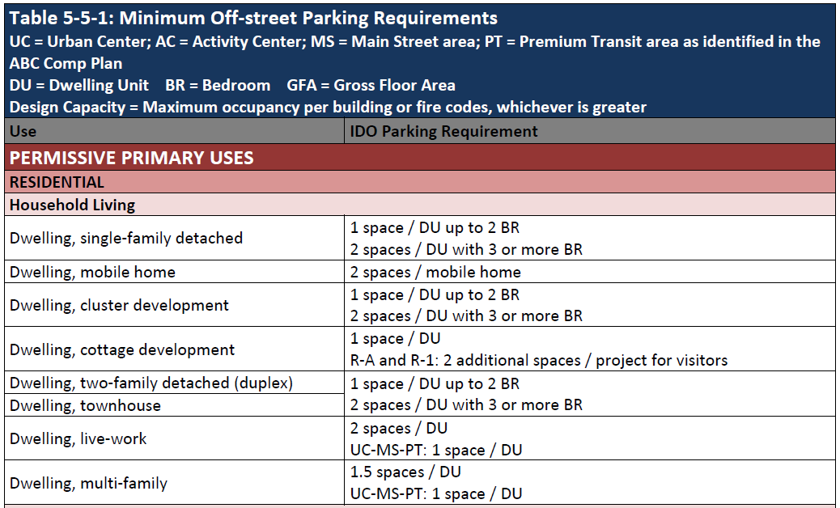
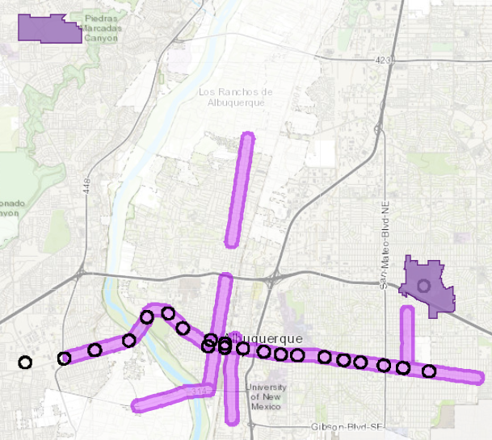
Off-street parking
Table 5-5-1
https://tinyurl.com/IDOzoningmap
Table by Allowable Use
Reductions in Centers + Corridors
https://abq-zone.com
UC = Urban Center
MS = 660 feet from Main Street
PT = 660 feet from Premium Transit station

Slide 20
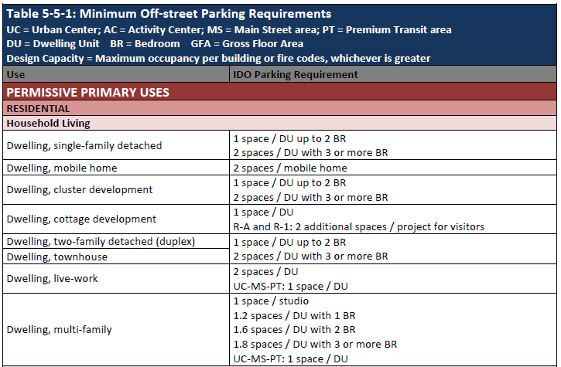
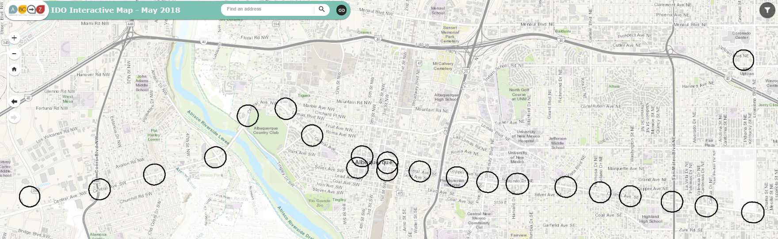
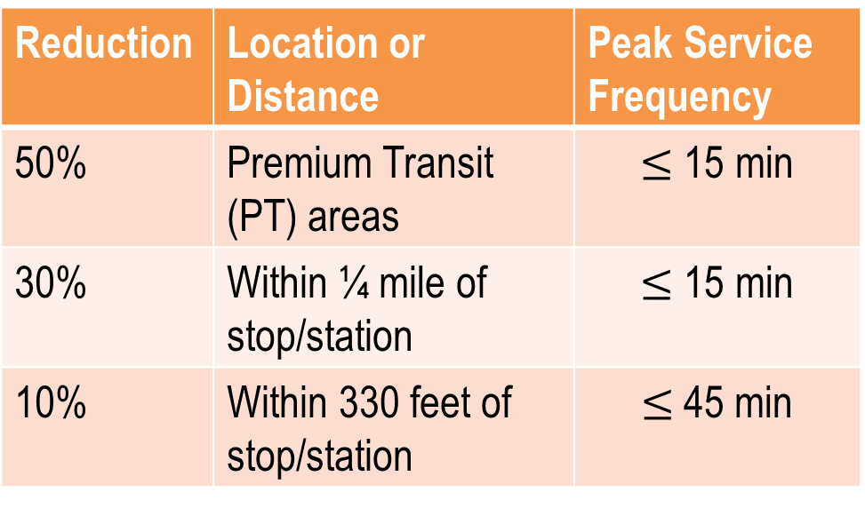
Off-street parking
Section 5-5(C)
Table by Allowable Use
Reductions for Transit
Reduction | Location or Distance | Peak Service Frequency
50% | Premium Transit (PT) areas | $≤$ 15 min
30% | Within ¼ mile of stop/station | $≤$ 15 min
10% | Within 330 feet of stop/station | $≤$45 min
Atrisco
https://abq-zone.com
Unser
Coors
Broadway
University
San Mateo
Louisiana
https://tinyurl.com/IDOzoningmap

Slide 21
standards
5-1 Dimensional Standards
5-2 Site Design + Sensitive Lands
5-3 Access + Connectivity
5-4 Subdivision of Land
5-5 Parking + Loading
5-6 Landscaping, Buffering, + Screening
5-7 Walls + Fences
5-8 Outdoor + Site Lighting
5-9 Neighborhood Edges
5-10 Solar Access
5-11 Signs
Part 5

Slide 22
Finding the Balance
Community Input
Early consultation
& more public notice
Streamlined Approval Process
More administrative review
Intent
If we get the rules right – and we need to continually work to get the rules right – and projects follow those rules, they get approved quickly.
Asking for exceptions means more notice, more public input, and a longer process.

Slide 23
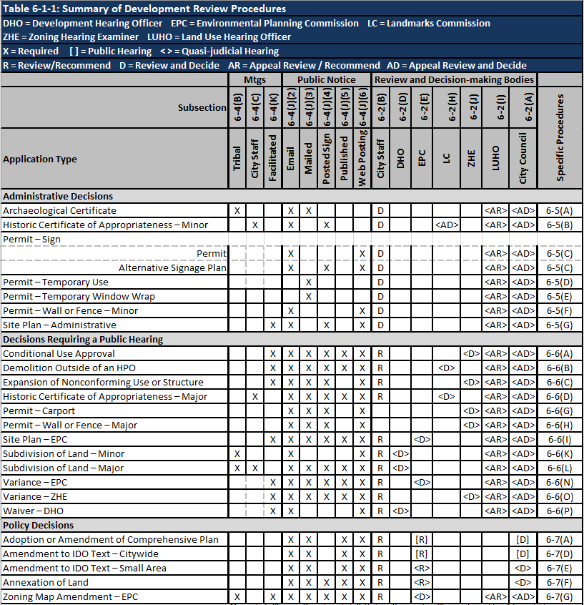



Review/decision
Table 6-1-1
Part 6
Some notice.
Administrative review.
Decided on IDO rules only.
https://abq-zone.com
Neighborhood Meeting.
More notice.
Public meeting or hearing.
Decided on IDO rules only.
https://compplan-abq-zone.com
Neighborhood Meeting.
Lots of notice.
Public hearing.
Rules decided case-by-case.
Comp Plan policies AND IDO regulations apply.
Notes:
Find chart. Make handout.

Slide 24
Part 6
Finding the balance
Last Stage / Projects following rules:
Administrative decision
Some notice required
Rules decided annually during IDO update
Administrative Decisions
Early Stage / Projects requesting exceptions:
Public Hearing
Pre-application Tribal Meeting required
Lots of notice required
Rules decided annually during IDO Update
Decisions
Requiring a Public Hearing
Predictability
Discretionary Decisions:
Public Hearing
Pre-application Neighborhood Meeting required
Lots of notice required
Rules decided case-by-case (Comp Plan applies)
Policy Decisions
Flexibility
Notes:
Handout

Slide 25
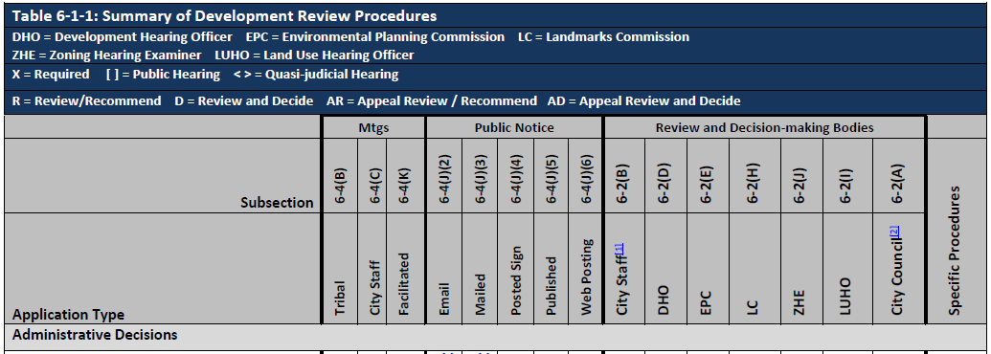
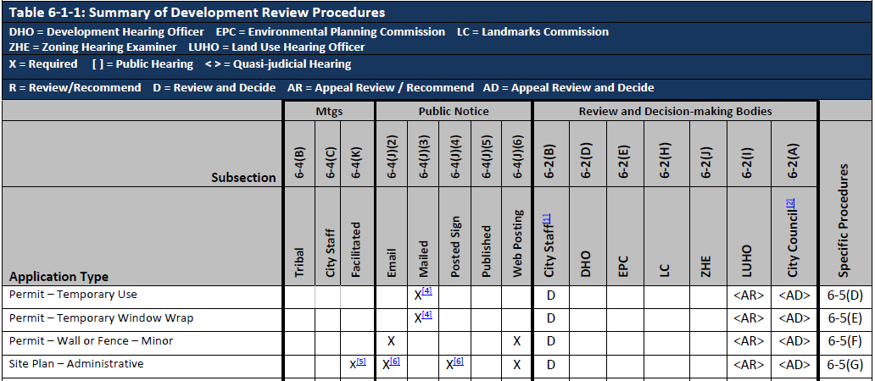

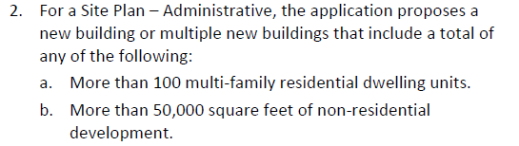
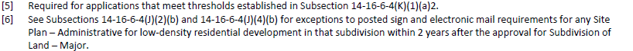
Table 6-1-1

Slide 26


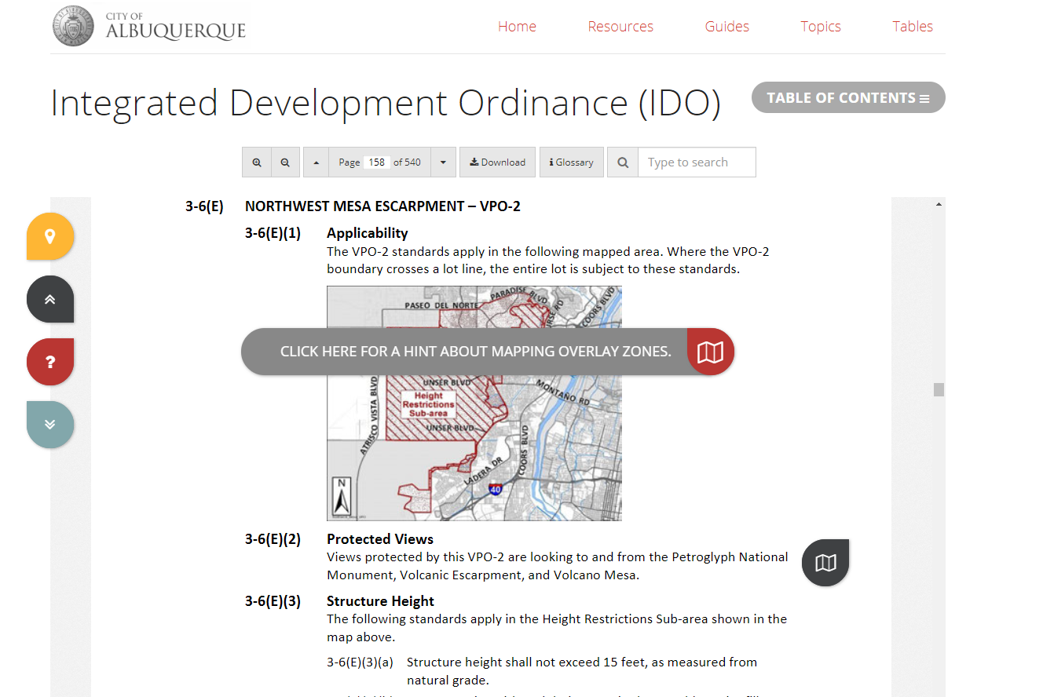
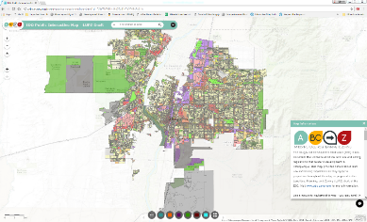


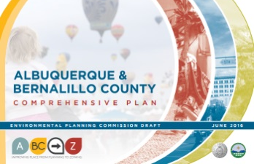
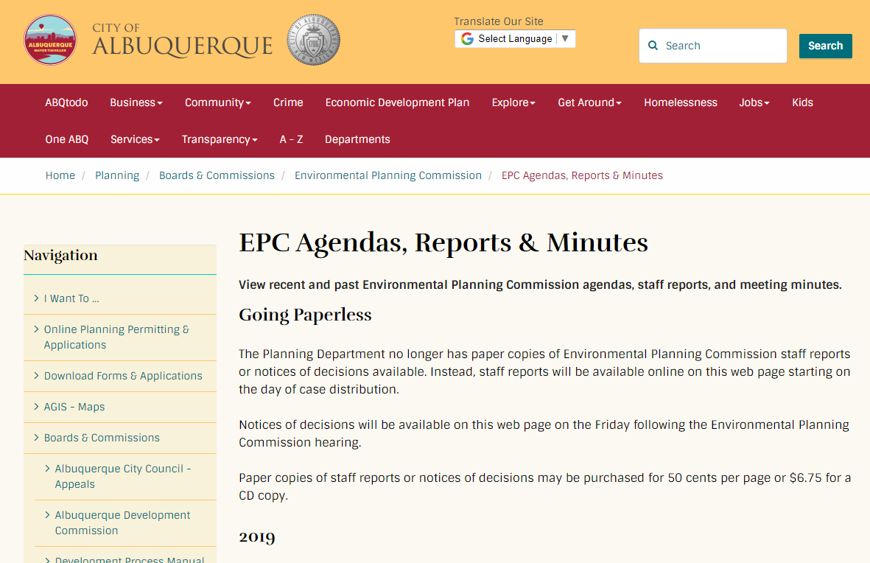
Interactive IDO
IDO Zoning Map
Resources
abq-zone.com
tinyurl.com/idozoningmap
Michael Vos
Principal Planner
mvos@cabq.gov
ABC Comp Plan
Planning Webpage
compplan.abq-zone.com
cabq.gov/planning

