Slide 1

Integrated Development Ordinance
https://abq-zone.com
Planning, Zoning, and Housing (oh my!)
Spring 2026
Mikaela Renz-Whitmore
Division Manager
mrenz@cabq.gov

Slide 2

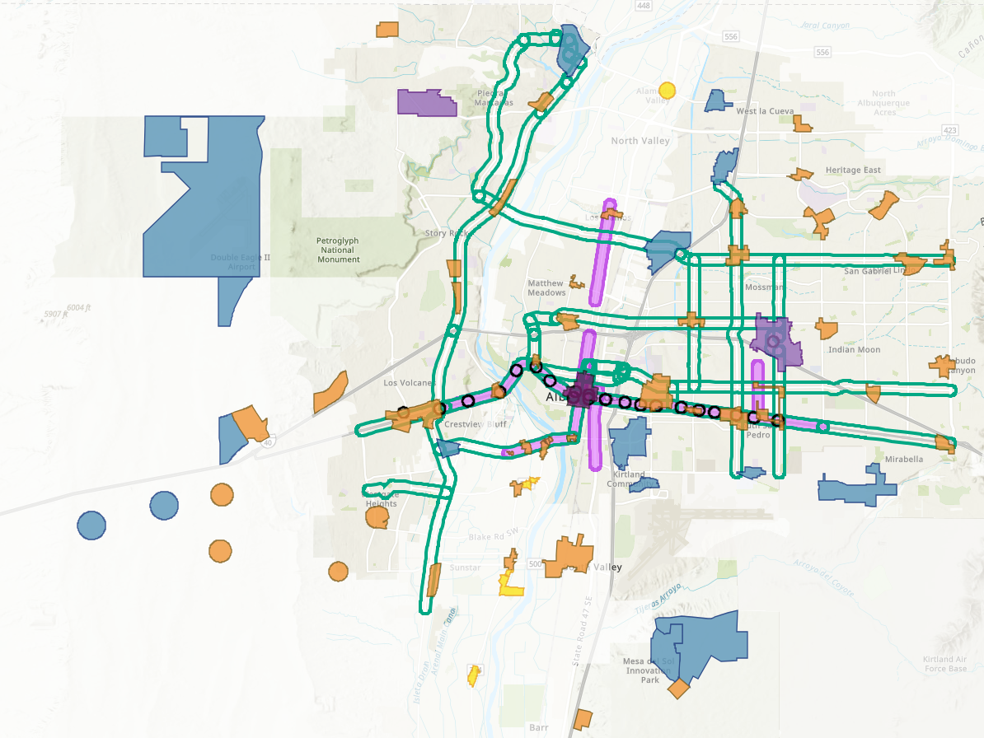


Planning + Zoning
ABC Comprehensive Plan
Integrated development ordinance
What we want + why:
Where to direct growth
What to protect
What actions to take
How to measure progress
How to get there:
Tailored rules
Centers + Corridors
Areas of Consistency
Overlay Zones
Special places
Transitions / Edge Protections
Between Areas of Change + Consistency
Next to neighborhoods
Policies
Centers + Corridors
Vision
EC
MT
MS
UC
Regulations
AC
DT
compplan.abq-zone.com
https://abq-zone.com
Notes:
In theory, at its best, zoning is a legal tool to implement our best plans
The WHY and the HOW
Why = goal/aspiration
How = minimum standards

Slide 3
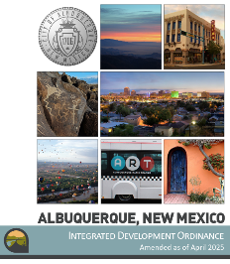

What is Zoning?
Vision
Goals & Policies
Zoning
a system of laws that establishes rights and limits on property
Albuquerque
Bernalillo
County
Comprehensive Plan
U.S Constitution
5th Amendment: Property Rights
14th Amendment: Due Process
10th Amendment: Police Power
for public health, safety, and welfare
“a person may not be deprived of property by the government without due process of law”
What is a taking?
A regulatory taking is when a zoning regulation limits the use of private property to the extent that it effectively deprives the owner of all economic value.
“nor shall any State deprive any person of life, liberty, or property, without due process of law”
Notes:
.

Slide 4
Finding the balance
Protecting
Neighborhoods, special places,
& City open space
Incentivizing
High-quality development
in appropriate areas

Slide 5

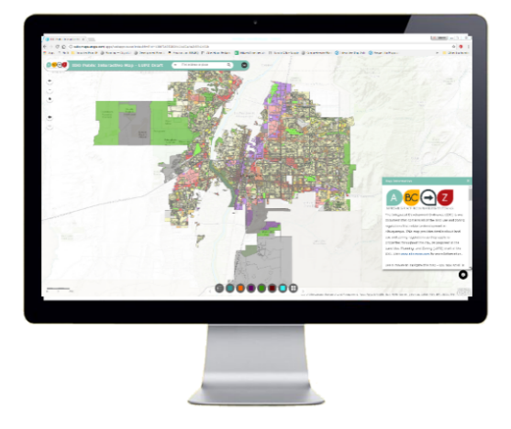

Hierarchy of rules
In the order applied
Overlay Zones
Character, Historic, View Protections
Context
Incentives
Zoning
Residential
Mixed-use
Non-residential
Edge buffers
Centers & Corridors
Small-area & Area of Consistency rules
Distance separations
Proximity to residential
Planned Development
Development types
Uses
Building design standards
Edge buffers
https://tinyurl.com/CABQ-IDO-12-2022
IDO Zoning Map
https://tinyurl.com/IDOzoningmap
Notes:
Improved description of how rules are applied in Part 1. (Section 14-16-1-8)
Any update to improve quality standard citywide WON’T apply to tailored standard. (Sometimes that’s good, sometimes that’s not. Need to review carefully!)
Tradeoff is additional complexity for extra protections.
Zoning is not easy, but it IS more predictable now under the IDO.

Slide 6
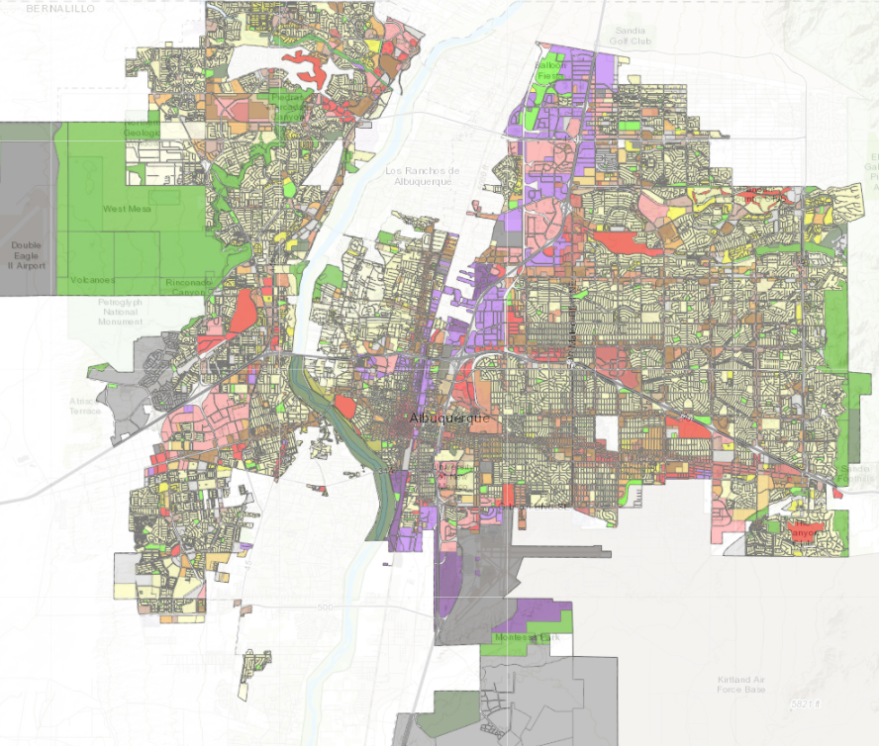
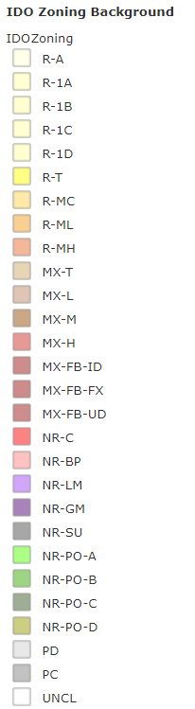


Zoning
https://ido.abq-zone.com
Part 2
Residential
Zone Districts
Mixed-use
Zone Districts
Non-residential
Zone Districts
Planned Development
Zone Districts
Unclassified
https://tinyurl.com/IDOzoningmap

Slide 7
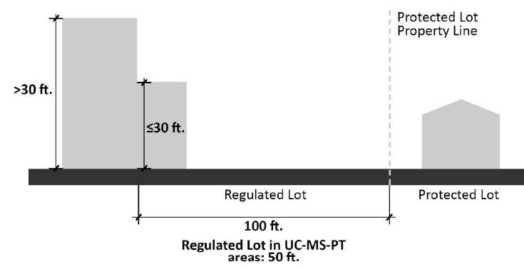

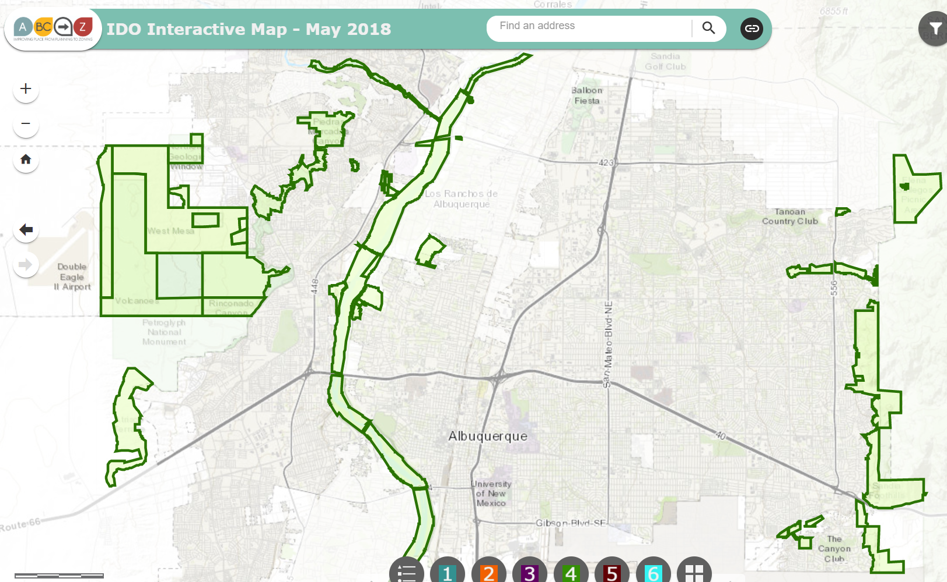

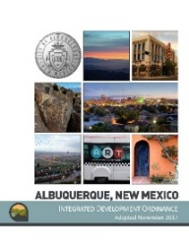
Zoning Protections
IDO Part 4
Allowable Uses
Distance separations from residential and Open Space areas and between uses
IDO Part 5
Development Standards
Use-
specific
Standards
Context Rules
Rules that set quality standards for development
From Residential Uses: Liquor retail, Heavy Manufacturing, Auto repair, etc.
From Open Space:
Car wash, Gas stations, Manufacturing, Solid Waste, etc.
Between uses: Group Homes, Pawn Shops, Bail Bonds, Payday Loans, etc.
Transitions:
Neighborhood Edges, Edge Buffers
Major Public Open Space Edges
https://tinyurl.com/IDOzoningmap
ido.abc-zone.com
Notes:
Between uses: Group Homes, Pawn Shops, Bail Bonds, Payday Loans, etc.
From Residential Uses: Retail Liquor, Heavy/Special Manufacturing, Auto repair, etc.

Slide 8
Limits on Density
Part 5
Citywide
CONTEXTUAL
Building height
Required usable open space
Required parking
Required landscaping
Building design standards
Use-specific standards
Distance from residential
Neighborhood Edges
Edge Buffers
Major Public Open Space Edge
Notes:
Areas of Change and Consistency for Edge Buffers

Slide 9
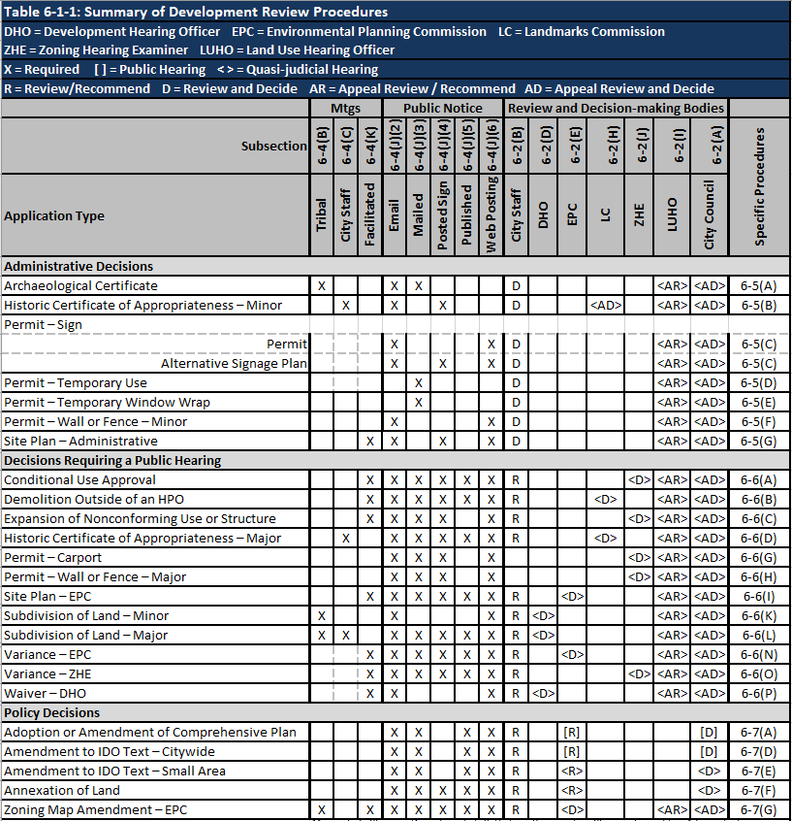
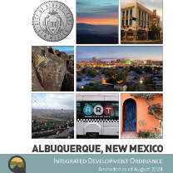


Review/decision
Table 6-1-1
Part 6
Predictable
Some notice.
Administrative review.
Decided on IDO rules only.
https://abq-zone.com
More notice.
Public hearing.
Decided on IDO rules only.
https://compplan-abq-zone.com
Lots of notice.
Public hearing.
Rules decided case-by-case.
Comp Plan AND IDO apply.
Flexible

Slide 10
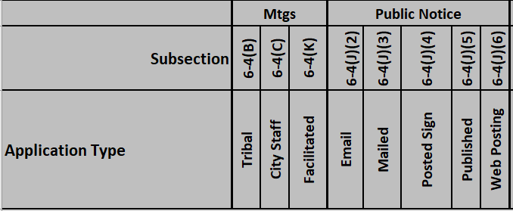
Public Notice
https://www.cabq.gov/planning/urban-design-development/public-notice
Before application
Emailed notice to Neigh. Assoc/Coalitions
Mailed notice to Property Owners
Table 6-1-1
6-4(J)2
6-4(J)3
After Application
Posted Sign (Applicant)
Published notice (CABQ)
[i.e., legal ad in ABQ Journal]
Web Posting (CABQ)
6-4(J)4
6-4(J)5
ABQ-PLAN
https://cabq.gov/abq-plan
6-4(J)6

Slide 11
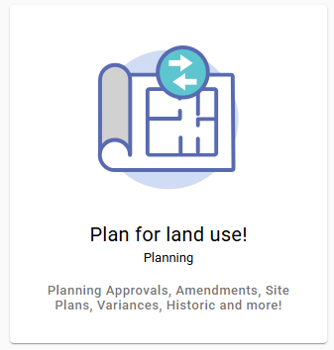
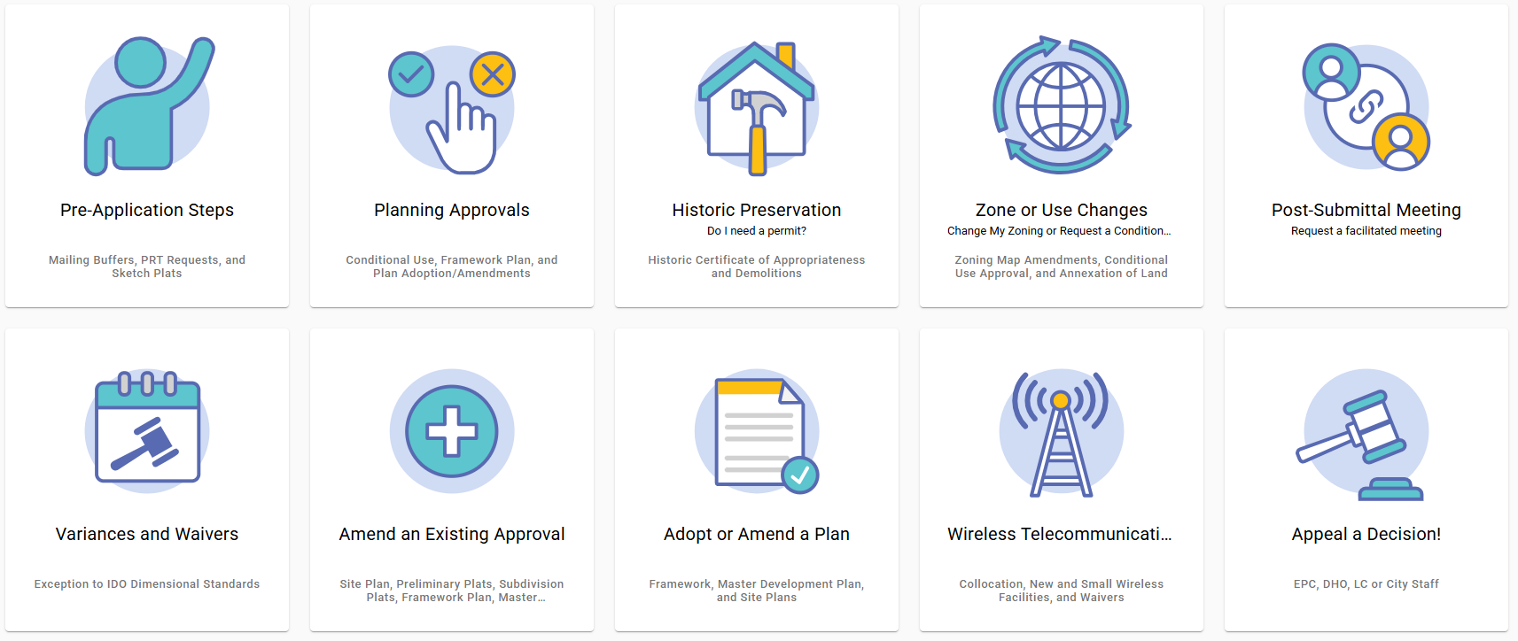
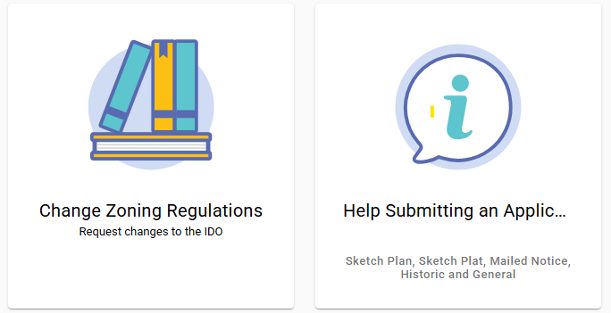
ABQ-PLAN
https://cabq.gov/abq-plan

Slide 12
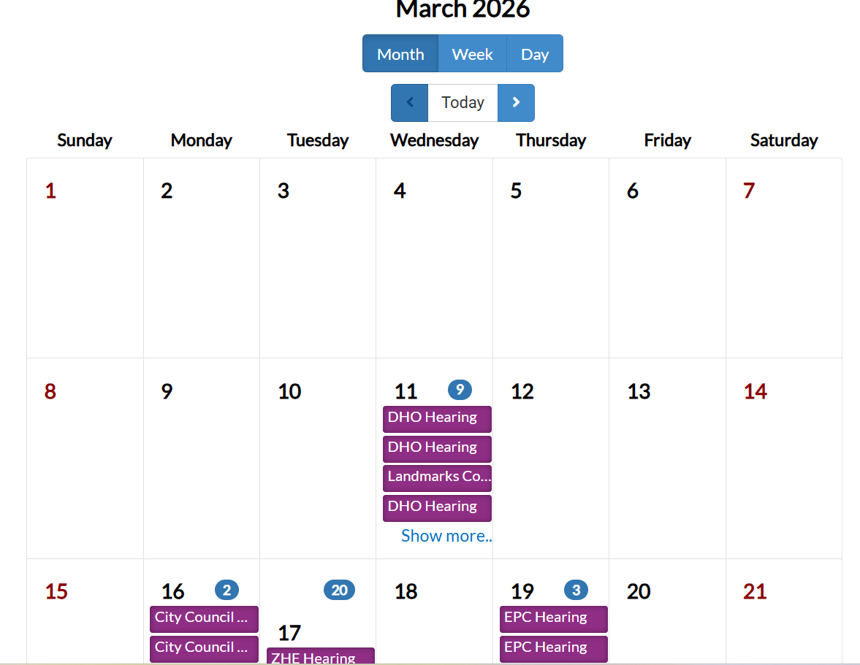
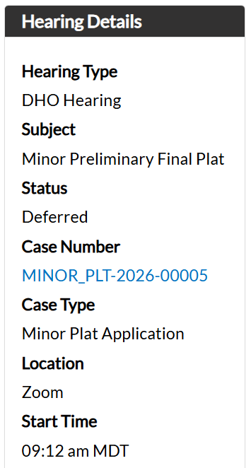
ABQ-PLAN

Slide 13
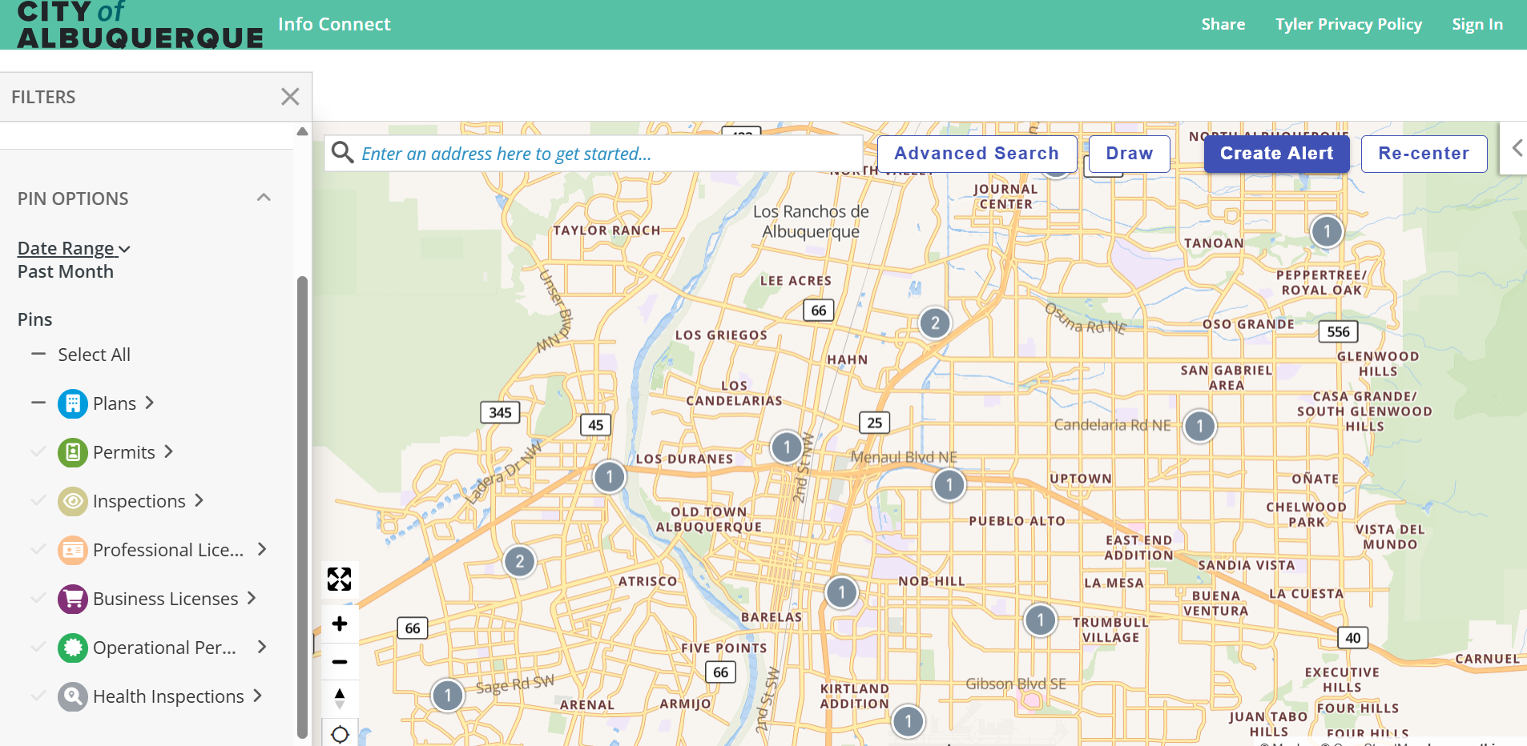
ABQ-PLAN

Slide 14
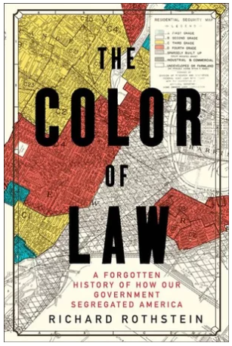
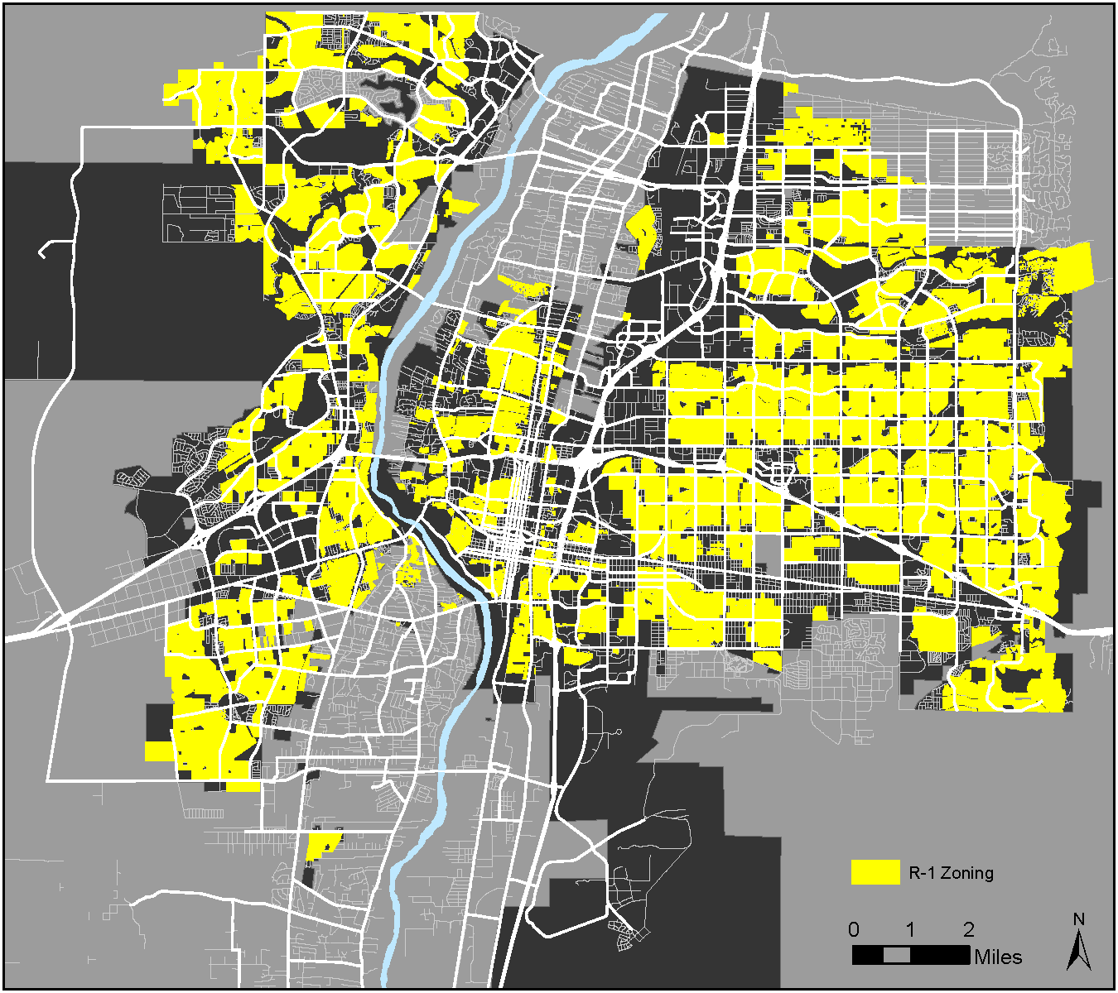
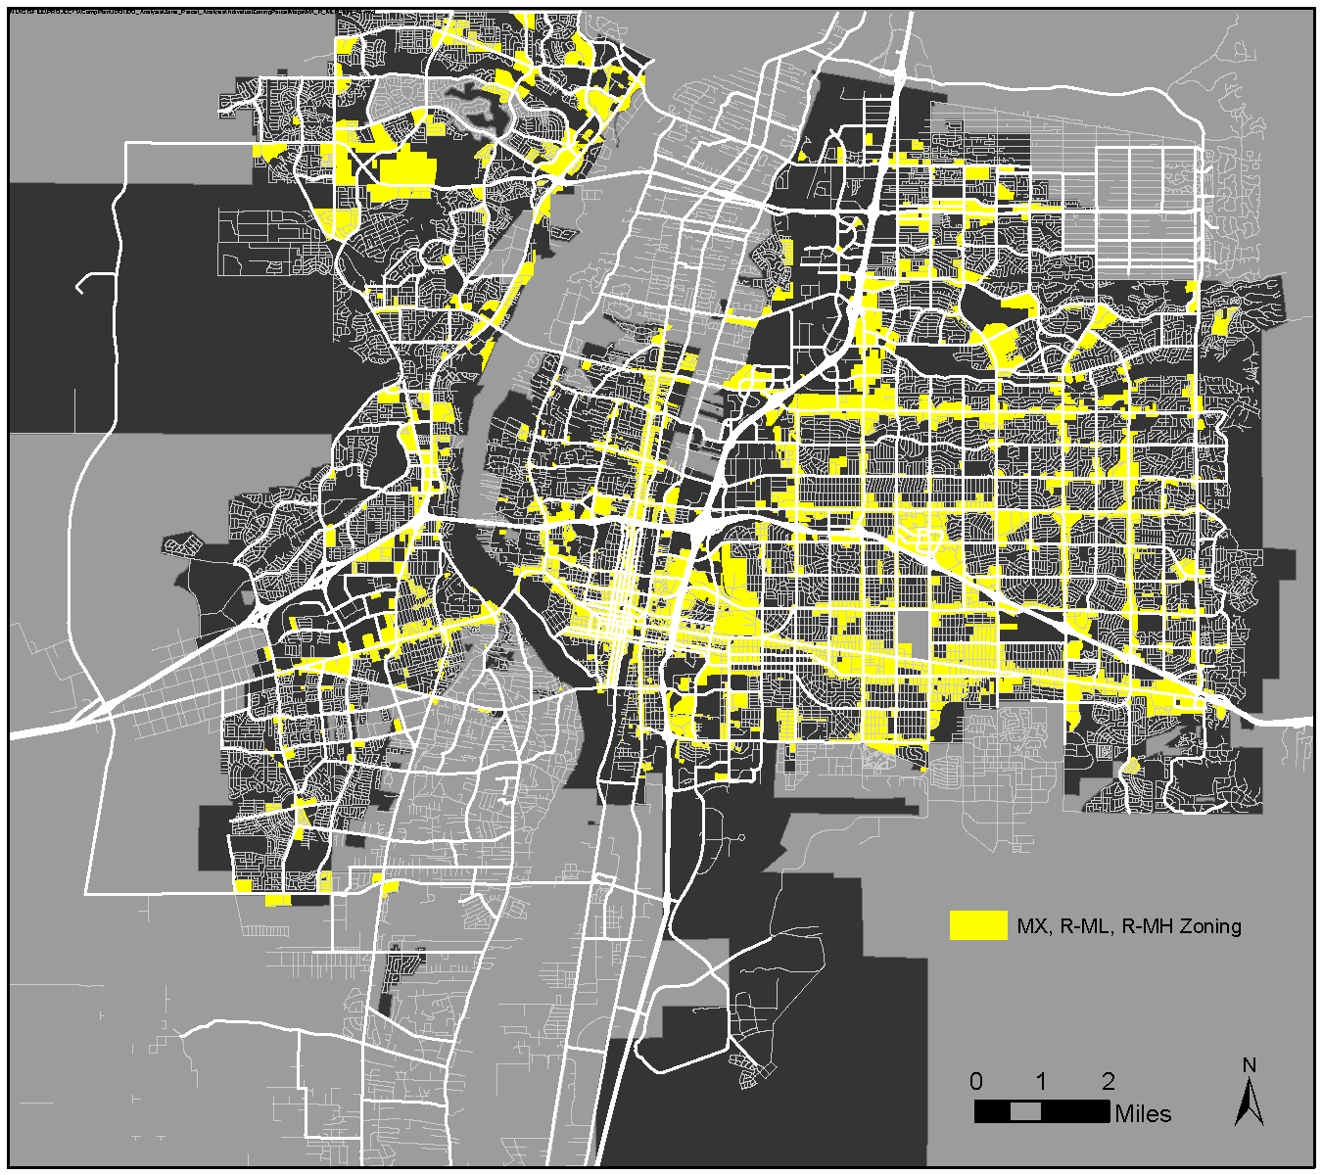
IDO Update
1917: Supreme Court struck down racial zoning ordinances
1924: Standard State Zoning Enabling Act
1928: Albuquerque proposes the first zoning code
1959: City of Albuquerque established first zoning code
1975: CABQ replaced zoning code
2017: CABQ adopted IDO
2023: Housing Forward Allowed Casitas and Non-residential Conversions
Zoning History
Segregated by Design
Only houses / Casitas allowed (67%)
Apartments Allowed (14%)
2023
Notes:
Buchanan v. Warley (1917) – Louisville, Kentucky – violated 14th Amendment
Because of other societal injustices (racist systems and institutions – i.e. systemic racism), BIPOC have less wealth, so any rules that raise the cost of housing construction (and therefore housing prices) has the result of excluding BIPOC
Density
Housing types
Lot size
Setbacks
Minimum structure size

Slide 15
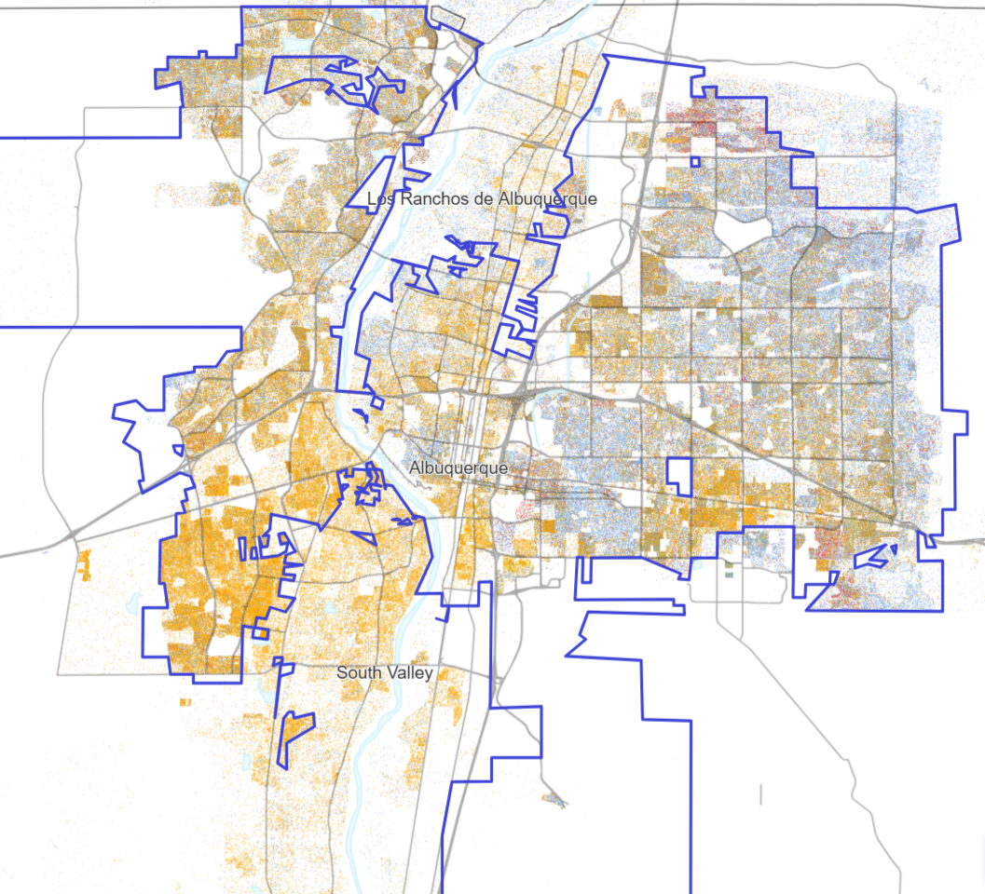
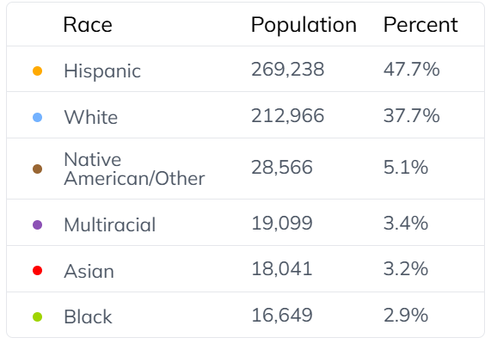
Albuquerque Population by Race, 2020
https://www.censusdots.com/race/albuquerque-nm-demographics

Slide 16
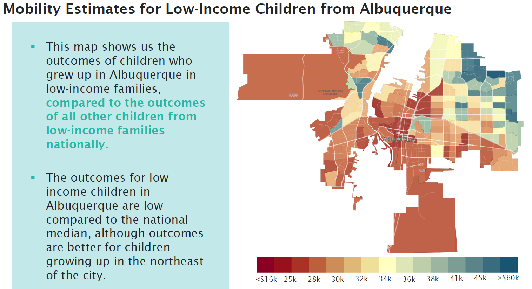
What’s not equitable
Harvard’s Opportunity Insights:
The Geography of Upward Mobility
Mean Household Income at Age 35 for Children with Parents Earning $27,000 (25th Percentile)
opportunityatlas.org

Slide 17

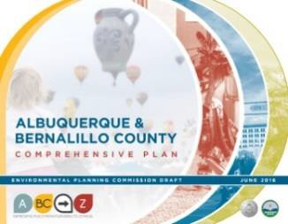
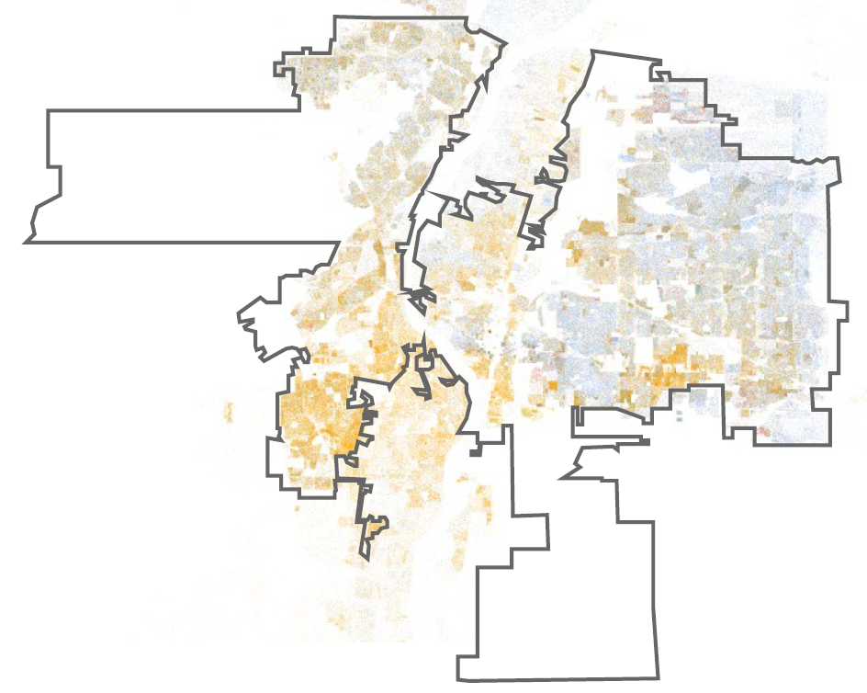
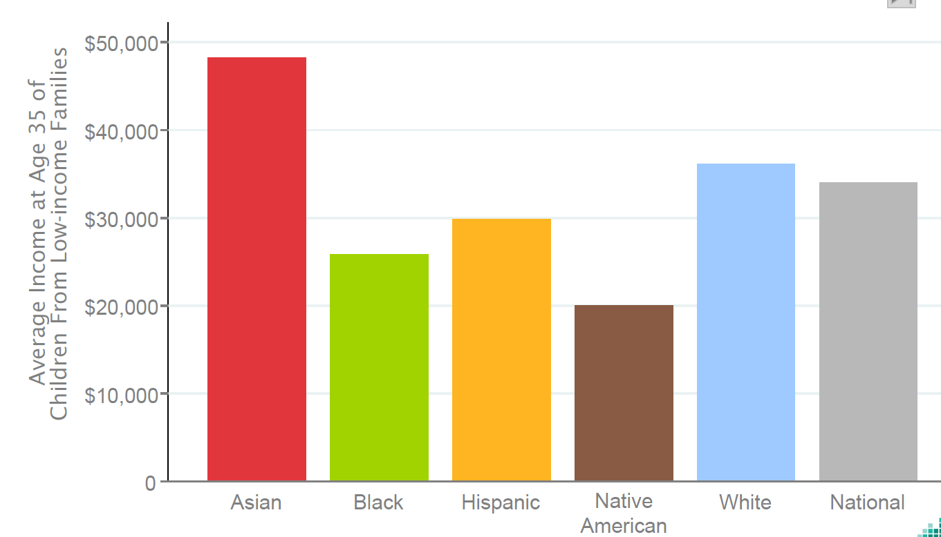
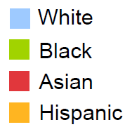
Equity
Guiding Principle for Equity: “All residents have access to good public services, a range of housing options, and healthy places to live, work, learn, and play.”
Goal for Racial Equity: “When race no longer determines one’s socioeconomic outcomes; when everyone has what they need to thrive, no matter where they live.”
compplan.abq-zone.com
https://www.raceforward.org/what-racial-equity
Children (now in their mid-30s) who grew up in low-income households in these areas
Average annual household income in 2014-15
for children (now in their mid-30s) who grew up in Bernalillo County
opportunityatlas.org
Notes:
Start with the idea of Equity… Comp Plan tells us to look at the different needs of people, neighborhoods, and places to move the city towards a more equitable outcome…
Equity vs. equality: looking at what each area needs – give right sized bike to each area; and apply an equity-based approach to prioritize resources and efforts to address the different needs of each area.

Slide 18
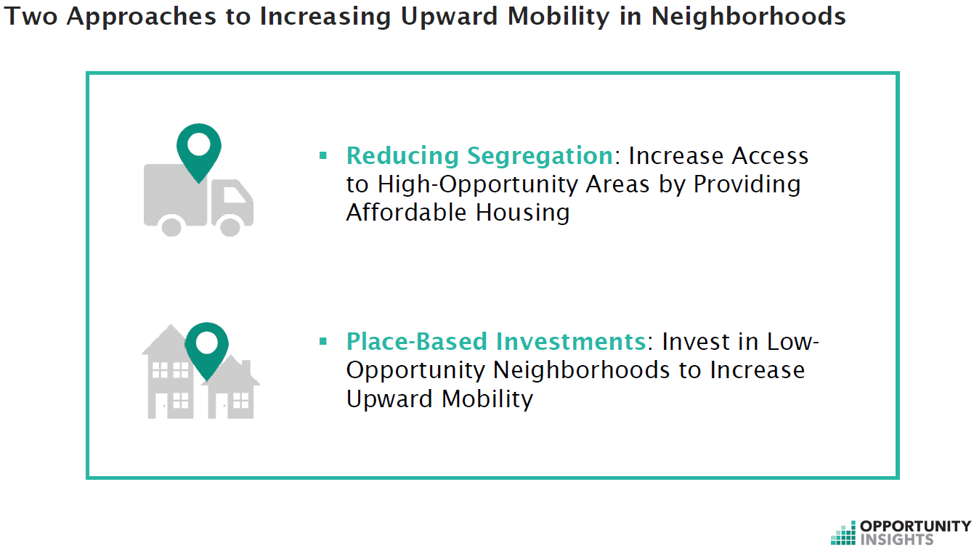
Equity

Slide 19
Agreement
Albuquerque is in a housing crisis.
House prices are too high for most families looking to own.
Rents are going up dramatically.
Homelessness is increasing.
Wages are not increasing as fast as housing costs.
The cost of construction materials and labor are limiting the pace of housing construction.
Only the largest-scale multi-family construction and highest-priced housing can pay for themselves without subsidy.
Small projects are getting more creative with funding to make them happen.
The City does not (and maybe can’t) allocate enough $ to subsidize enough affordable housing to meet the need.

Slide 20
Lower Costs per Housing Unit
Require less land/parking to leave more money and space for constructing housing units
PASSED
R-1 Dimensional Standards – Removed larger minimum lot sizes and setbacks
Building Heights
R-ML and R-MH and Mixed-use Zone Districts
Added building height in AC-MT
Increased building height in UC-MS-PT
Parking
Citywide Parking Minimums
Reduced minimum requirements for multi-family
1 space / DU for workforce housing
Reduced parking minimums by 20% for most uses
Centers and Corridors:
Eliminated parking minimums in DT-UC-AC-MS-PT-MT
IDO Zoning Map
DT = Downtown
UC = Urban Center
AC = Activity Center
EC = Employment Center
MS = 660 feet from Main Street
PT = 660 feet from Premium Transit station
MT = 660 feet from Major Transit

Slide 21
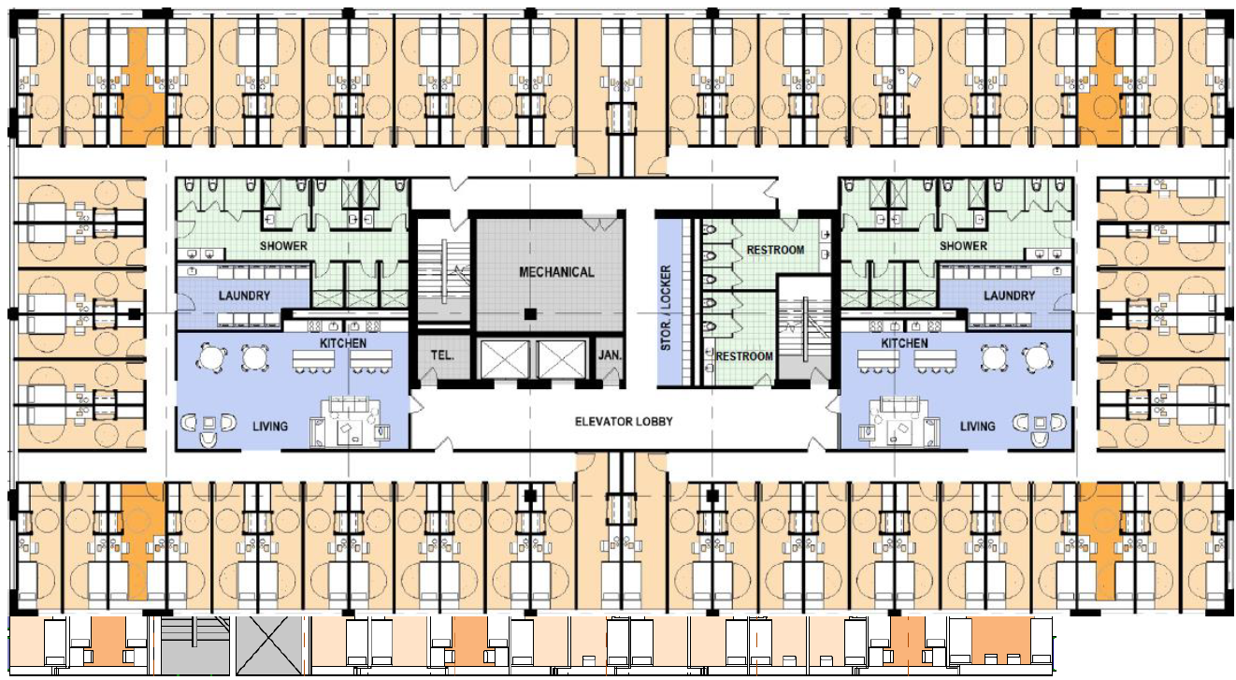
Increase Housing Choices
Take bold but gentle action to create more housing choices for families
PASSED
Dormitory – Allowed in all zone districts that allow multi-family dwellings
Examples:
Supportive / transitional housing
Non-residential conversions
Vertical mixed-use
“Albuquerque and Santa Fe could add hundreds of low-cost homes and curb homelessness with small, dormitory-style microapartments that have shared kitchens, bathrooms, and amenities.
The Pew/Gensler study found that each ‘co-living’ apartment would cost about $130,600 to build in Albuquerque and $184,400 in Santa Fe, well below the roughly $300,000 needed to build a typical studio apartment.”
Pew Charitable Trusts, Co-living and Affordability in ABQ (8/5/2025)

Slide 22
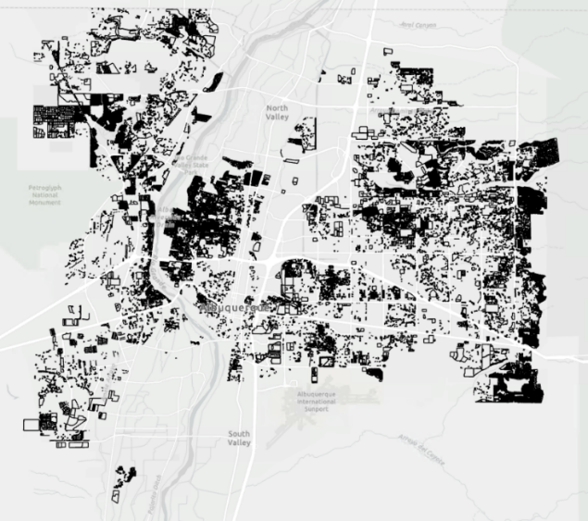

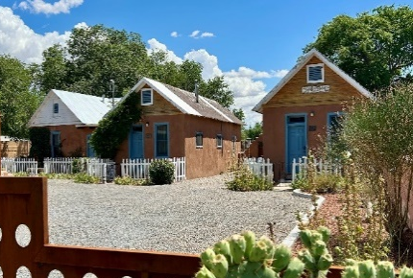
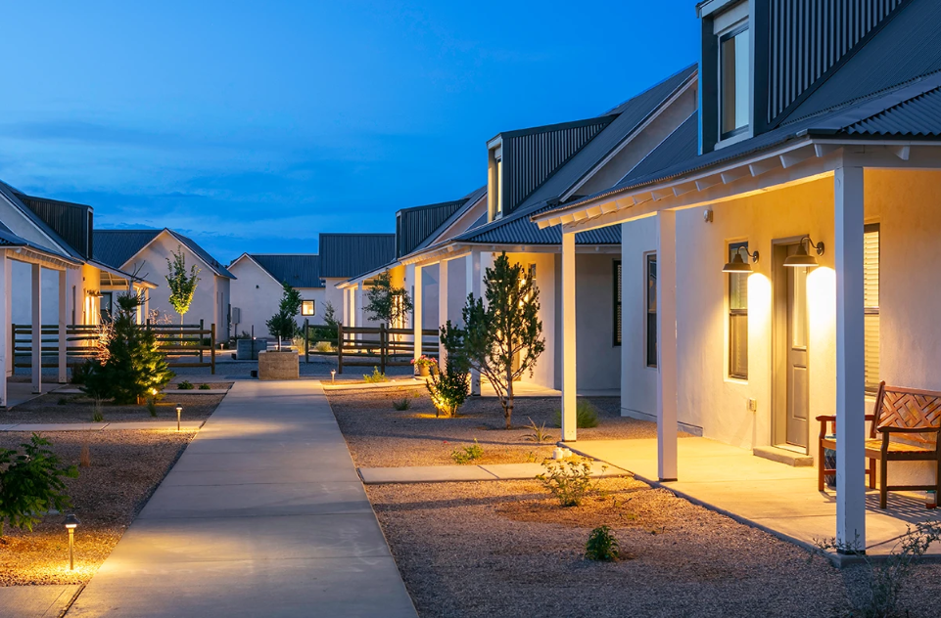
Increase Housing Choices
Take bold but gentle action to create more housing choices for families
PASSED
Cottage courts – Allows multiple small single-family or duplexes citywide on lots 10,000+ s.f.
Examples:
Multigenerational family compounds / senior living / intentional communities
Build-to-Rent
Affordable housing
10,000+ s.f. lots
 | Square Feet (s.f.) | Calculation Result
Start with an example lot size total | 10,000
Divide by minimum lot size in the zone district
R-1 | 3,500 | 2.86 | units
Multiply by an assumed s.f. per unit in a typical house | 2,000 | 5,714 | total s.f.
Divide by size limits in the zone district
Minimum size | 650 | 8 | cottage units
Maximum size | 1,200 | 4 | cottage units
1700 Old Town Rd.
Griegos Farms by Rembe Urban Design + Development

Slide 23
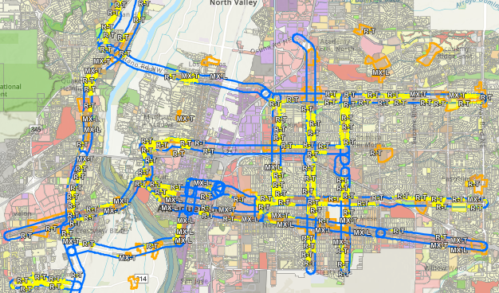
Increase Housing Choices
Take bold but gentle action to create more housing choices for families
NOT PASSED
Legislative Zoning Conversions for Major Transit (MT) and Activity Centers (AC)
R-1 → R-T – Adds townhouses as permissive (up to 3 units)
R-T → MX-T – Adds multi-family and non-residential as permissive
R-ML → MX-L – Adds non-residential as permissive
MT = 660 feet from Major Transit Corridor
AC = Activity Center
https://abq-zone.com/node/1937

Slide 24
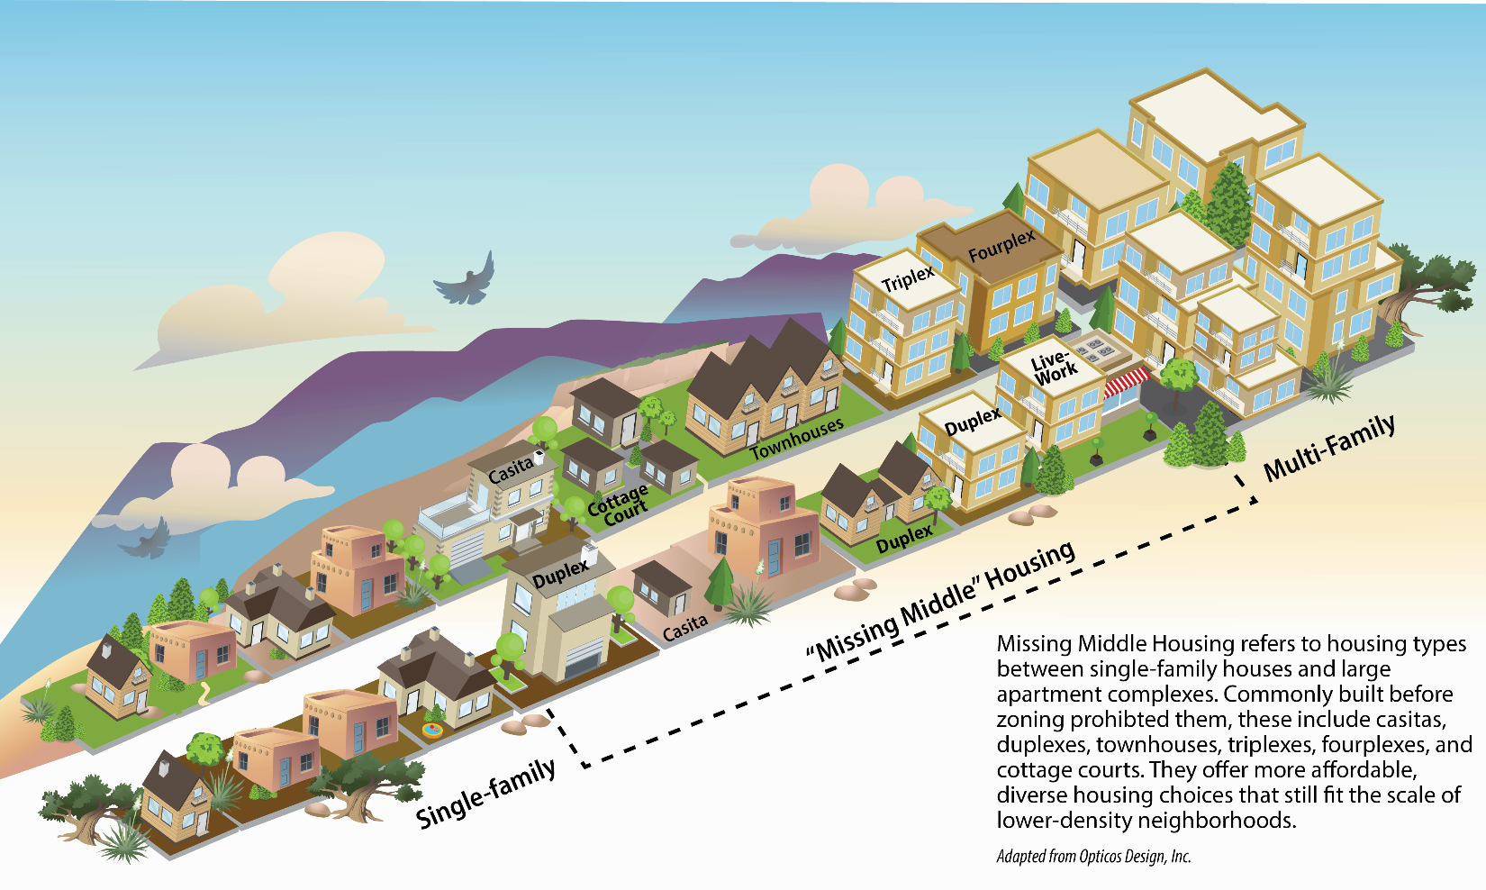
Increase Housing Choices
Take bold but gentle action to create more housing choices for families
NOT PASSED
Duplex – Allow duplexes citywide in R-1
Townhouse – Allow townhouses citywide in R-1 (up to 3 units)
Accessory Dwelling Units (ADUs) / Casitas – Allows attached ADUs citywide
Safe Outdoor Space – Remove requirements for plumbing and 24/7 security

Slide 25
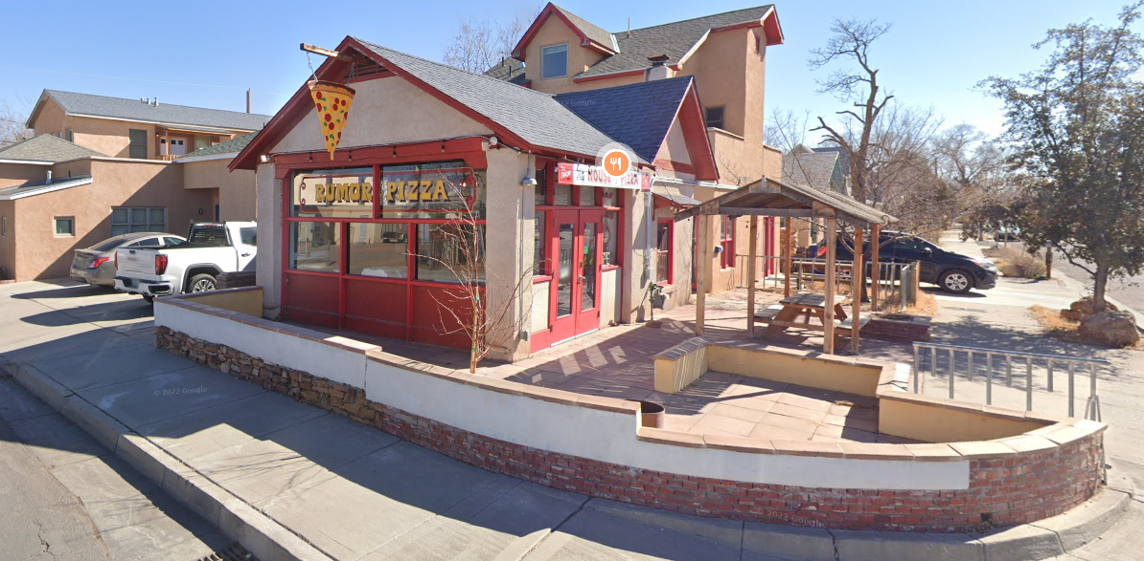
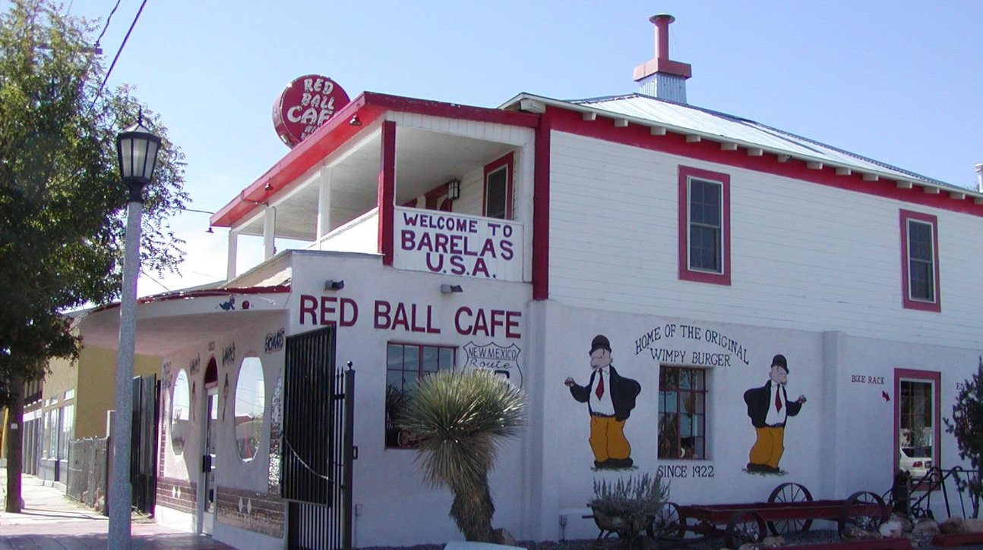
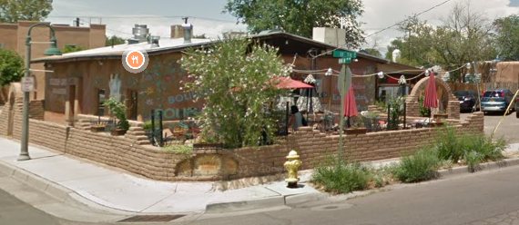
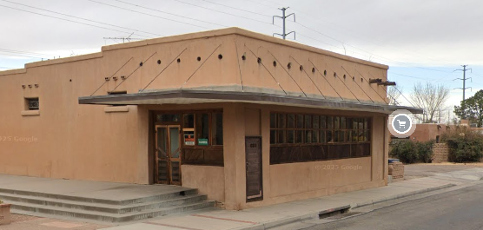
Allow Food near Neighborhoods
Create opportunities for small businesses, encourage walkability, and provide important daily goods such as food, household items, and medicine closer to the places where people
NOT PASSED
Bodegas / Tienditas: Allow retail, restaurant, grocery, and live-work on corner lots 5,000+ s.f. in residential zones
Conditional on local streets
Permissive on arterial / collectors
Not allowed to sell alcohol, cannabis, or nicotine

Slide 26
The debate
Will zoning changes result in housing construction?
For large-scale projects, can allowing more units help projects “pencil” and cover constructions costs?
Will individual people invest in incremental, missing middle housing?
Is all housing good housing?
Would housing get built if the City required some units to be affordable (inclusionary zoning)?
Would too much housing lead to gentrification in communities of color?
Would the City be ready with tools / strategies to intervene, if so?
Will Albuquerque still be Albuquerque if more housing gets built?
Will Albuquerque have a future if we continue with the status quo?
What are we “ready” for?

Slide 27
Levers & Constraints
What zoning does well
What zoning doesn’t do well
Prohibit uses / allow uses
Set minimum standards
Make uses / development projects happen
Create good design / nice places

Slide 28
factors in development
city regulations
federal regulation + private market
Zoning
Noise Ordinance
Street Tree Ordinance
Traffic Ordinance
Short-term Rental Ordinance
Vacant Premises Ordinance
Interest rates + mortgage rates
Tax structure + incentives
Housing subsidies
Banks + lending practices
Fair Housing Act
Building codes
Developers
Construction workforce
Construction costs
Investor capital
Jobs + wages
Household trends + preferences
city Incentives
Metropolitan Redevelopment Areas + financial tools
Housing subsidies
Economic development financial tools
Repair assistance
Notes:
Parking management strategies?

Slide 29

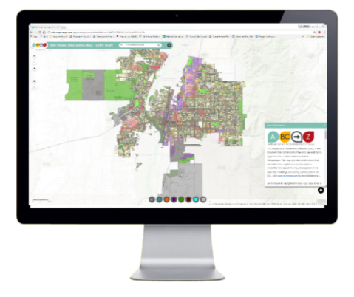
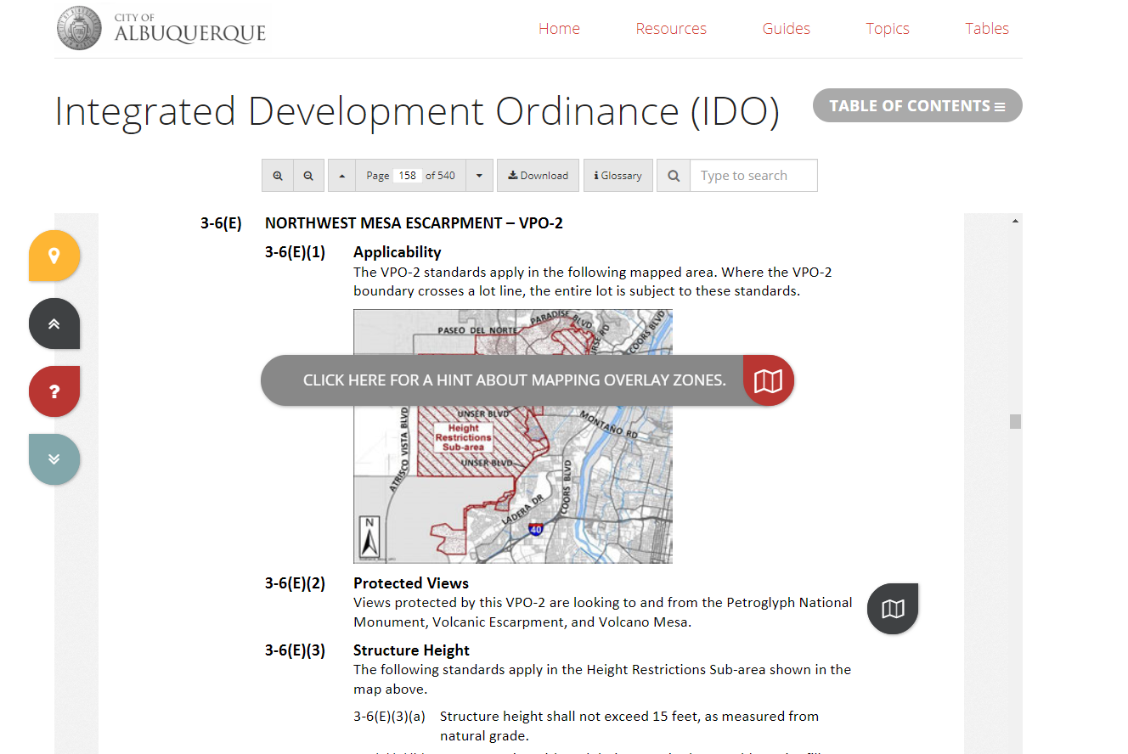
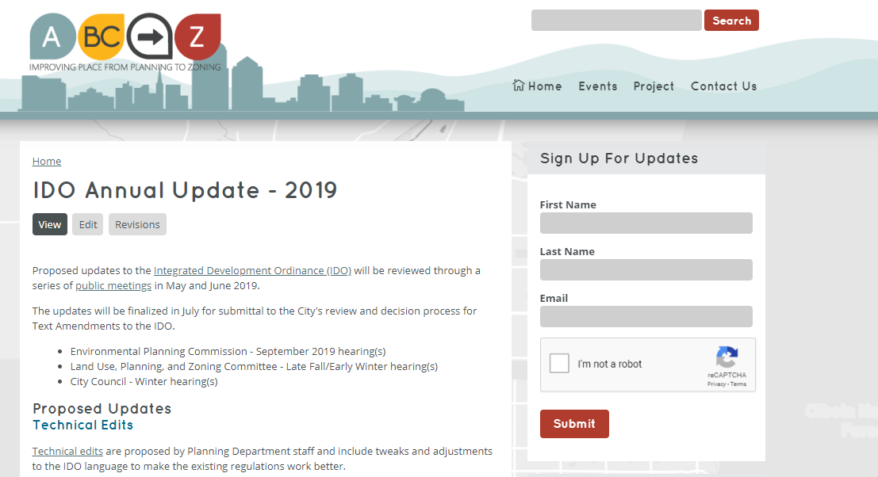


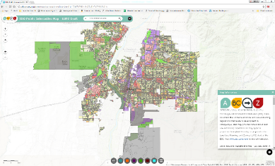
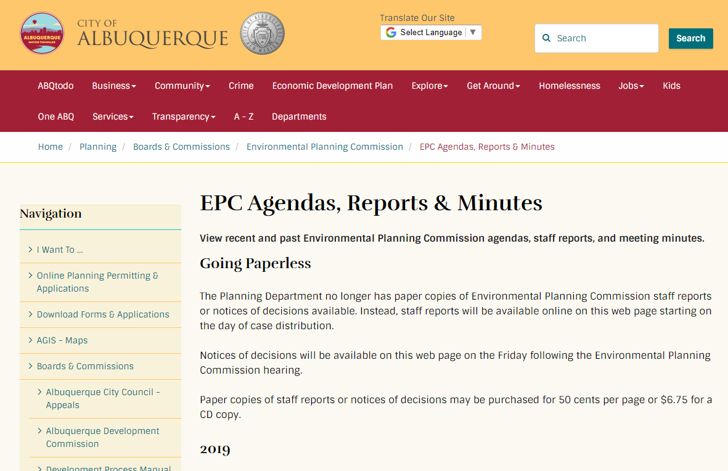

Interactive IDO
Project Webpage
ABC-Z Project
abctoz@cabq.gov
ido.abc-zone.com
abc-zone.com
Resources
IDO Zoning Map
Planning Webpage
Mikaela Renz-Whitmore
Urban Design + Dev. Division Manager
mrenz@cabq.gov
Kate Clark
Regulatory Planning Team Lead
kclark@cabq.gov
Jessica Sapunar-Jursich
Mid Range Planning Team Lead
jessica@cabq.gov
tinyurl.com/idozoningmap
cabq.gov/planning
ABC Comp Plan
compplan.abc-zone.com

Slide 30

Contents
1. General Provisions
Zone Districts
Overlay Zones
4. Use Regulations
Allowable Use Table
Use-specific Standards
Development Standards
Dimensional Standards Tables
General Regulations
6. Administration & Enforcement
7. Definitions & Acronyms
https://abq-zone.com
IDO Zoning Map
Uses
Zones
Standards
Processes
https://tinyurl.com/IDOzoningmap

Slide 31
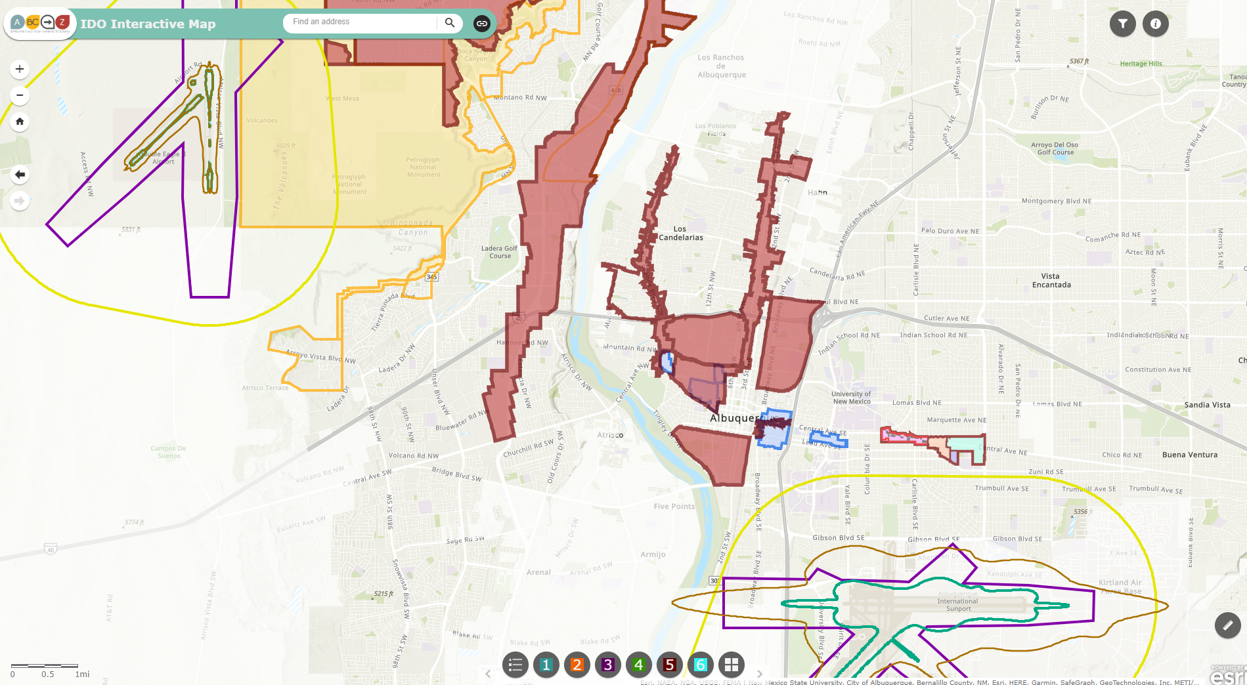
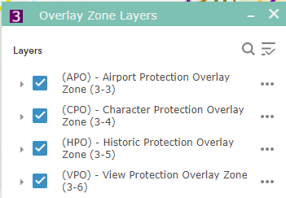
overlay zones
Part 3
ido.abc-zone.com
https://tinyurl.com/IDOzoningmap

Slide 32
Table 4-2-1
Table 4-2-1: Allowable Uses P = Permissive Primary C = Conditional Primary A = Permissive Accessory CA = Conditional Accessory CV = Conditional if Structure Vacant for 5+ years T = Temporary CT = Conditional Temporary Blank Cell = Not Allowed
Zone District >> Land Uses | Residential |  |  |  |  |  | Mixed-use |  |  |  | Non-residential |  |  |  |  |  |  |  | Use-specific Standards
 | R-A | R-1 | R-MC | R-T | R-ML | R-MH | MX-T | MX-L | MX-M | MX-H | NR-C | NR-BP | NR-LM | NR-GM | NR-SU | NR-PO
 |  |  |  |  |  |  |  |  |  |  |  |  |  |  |  | A | B | C
PRIMARY USES THAT MAY BE ACCESSORY IN SOME ZONE DISTRICTS
RESIDENTIAL USES
Household Living
Group Living
CIVIC AND INSTITUTIONAL USES
COMMERCIAL USES
Agriculture and Animal-related
Food, Beverage, and Indoor Entertainment
Lodging
Motor Vehicle-related
Offices and Services
Outdoor Recreation and Entertainment
Retail Sales
Transportation
INDUSTRIAL USES
Manufacturing, Fabrication, and Assembly
Telecommunications, Towers, and Utilities
Waste and Recycling
Wholesaling and Storage
ACCESSORY AND TEMPORARY USES
ACCESSORY USES
TEMPORARY USES
IDO Part 4
Allowable Uses
Use-
specific
Standards
Distance Separations
From Residential Uses: Liquor retail, Heavy Manufacturing, etc.
From Open Space: Car wash, Gas stations, Manufacturing, etc.
Between uses: Group Homes, Pawn Shops, Bail Bonds, etc.
Notes:
Between uses: Group Homes, Pawn Shops, Bail Bonds, Payday Loans, etc.
From Residential Uses: Retail Liquor, Heavy/Special Manufacturing, Auto repair, etc.

Slide 33
Use table
Table 4-2-1: Allowable Uses P = Permissive Primary C = Conditional Primary A = Permissive Accessory CA = Conditional Accessory CV = Conditional if Structure Vacant for 5+ years T = Temporary CT = Conditional Temporary Blank Cell = Not Allowed
Zone District >> Land Uses | Residential |  |  |  |  |  | Mixed-use |  |  |  | Non-residential |  |  |  |  |  |  |  | Use-specific Standards
 | R-A | R-1 | R-MC | R-T | R-ML | R-MH | MX-T | MX-L | MX-M | MX-H | NR-C | NR-BP | NR-LM | NR-GM | NR-SU | NR-PO
 |  |  |  |  |  |  |  |  |  |  |  |  |  |  |  | A | B | C
PRIMARY USES THAT MAY BE ACCESSORY IN SOME ZONE DISTRICTS
RESIDENTIAL USES
Household Living
Group Living
CIVIC AND INSTITUTIONAL USES
COMMERCIAL USES
Agriculture and Animal-related
Food, Beverage, and Indoor Entertainment
Lodging
Motor Vehicle-related
Offices and Services
Outdoor Recreation and Entertainment
Retail Sales
Transportation
INDUSTRIAL USES
Manufacturing, Fabrication, and Assembly
Telecommunications, Towers, and Utilities
Waste and Recycling
Wholesaling and Storage
ACCESSORY AND TEMPORARY USES
ACCESSORY USES
TEMPORARY USES
Table
4-2-1
7-1
Definitions
Notes:
Delete USS in bottom of table

Slide 34
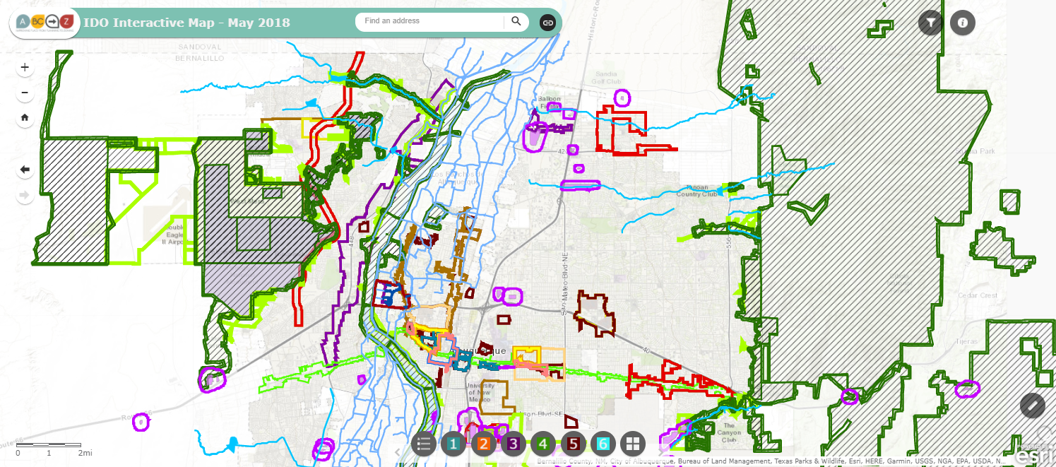

IDO Part 5
Development Standards
Context Rules
Rules that set quality standards for development
5-1 Dimensional Standards
5-2 Site Design + Sensitive Lands
5-3 Access + Connectivity
5-4 Subdivision of Land
5-5 Parking + Loading
5-6 Landscaping, Buffering, + Screening
5-7 Walls + Fences
5-8 Outdoor + Site Lighting
5-9 Neighborhood Edges
5-10 Solar Access
5-11 Signs
https://tinyurl.com/CABQ-IDO-12-2022
https://tinyurl.com/IDOzoningmap
Notes:
Between uses: Group Homes, Pawn Shops, Bail Bonds, Payday Loans, etc.
From Residential Uses: Retail Liquor, Heavy/Special Manufacturing, Auto repair, etc.

Slide 35
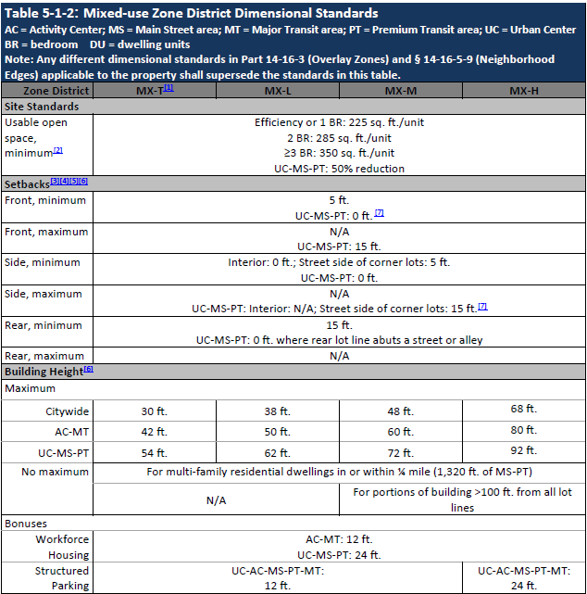
Dimensional Standard Tables: By Zone Categories
Acronyms
Zones
(By intensity)
Standards
5-1
Center Provisions
Notes:
Be ready to define terms

Slide 36
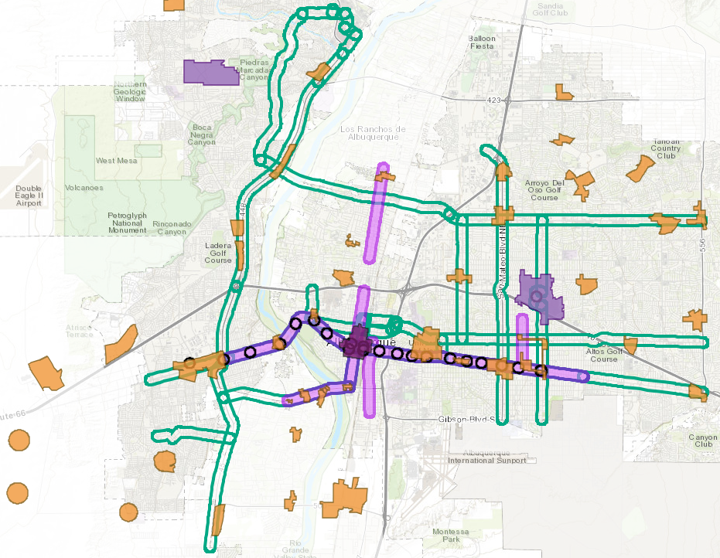
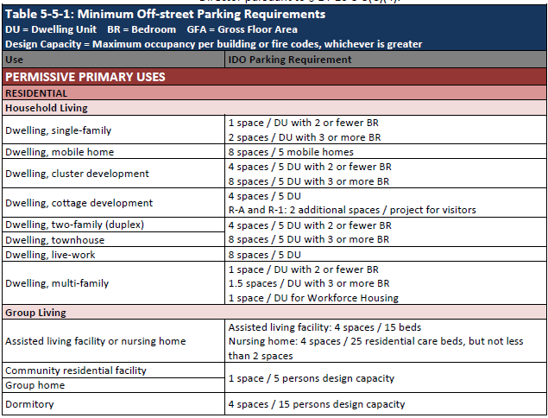
Off-street parking
Table
5-5-1
No Requirement
in Centers + Corridors
Table by Allowable Use
UC
MT
AC
MS
UC = Urban Center
AC = Activity Center
MS = 660 feet from Main Street
PT = 660 feet from Premium Transit station
MT = 660 feet from Major Transit
https://abq-zone.com
https://tinyurl.com/IDOzoningmap

Slide 37
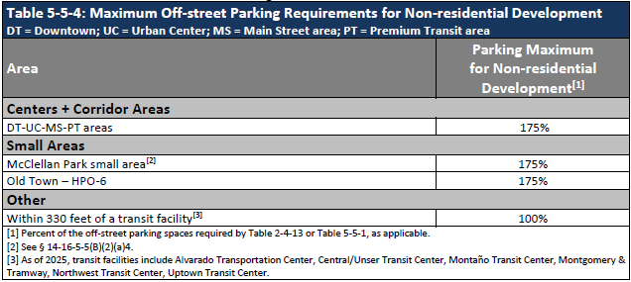



Off-street parking
Section 5-5(C)
Parking maximums
Reductions for Transit
Reduction | Location or Distance | Peak Service Frequency
30% | Within ¼ mile of MS-PT | $≤$ 15 min
10% | Within 330 feet of stop/station | $≤$45 min
https://abq-zone.com
DT = Downtown Center
UC = Urban Center
MS = 660 feet from Main Street
PT = 660 feet from Premium Transit station
https://tinyurl.com/IDOzoningmap

Slide 38


agreement
Albuquerque is in a housing crisis.
House prices are too high for most families looking to own.
ABQ Region Housing Needs Assessment (2024)
https://tinyurl.com/ABQ-HNA

Slide 39


agreement
Albuquerque is in a housing crisis.
House prices are too high for most families looking to own.
Rents are going up dramatically.

Slide 40

agreement
Albuquerque is in a housing crisis.
House prices are too high for most families looking to own.
Rents are going up dramatically.
Homelessness is increasing.

Slide 41


agreement
Albuquerque is in a housing crisis.
House prices are too high for most families looking to own.
Rents are going up dramatically.
Homelessness is increasing.
Wages are not increasing as fast as housing costs.
ABQ Region Housing Needs Assessment (2024)
https://tinyurl.com/ABQ-HNA

Slide 42

the need
ABQ Region Housing Needs Assessment (2024)
https://tinyurl.com/ABQ-HNA
Smaller households means
we need more units to house
the same number of people

Slide 43

the opportunity
ABQ Region Housing Needs Assessment (2024)
https://tinyurl.com/ABQ-HNA

Slide 44

housing supply

Slide 45
Next Steps
Housing
Health, Housing, and Homelessness
Metropolitan Redevelopment Agency
Senior
Affairs
Planning Department
Economic Development

Slide 46
Community change
The City recognizes that it is important to invest in communities, and that investment can lead to displacement and gentrification if steps are not taken to ensure that long-time residents and businesses can afford to stay and enjoy the benefits of new investment and an improved economy. The City has identified anti-displacement resources and strategies to help maintain the social and economic vitality of its diverse communities.
Displacement
Gentrification
The involuntary relocation of people from their homes and communities due to external forces, including gentrification, development projects, policy decisions, and economic pressures.
Displacement can be one component of gentrification.
A process of change in community identity over time as wealthier people move in, improve housing, and attract new businesses, often displacing historical community members physically, economically, and culturally.
Historical community members are either priced out of housing and leases (i.e., displacement) or incentivized to sell because of higher property values. The loss of historical community members and long-time businesses changes the culture and often the character of the place.

Slide 47

Next Steps
Anti-displacement Toolbox
Existing resources that may be helpful for residents and businesses.
Featured strategies that other cities have put in place that can inform our efforts.
Actions that the City can take to help residents and businesses thrive in their communities.
https://tinyurl.com/CABQ-Anti-Displacement

Slide 48

Next Steps
What else?
https://tinyurl.com/CABQ-Anti-Displacement

