Slide 1
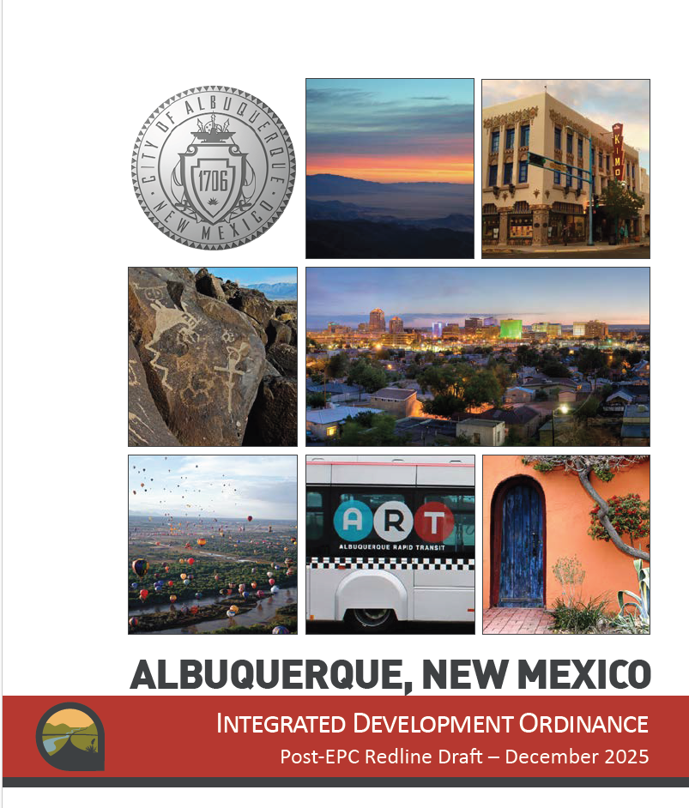
Integrated Development Ordinance
https://abq-zone.com/ido-updates-2025
IDO Update 2025
ABQ Affordable Housing Coalition

Slide 2
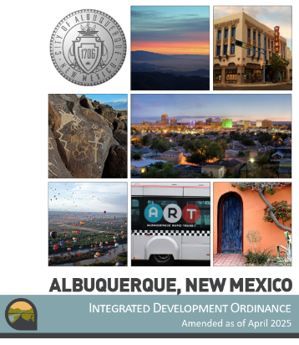
Thanks for
participating!
2025 IDO Update
Get to Know Your IDO
Handout (PDF)
Presentation (PDF)
Video
https://abq-zone.com/ido-updates-2025
IDO Online
Environmental
Planning
Commission
Land
Use
Planning
Zoning
City Council
https://ido.abq-zone.com
Watch for Trainings on the Updated IDO in April 2026!
October 2025
January 2026
February 2026
Council’s
Committee

Slide 3
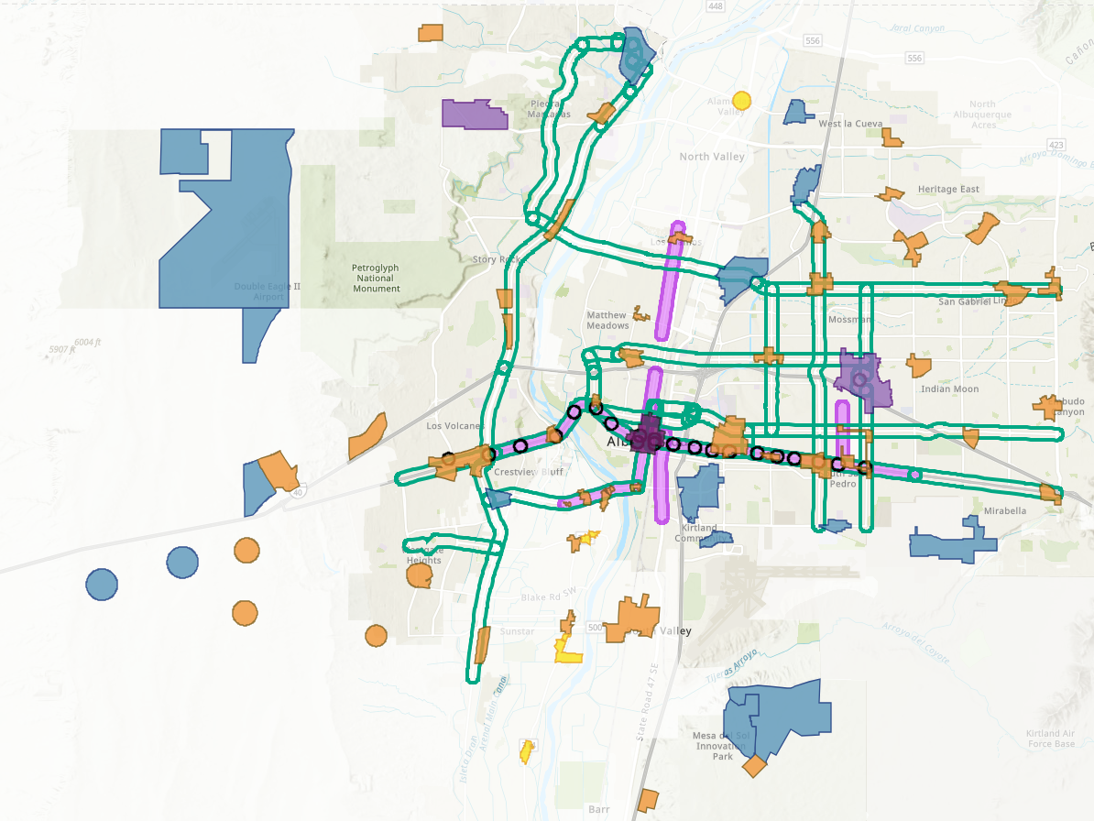
Lower Costs per Housing Unit
Require less land/parking to leave more money for constructing housing units
R-1 Dimensional Standards – Removed subzones with larger minimum lot sizes and setbacks
Building Heights
R-ML and R-MH and Mixed-use Zone Districts
Added a new tier of higher building height in Major Transit and Activity Centers
Bumped up building height in Urban Center, Premium Transit, and Main Street areas accordingly
Parking
Citywide Parking Minimums
Reduced minimum requirements for multi-family.
New built-in reduction for workforce housing (1 space / DU)
Decreased parking minimums by 20% for most uses
Centers and Corridors:
Eliminated parking minimums
IDO Zoning Map
DT = Downtown
UC = Urban Center
AC = Activity Center
EC = Employment Center
MS = 660 feet from Main Street
PT = 660 feet from Premium Transit station
MT = 660 feet from Major Transit

Slide 4
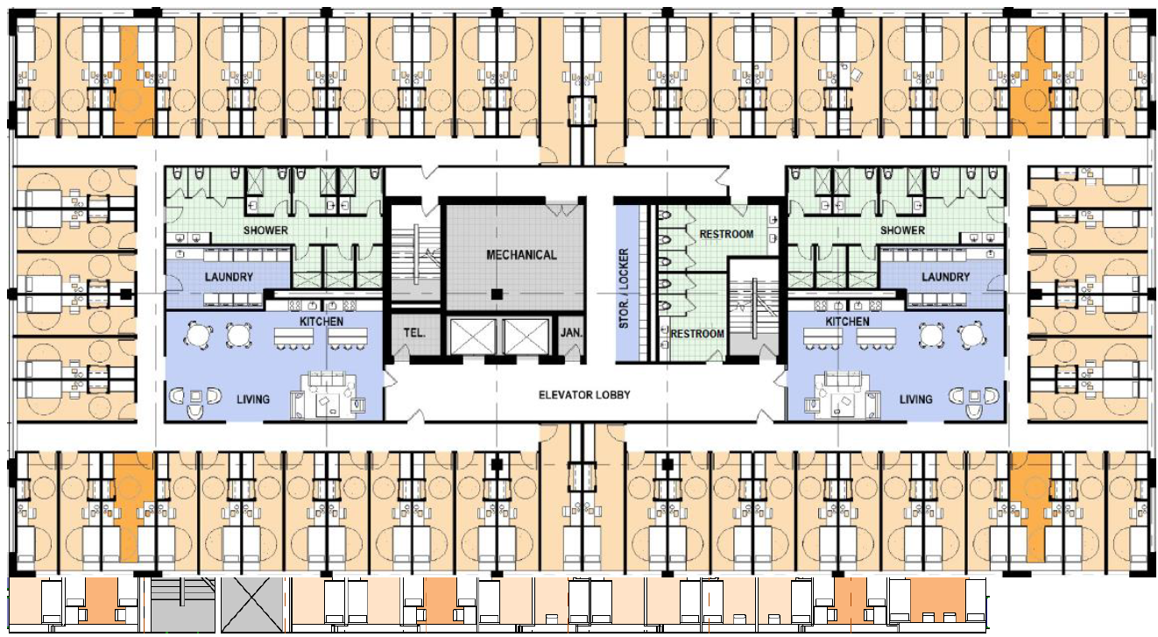
Increase Housing Choices
Take bold but gentle action to create more housing choices for families
Dormitory – Made co-living permissive in R-ML and MX-T (already allowed in R-MH and the other Mixed-use zones)
“Albuquerque and Santa Fe could add hundreds of low-cost homes and curb homelessness with small, dormitory-style microapartments that have shared kitchens, bathrooms, and amenities.
The Pew/Gensler study found that each ‘co-living’ apartment would cost about $130,600 to build in Albuquerque and $184,400 in Santa Fe, well below the roughly $300,000 needed to build a typical studio apartment.”
Pew Charitable Trusts, Co-living and Affordability in ABQ (8/5/2025)

Slide 5
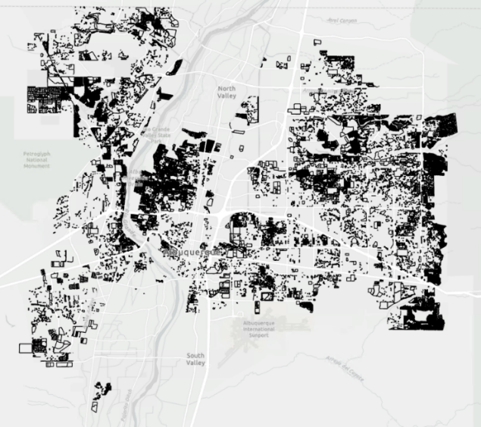

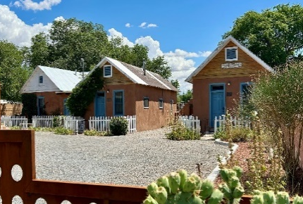
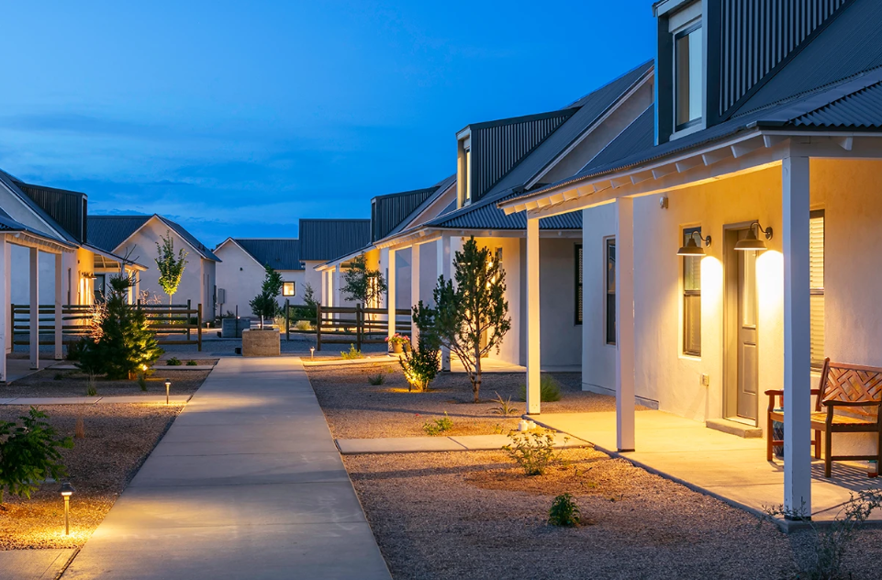
Increase Housing Choices
Take bold but gentle action to create more housing choices for families
Cottage courts – Allowed multiple small single-family or duplexes citywide on lots 10,000+ s.f.
Examples:
Multigenerational family compounds / senior living / intentional communities
Build-to-Rent
Affordable housing
 | Square Feet (s.f.) | Calculation Result
Start with an example lot size total | 10,000
Divide by minimum lot size in the zone district
R-1 | 3,500 | 2.86 | units
Multiply by an assumed s.f. per unit in a typical house | 2,000 | 5,714 | total s.f.
Divide by size limits in the zone district
Minimum size | 650 | 8 | cottage units
Maximum size | 1,200 | 4 | cottage units
10,000+ s.f. lots
1700 Old Town Rd.
Griegos Farms by Rembe Urban Design + Development

Slide 6
factors in development
city regulations
federal regulation + private market
Zoning
Street Tree Ordinance
Traffic Ordinance
Short-term Rental Ordinance
Vacant Premises Ordinance
Interest rates + mortgage rates
Tax structure + incentives
Housing subsidies
Banks + lending practices
Fair Housing Act
Building codes
Developers
Construction workforce
Construction costs
Investor capital
Jobs + wages
Household trends + preferences
city Incentives
Metropolitan Redevelopment Areas + financial tools
Housing subsidies
Economic development financial tools
Repair assistance
Notes:
Parking management strategies?

Slide 7
agreement
Albuquerque is in a housing crisis.
House prices are too high for most families looking to own.
Rents are going up dramatically.
Homelessness is increasing.
Wages are not increasing as fast as housing costs.
The cost of construction materials and labor are limiting the pace of housing construction.
Only the largest-scale multi-family construction and highest-priced housing can pay for themselves without subsidy.
Small projects are getting more creative with funding to make them happen.
The City does not (and maybe can’t) allocate enough $ to subsidize enough affordable housing to meet the need.

Slide 8
The debate
Will zoning changes result in housing construction?
For large-scale projects, can allowing more units help projects “pencil” and cover constructions costs?
Will individual people invest in incremental, missing middle housing?
Is all housing good housing?
Would housing get built if the City required some units to be affordable (inclusionary zoning)?
Would too much housing lead to gentrification in communities of color?
Would the City be ready with tools / strategies to intervene, if so?
Will Albuquerque still be Albuquerque if more housing gets built?
Will Albuquerque have a future if we continue with the status quo?
What are we “ready” for?

Slide 9
Next Steps
Housing
Health, Housing, and Homelessness
Metropolitan Redevelopment Agency
Senior
Affairs
Planning Department
Economic Development

Slide 10

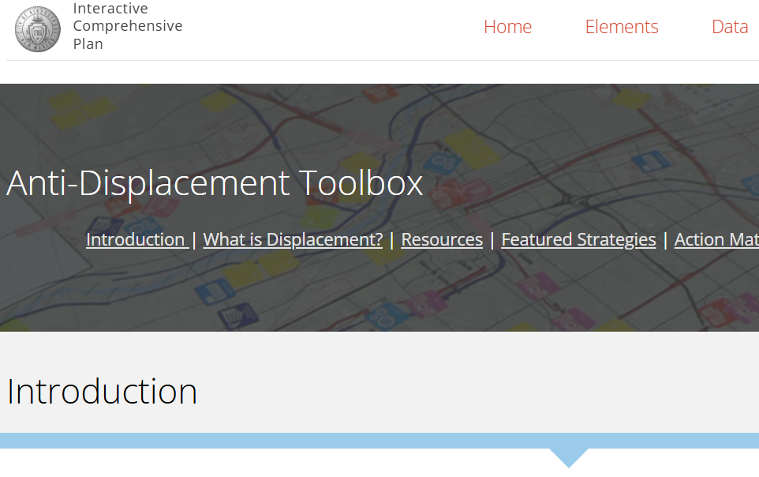
Next Steps
Anti-displacement Toolbox
Existing resources that may be helpful for residents and businesses.
Featured strategies that other cities have put in place that can inform our efforts.
Actions that the City can take to help residents and businesses thrive in their communities.
https://tinyurl.com/CABQ-Anti-Displacement

Slide 11
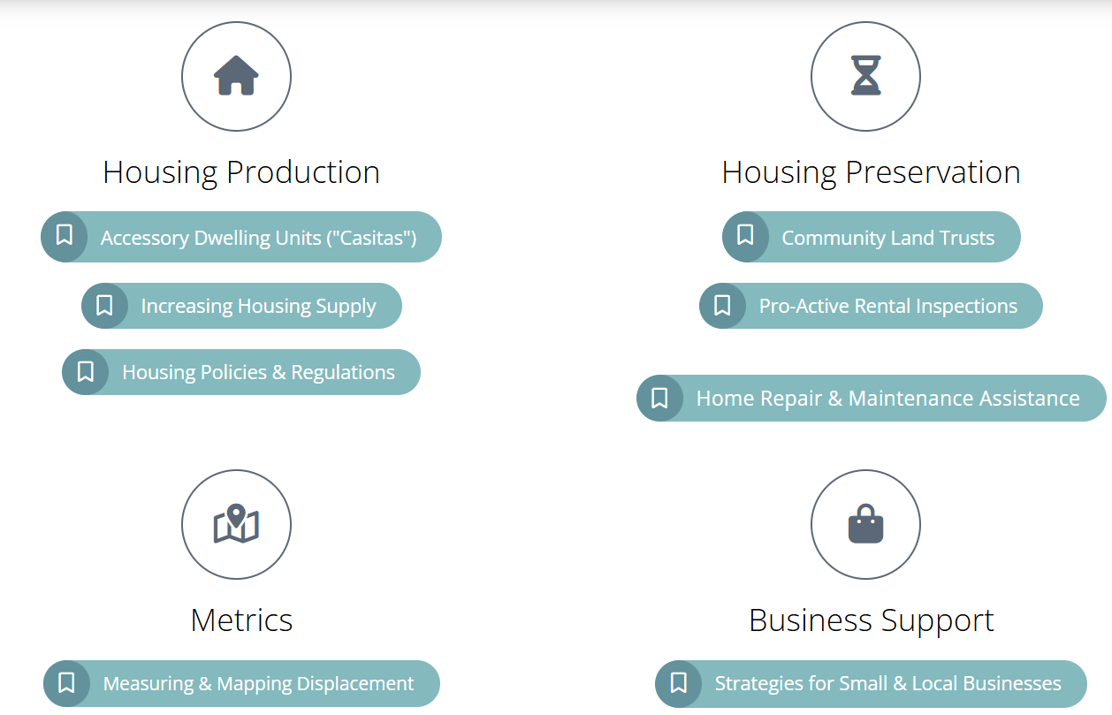
Next Steps
What else?
https://tinyurl.com/CABQ-Anti-Displacement

Slide 12


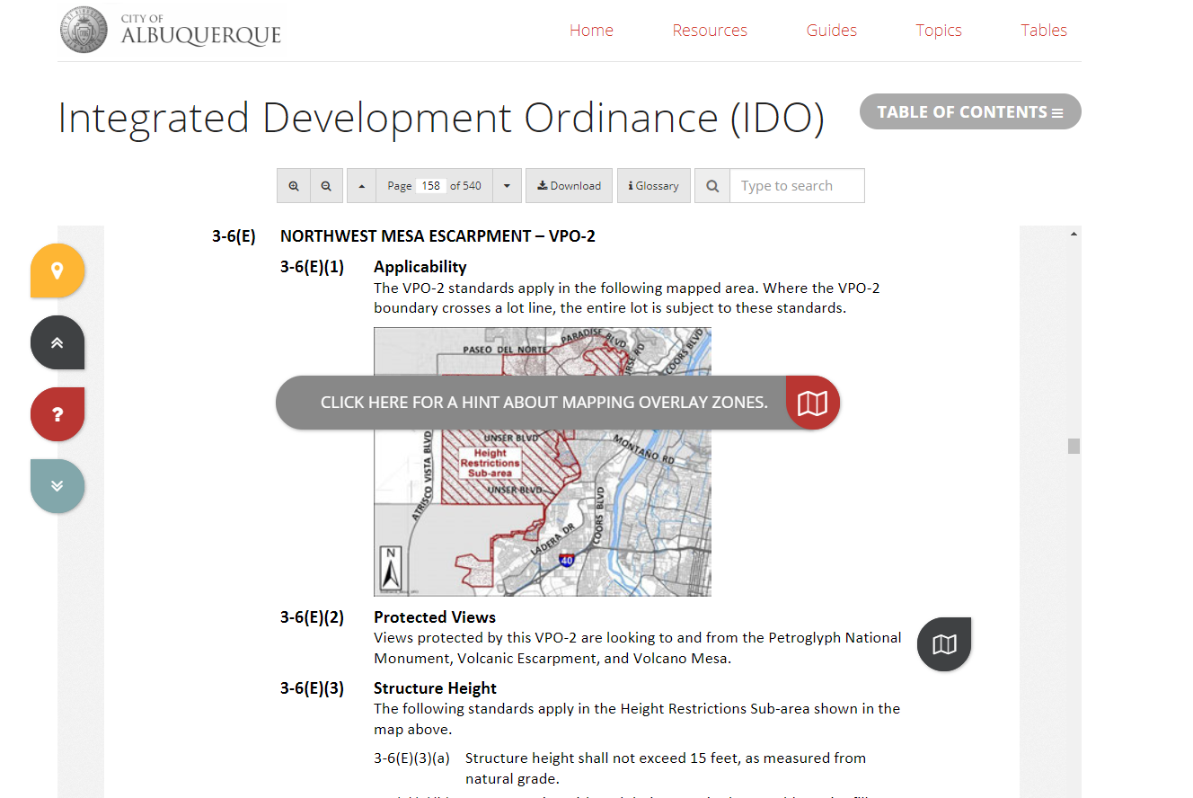
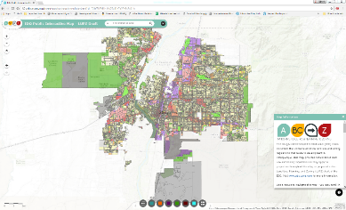

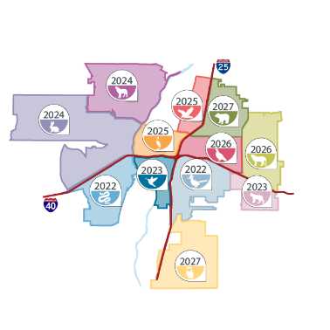

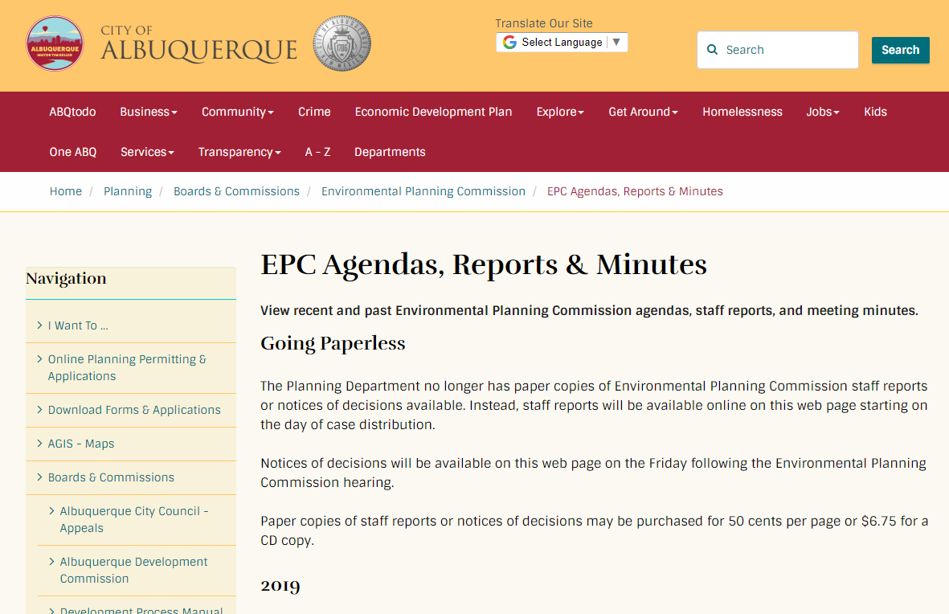
Interactive IDO
IDO Zoning Map
ABC-Z Project
abctoz@cabq.gov
ido.abq-zone.com
tinyurl.com/idozoningmap
thank you
Comp Plan
Community Planning Areas
Mikaela Renz-Whitmore
Urban Design + Dev. Division Manager
mrenz@cabq.gov
Kate Clark
Regulatory Planning Team Lead
kclark@cabq.gov
Jessica Sapunar-Jursich
Mid Range Planning Team Lead
jessica@cabq.gov
compplan.abq-zone.com
cpa.abq-zone.com
Planning Webpage
cabq.gov/planning

