Slide 1
Rocky Mountain Land Use Institute Conference
March 2025
Don still deciding on pictures
Improving Equity While we
Expand and Preserve Housing

Slide 2
Why This Session ?
Because
Don will complete this slide

Slide 3
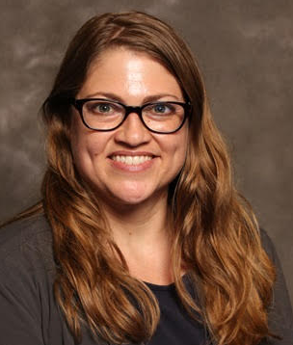
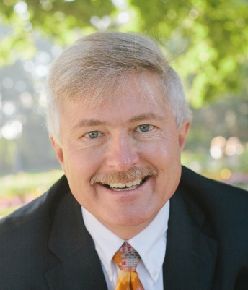
Today’s Panelists
Paul Donegan, AICP
Xx
Yy
Mikaela Renz-Whitmore, AICP
Division Manager, Urban Design & Development, City of Albuquerque Planning Department
Planner drafting development code and managing Boards/Commissions
Elizabeth Weigle
Xx
Yy
Don Elliott, Esq. FAICP
Senior Consultant, Clarion Associates, Denver
Planner/lawyer drafting development codes
Please add one or two bullets about yourself and upload a picture

Slide 4
[Paul’s Slides]
AAA
BB
CC
Best to keep this under 20 slides – copy and paste this template slide as necessary
Please use 20 point font or larger

Slide 5
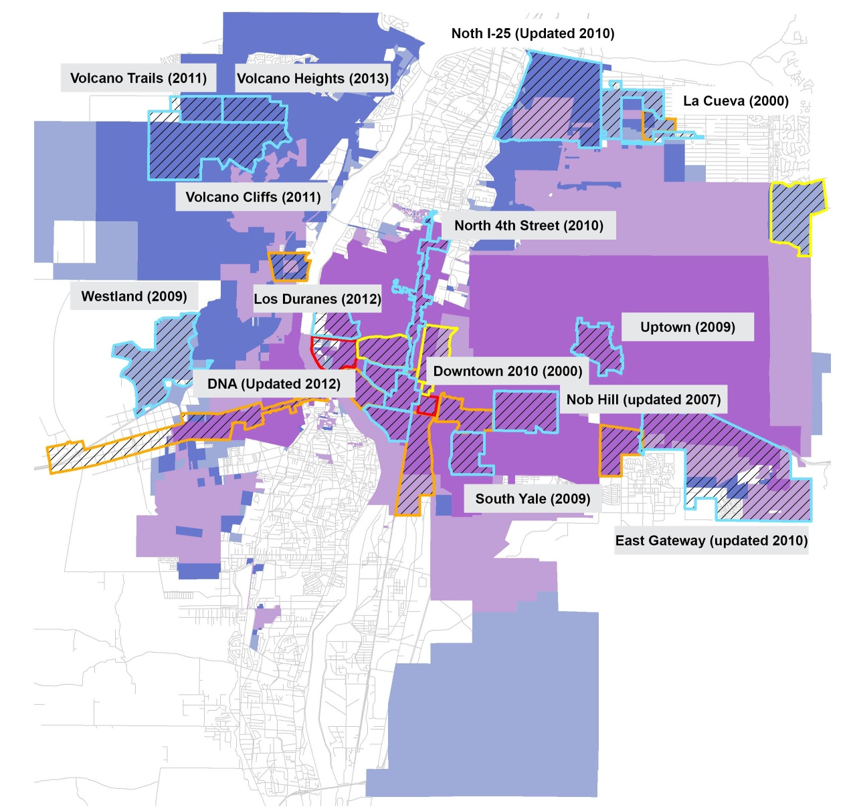
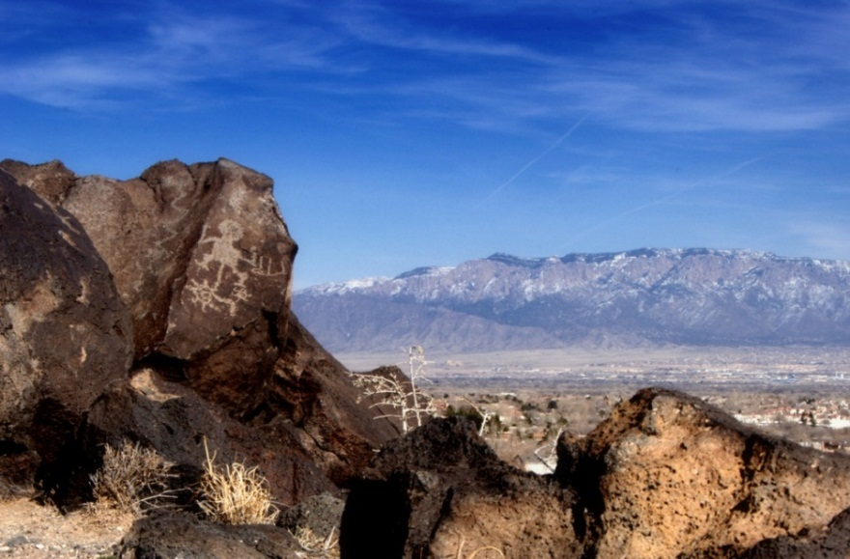
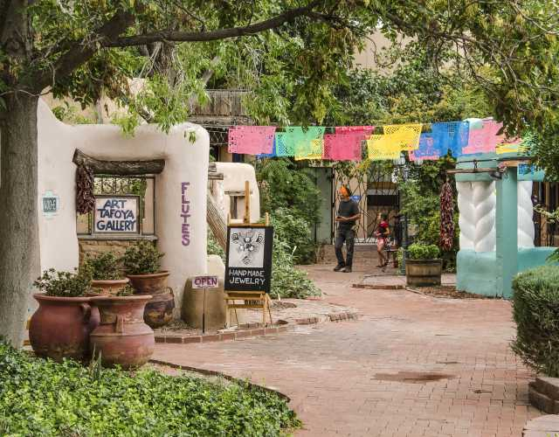
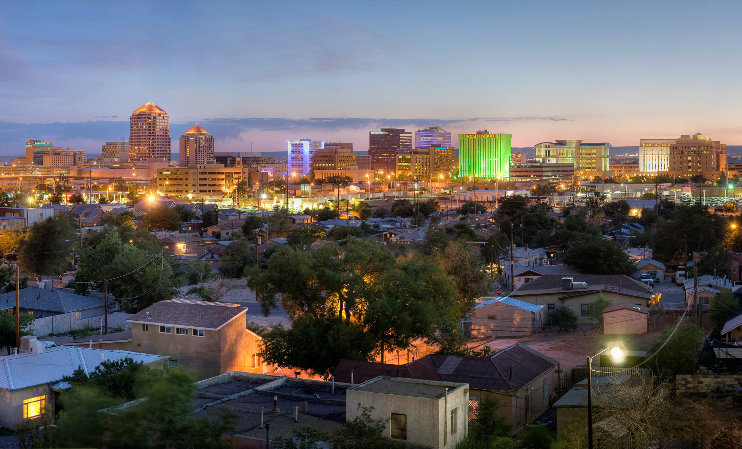
City of Albuquerque
300+ years as a city
Multicultural history
Native American
Hispanic
Anglo
Rural & urban lifestyles
“Small town” with city issues
1989 City Limits
1979 City Limits
1959 City Limits
1970s SDPs
1980s SDPs
1990s SDPs
1999 City Limits
2000s SDPs

Slide 6
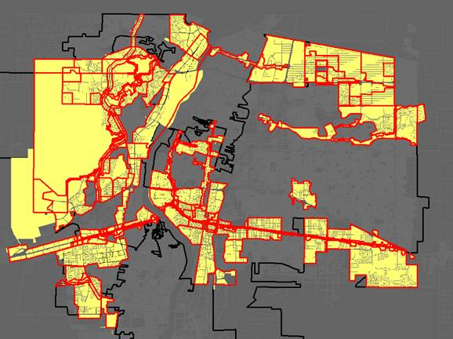
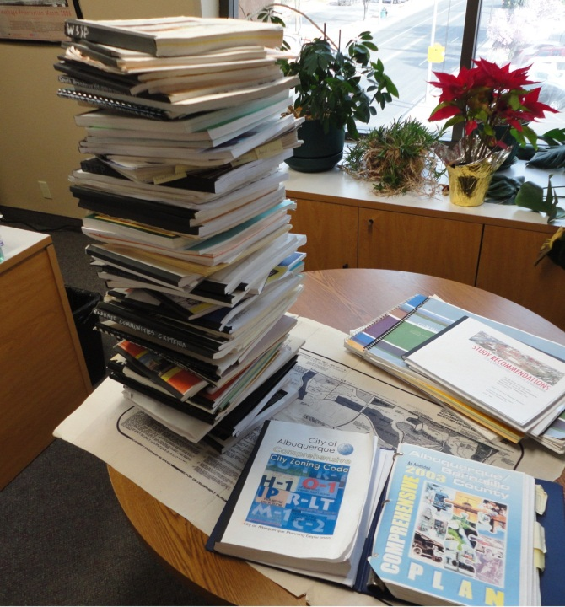
City of Albuquerque
Previous System
One-off protections
Hard to administer consistently
60+ Sector Plans
(1978-2014)
> 400
SU-2/SU-3
zones
5 Design Overlay Zones
Subdivision Ordinance
6 Historic Overlay Zones
> 770
SU-1
zones
Zoning Code

Slide 7
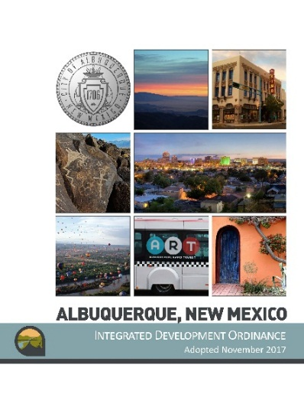
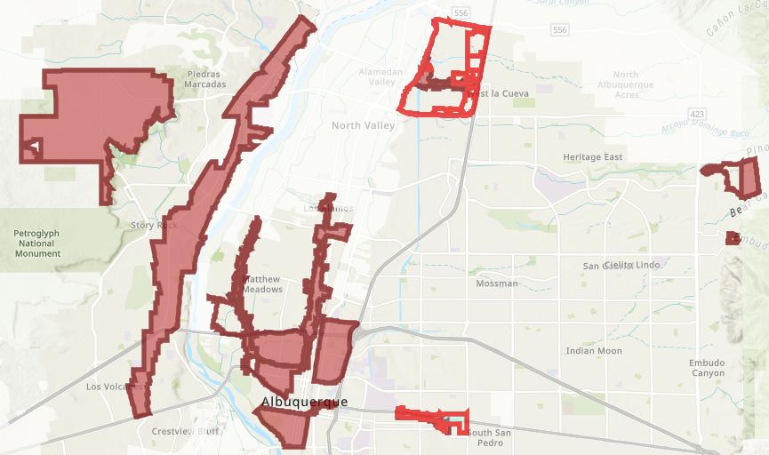
City of Albuquerque
Integrated Development Ordinance (2018)
13 Character Protection Overlay zones
Standards for building height, setbacks, etc. (not uses)
Reviewed administratively
Requested by petition
abq-zone.com
tinyurl.com/idozoningmap

Slide 8
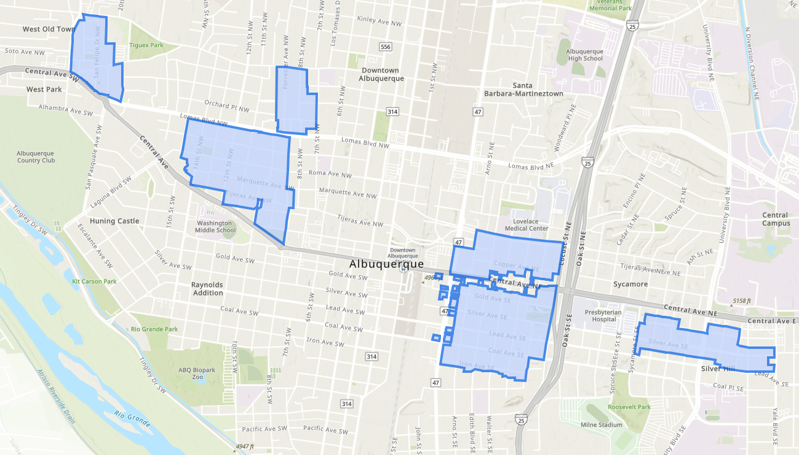
City of Albuquerque
New system: Integrated Development Ordinance (2018)
7 Historic Protection Overlay zones
Standards for materials, styles, setbacks (not uses)
Reviewed by Landmarks Commission
abq-zone.com
tinyurl.com/idozoningmap

Slide 9
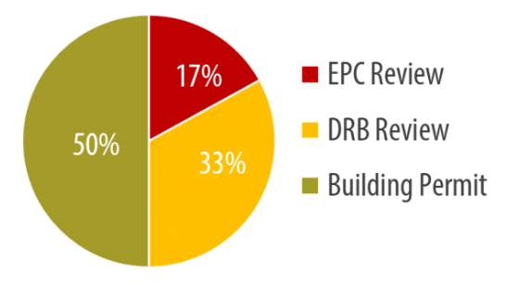
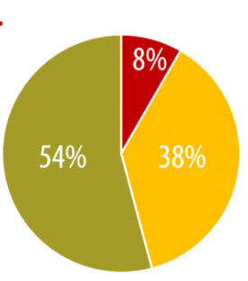
City of Albuquerque
Integrated Development Ordinance (2018)
Moved more decisions to staff/ administrative review
Moved many uses from conditional (mitigations for harm added only if contested by neighbors) to permissive with use-specific standards
Fewer hearings
More notice
Emails to Neighborhood Associations
Signs on the property during review/appeal period
Old System
Planning Commission
Staff Review Board
Administrative
New System
Planning Commission
Staff Review Board
Administrative

Slide 10
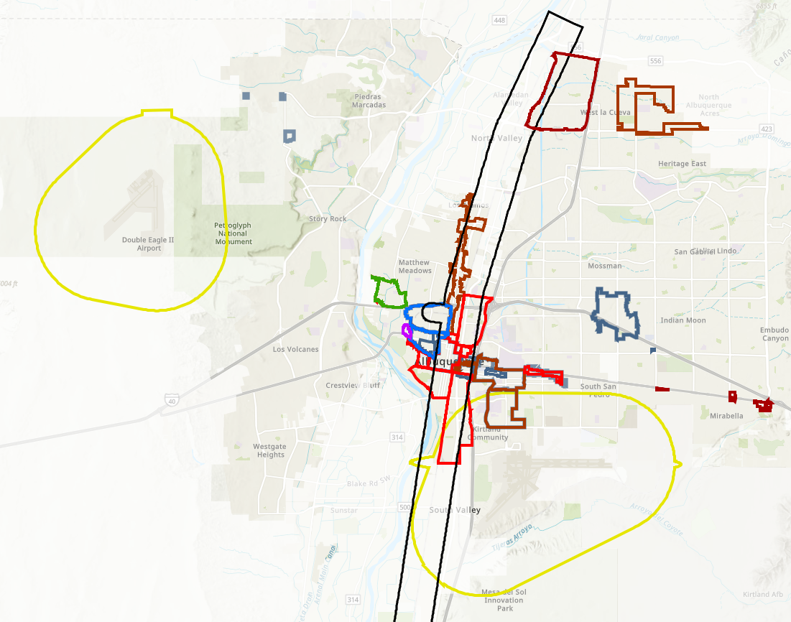
City of Albuquerque
Integrated Development Ordinance (2018)
Use-specific standards
Predictable mitigations for harm
Distance separations from residential uses
Distance separations between locally unwanted land uses (LULUs)
Some small area prohibitions

Slide 11
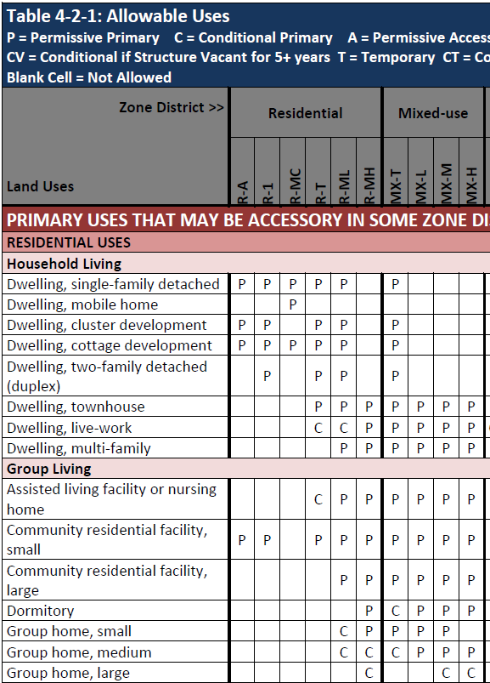
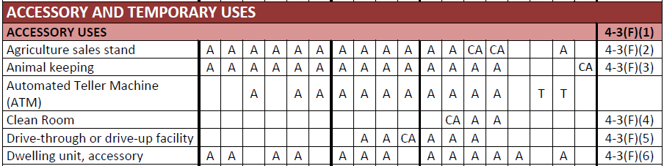
City of Albuquerque
Integrated Development Ordinance (2018-2023)
Housing Types
Duplexes
Townhouses
Live-work
Multi-family
Cottage development
Dormitory
Accessory Dwelling Units
Safe Outdoor Spaces

Slide 12
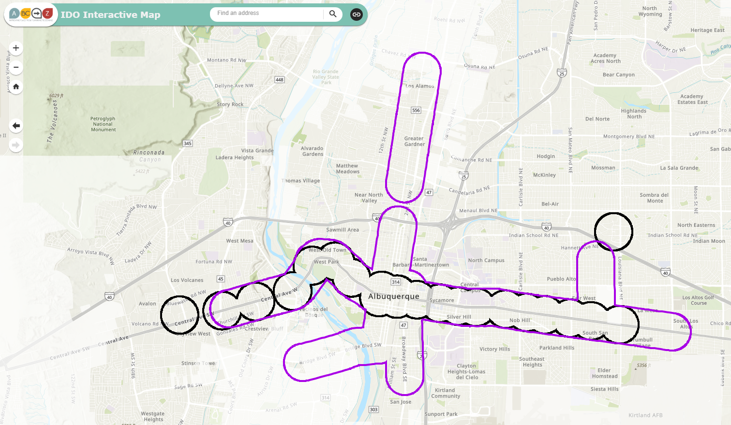
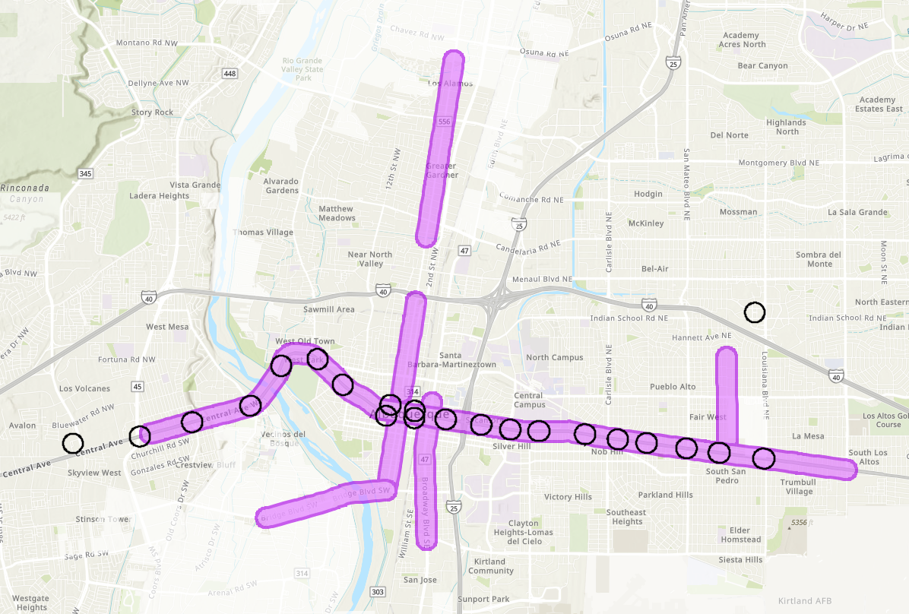
City of Albuquerque
Integrated Development Ordinance (2024)
Additional housing options where you want density
Table 4-2-1: Allowable Uses P = Permissive Blank Cell = Not Allowed
Zone District >> Land Uses | Residential |  |  |  |  |  | Mixed-use |  |  |  | Use-specific Standards
 | R-A | R-1 | R-MC | R-T | R-ML | R-MH | MX-T | MX-L | MX-M | MX-H
PRIMARY USES
RESIDENTIAL USES
Household Living
Dwelling, two-family detached (duplex) | [P] | P | [P] | P | P |  | P |  |  |  | 4-3(B)(5)
Dwelling, townhouse | [P] | [P] | [P] | P | P | P | P | P | P | P | 4-3(B)(6)
Dwelling, multi-family | [P] | [P] | [P] | [P] | P | P | P | P | P | P | 4-3(B)(8)
Within ¼ mile of Main Streets (per Comp Plan)
Within ¼ mile of Premium Transit stations

Slide 13
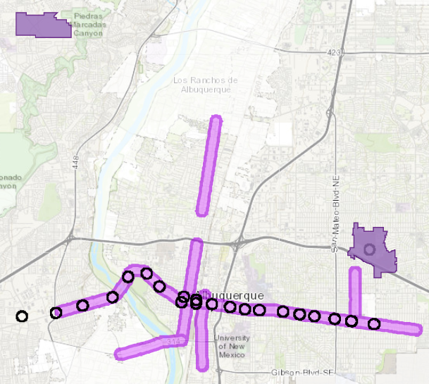
City of Albuquerque
Integrated Development Ordinance (2018-2023)
Additional density where you want it
Additional building height by right
Bonus height for structured parking
Bonus height for workforce housing
Lower parking requirements
Parking reductions for proximity to:
Transit
Parks
Trails
UC = Urban Center
MS = 660 feet from Main Street
PT = 660 feet from Premium Transit station

Slide 14
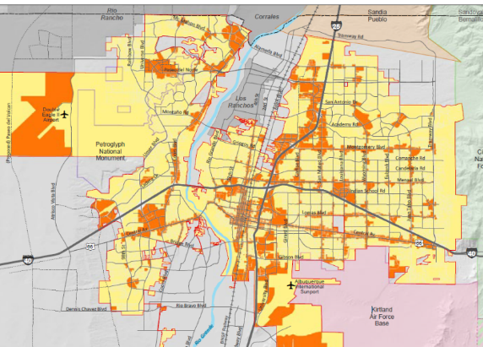

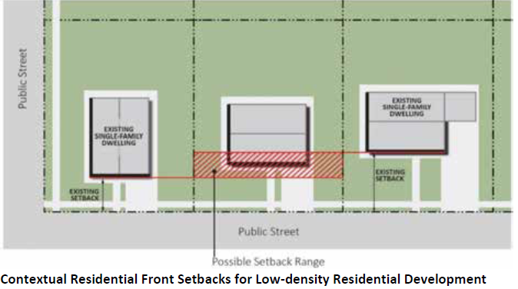
City of Albuquerque
Integrated Development Ordinance (2018-2022)
Contextual Standards – Areas of Consistency
Lot sizes
Within ¼ mile of Center/Corridor: Between 50%-125% of the size of lots on same block
Citywide: Between 75% - 125% of size of lots on same block
Front / Side Setbacks
Between setbacks of adjacent homes

Slide 15
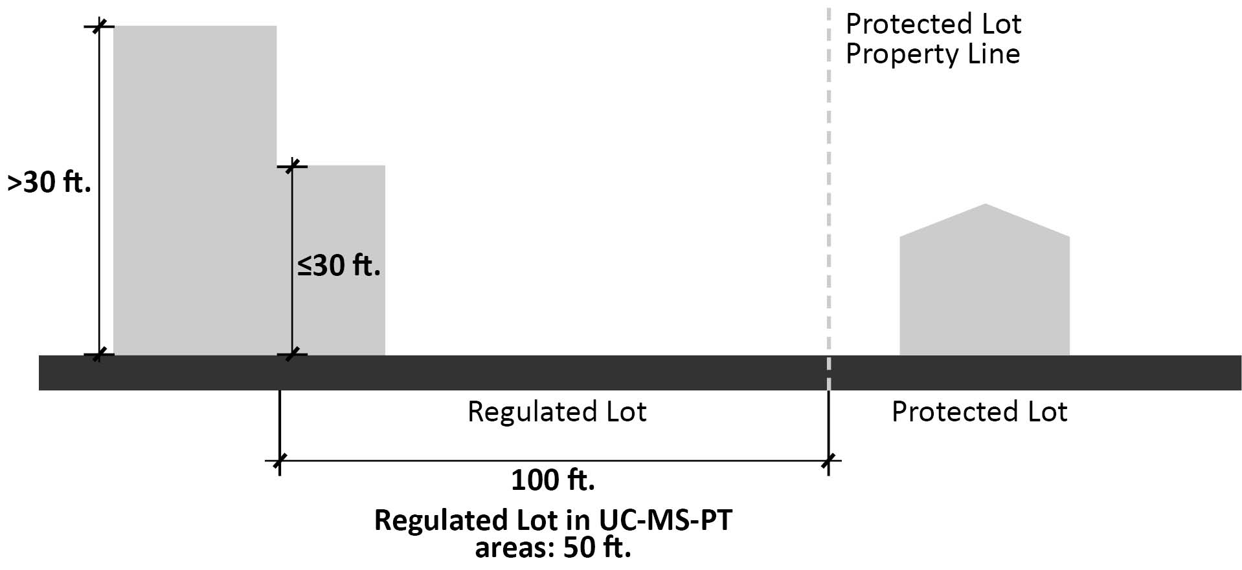
City of Albuquerque
Integrated Development Ordinance (2018)
Neighborhood Edge: Building height stepdown
Protected lot = Low-density residential in Residential zone district
Regulated lot = Adjacent development

Slide 16
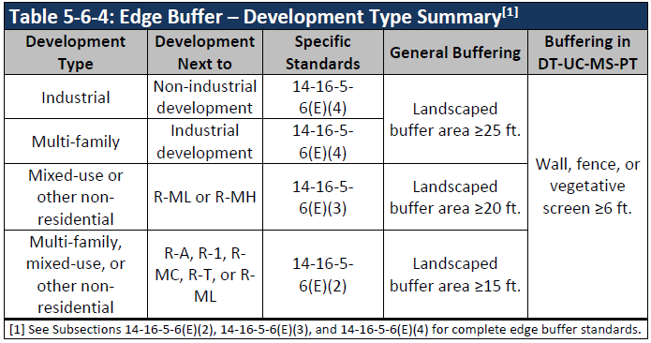
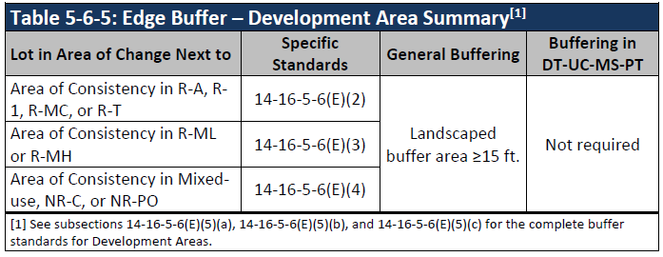
City of Albuquerque
Integrated Development Ordinance (2018)
Development Standards
Edge Buffer: Landscaped areas
Between Areas of Change / Areas of Consistency
Between Industrial / Non-industrial

Slide 17
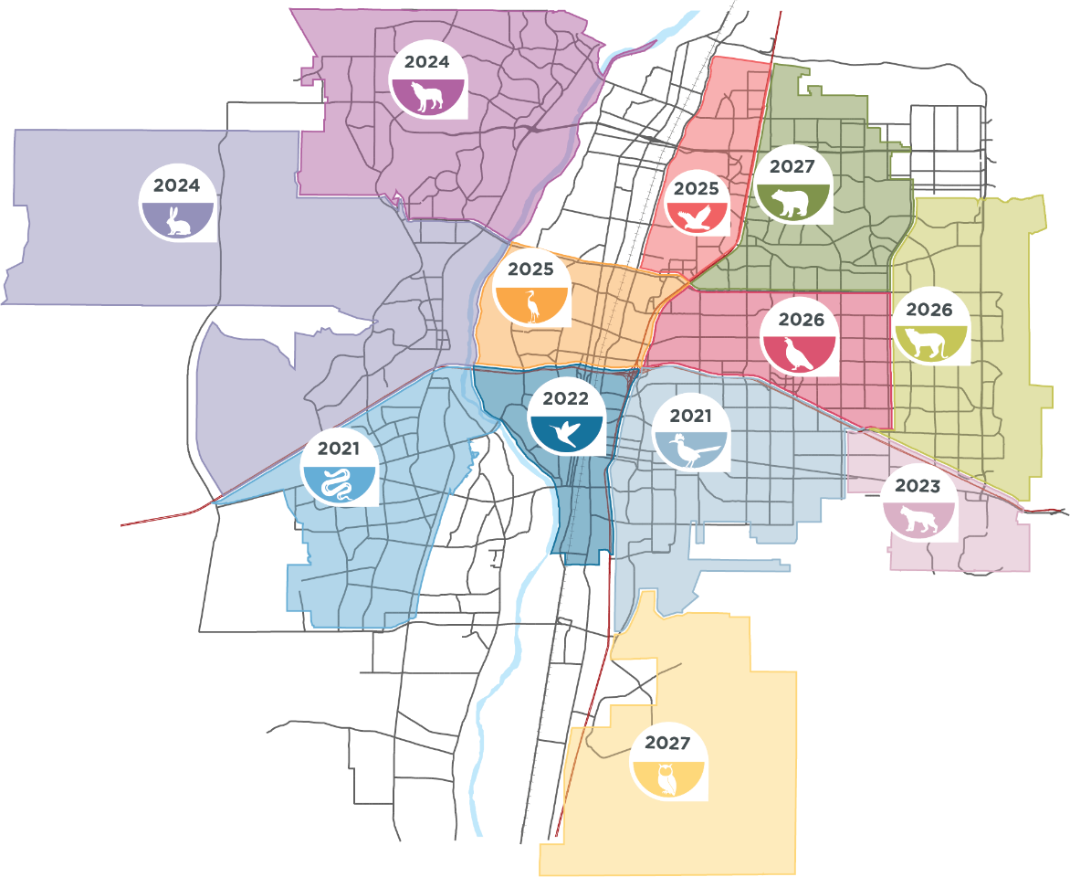
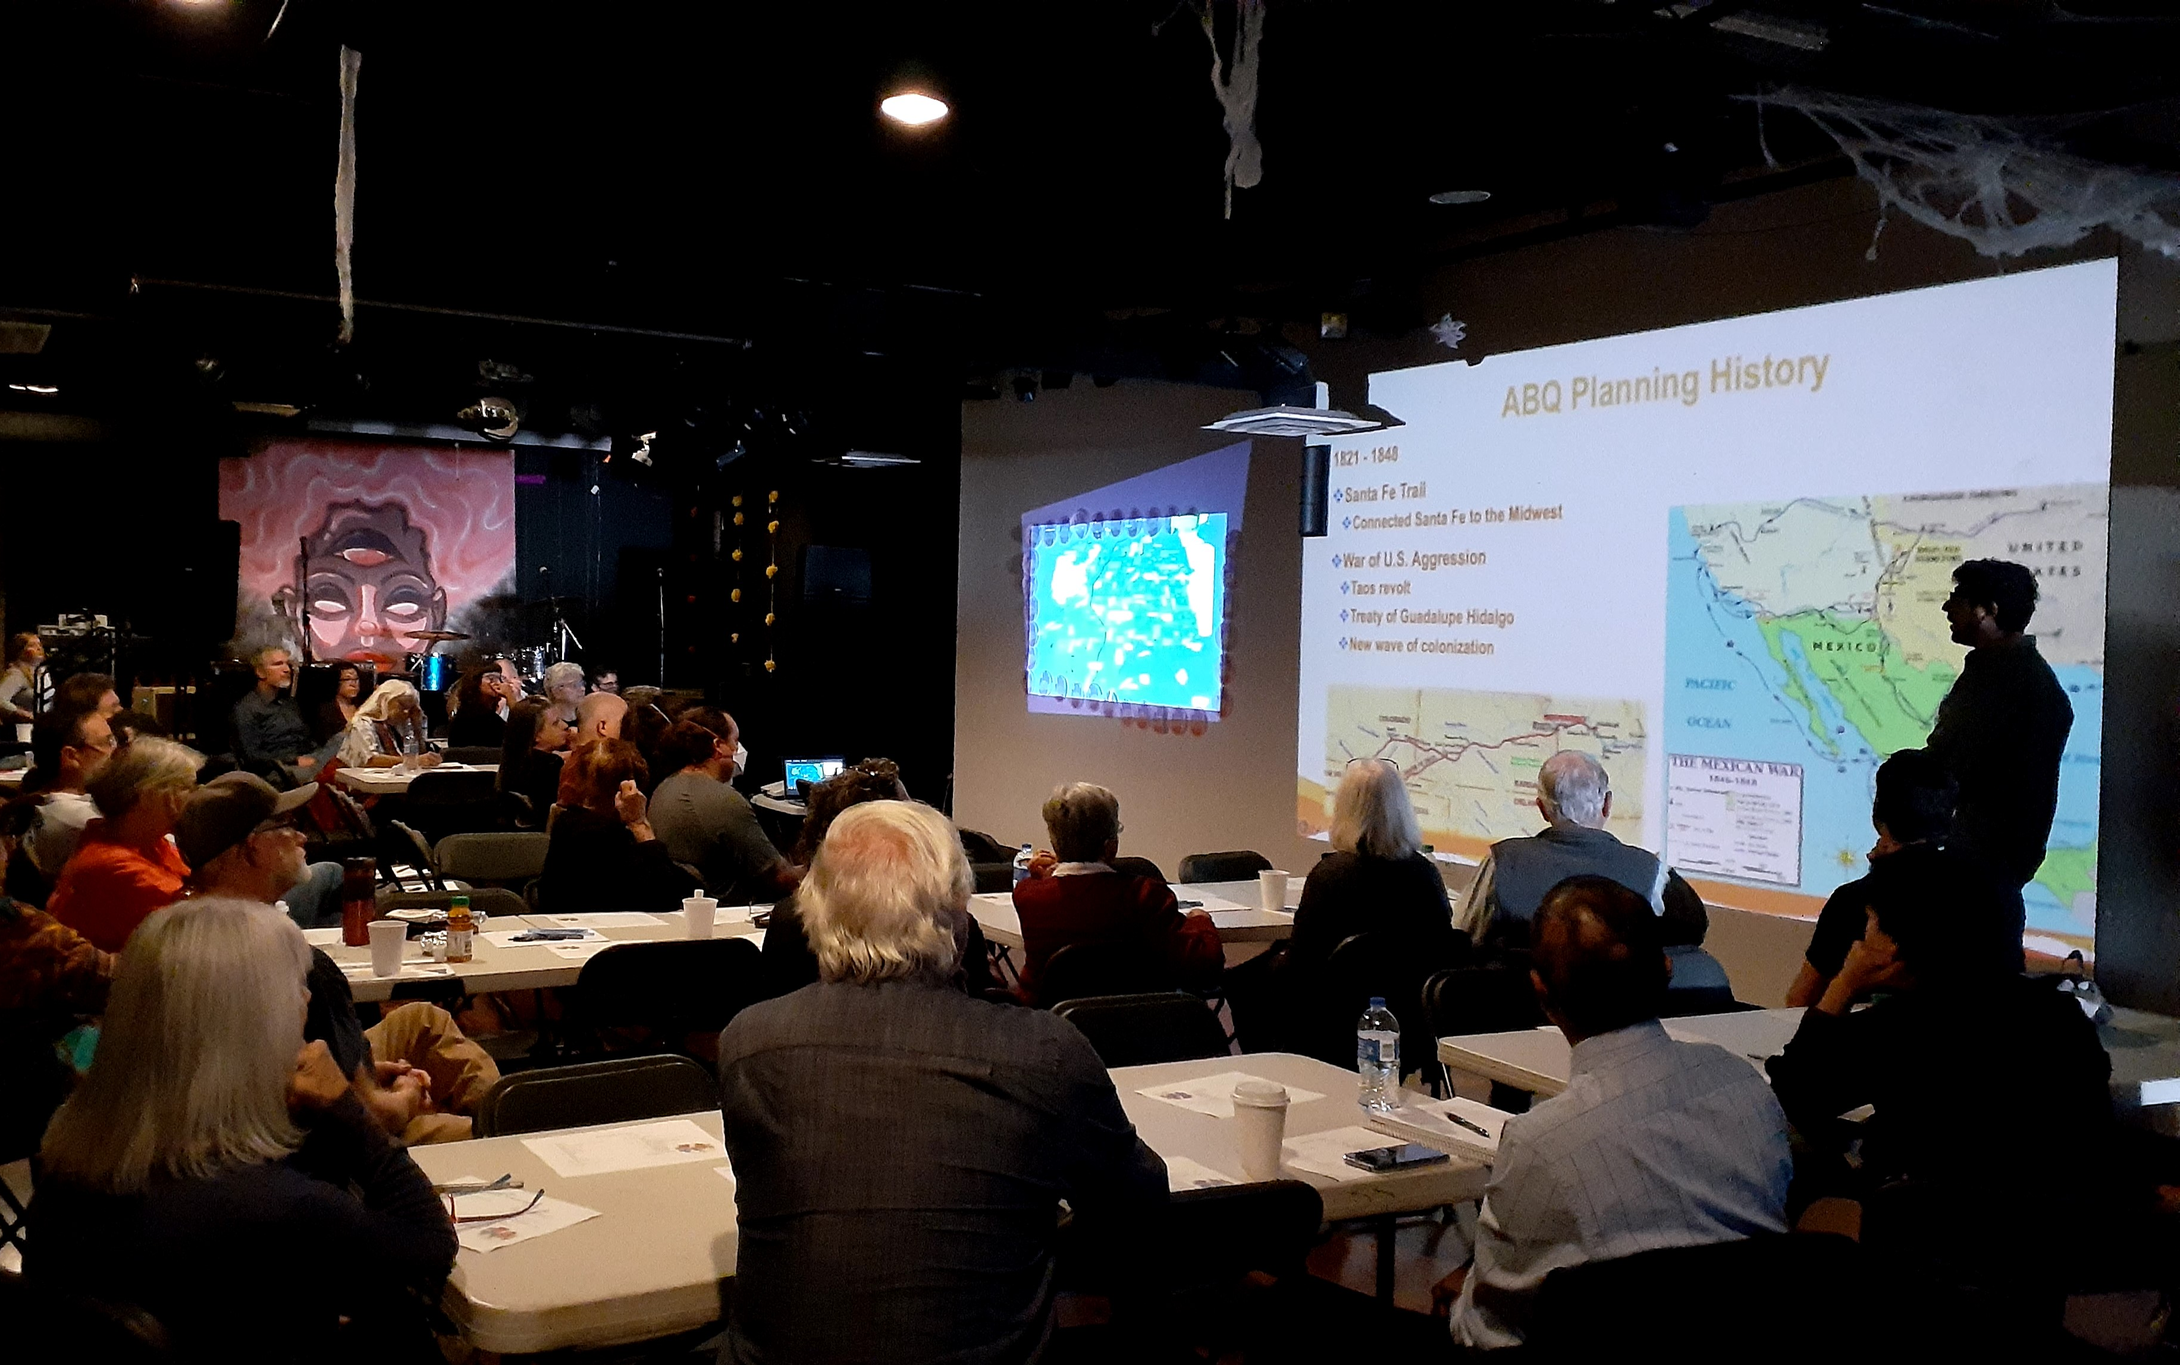
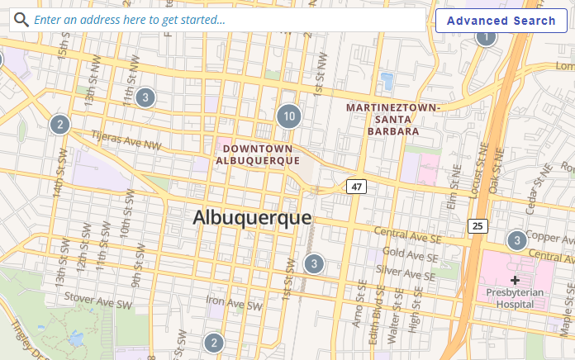
City of Albuquerque
Beyond zoning… building community capacity
Community Planning Area
Assessments
City Leaders
Workshops
InfoConnect
Map of Cases under Review

Slide 18
[Elizabeth’s Slides]
AAA
BB
CC
Best to keep this under 20 slides – copy and paste this template slide as necessary
Please use 20 point font or larger

Slide 19
[Don’s Slides]
AAA
BB
CC
Best to keep this under 20 slides – copy and paste this template slide as necessary
Please use 20 point font or larger

Slide 20
Questions and Discussions
Paul Donegan, AICP.
Mikaela Renz-Whitmore, AICP
Elizabeth Weigle
Don Elliott, Esq., FAICP
delliott@clarionassociates.com
Please add your contact information

