Slide 1
WELCOME
ANNUAL EPC TRAINING
April 23, 2026

Slide 2
Introductions
Who are you
and
what is your background?
Notes:
MEGAN

Slide 3
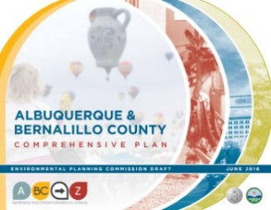

CABQ Planning
Albuquerque
Bernalillo County
County
Comprehensive Plan
Integrated
Development
Ordinance
https://compplan.abq-zone.com
https://ido.abq-zone.com
Urban Design + Development
Spring 2026
Mikaela Renz-Whitmore
UDD Division Manager
mrenz@cabq.gov

Slide 4
Planning Department
5 Divisions of the Planning Department
Planning*
A
Administration
B
Building Safety
C
Code Enforcement
D
Development Review Services
* Urban Design + Development
Notes:
Not for students – use for neighbor groups if needed

Slide 5
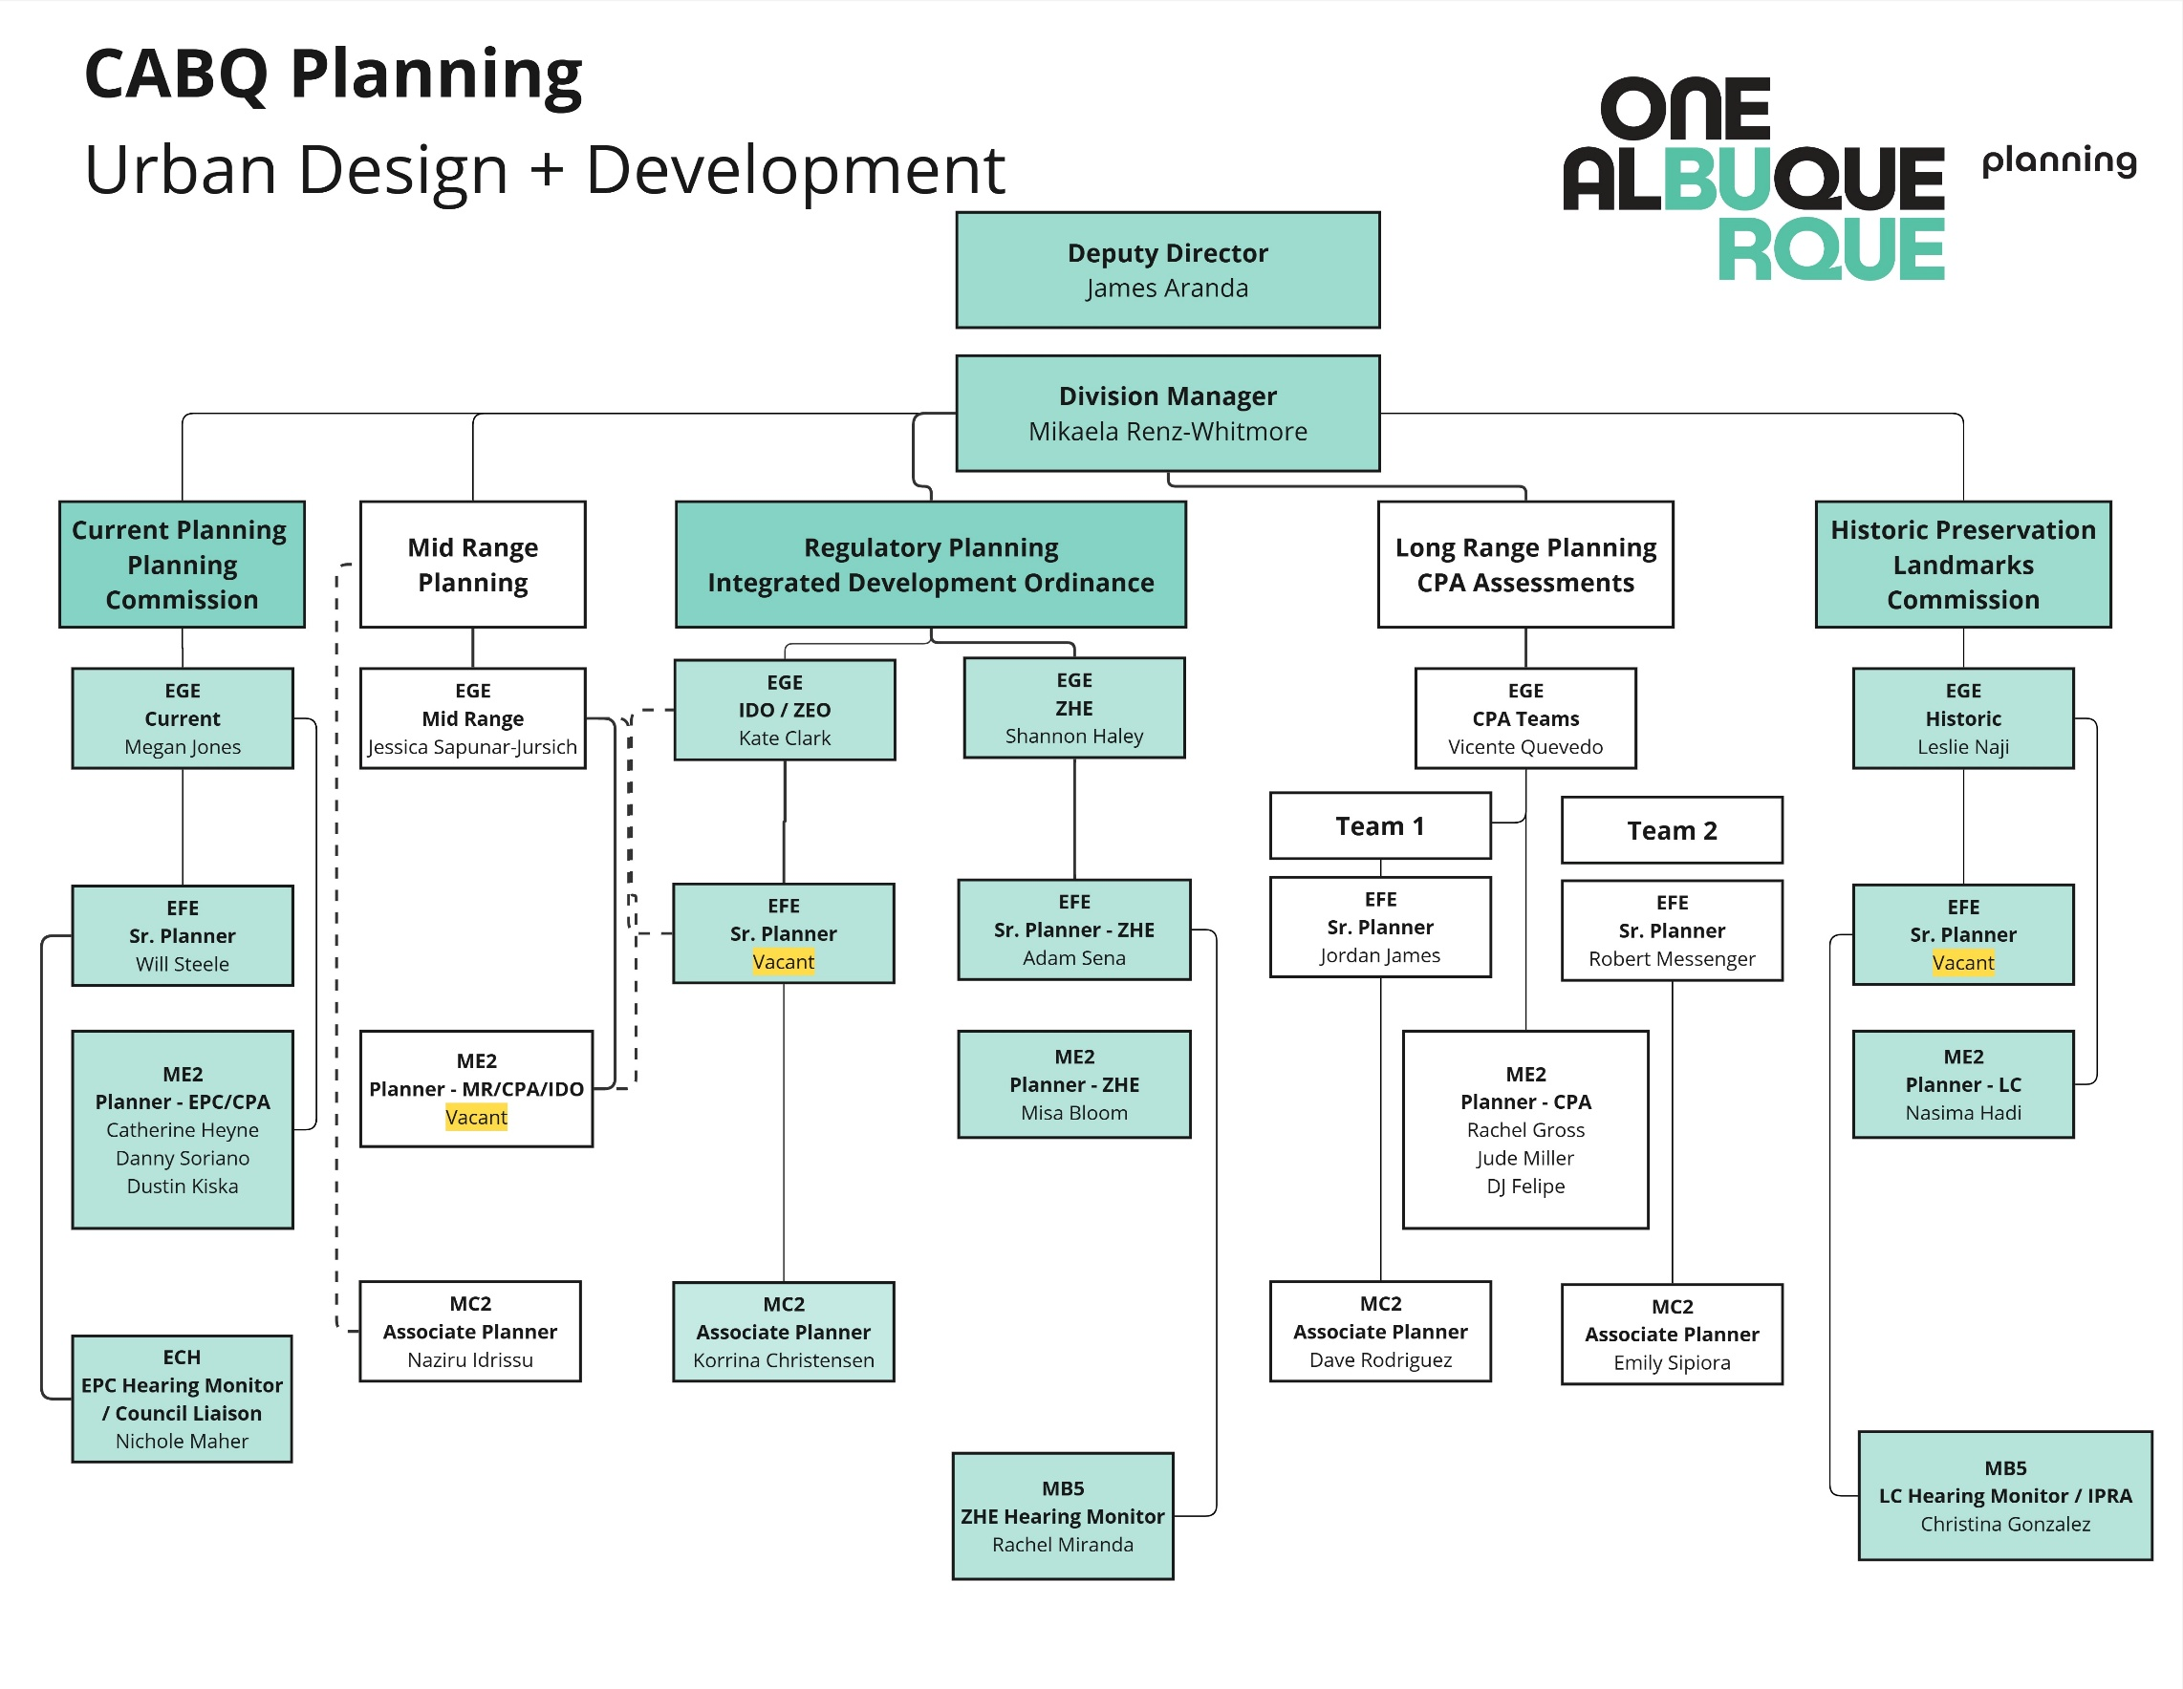
Org Chart

Slide 6
EPC Commissioner ROLE & responsibilities

Slide 7
WHY DID YOU VOLUNTEER TO BE A COMMISSIONER?
Notes:
JAMES

Slide 8
EPC plays an influential advisory role in the City’s planning processes.
Important Roles of EPC:
Acting in the public interest and maintaining public oversight of government planning powers
Providing a public forum for debate about the future of our community
Making decisions that shape the fabric of Albuquerque over time
EPC Commissioners are leaders in the process of establishing and implementing a vision for Albuquerque's future!
Notes:
JAMES

Slide 9
Key EPC Responsibilities per IDO § 14-16-6-4(E):
Make recommendations or decisions on EPC application in Table 6-1-1.
Review and decide Extraordinary Facilities in City Parks and Open Space
Make recommendations for programming of capital improvements for the City
Review any recommendations, concerns, or comments provided by commenting agencies, departments, stakeholders, and the public prior to final decisions.
Study urban and regional planning and means of protecting and improving the environment and promote the understanding of planning and environmental matters among public officials and residents of the city.
Advise the Mayor, City Council, and City staff concerning the development and revision of community goals, Community Planning Area assessments, plans for urban development and protection of the environment, policies on development and protection of the environment, ordinances appropriate for affecting such plans and policies, and annexations to the City.
Notes:
COON/MYERS

Slide 10
Planning Staff & EPC Relationship
Ordinance § 14-13-3-4 STAFF
Staff is here to support the commission & fill in the blanks
Staff conducts the analysis and writes the findings of fact for the commission to review prior to the hearing
Ask us questions and ask for help when needed

Slide 11
EPC Rules
Notes:
COON/MYERS

Slide 12
Quasi-Judicial Decisions vs. Legislative Decisions
EPC recommendations / Council decisions
EPC decisions
Ex-Parte Communication
Attendance – Quorum & Zoom
Notes:
COON, MYERS, NICHOLE

Slide 13
Zoning Regulations and Practice
Notes:
MIKAELA

Slide 14

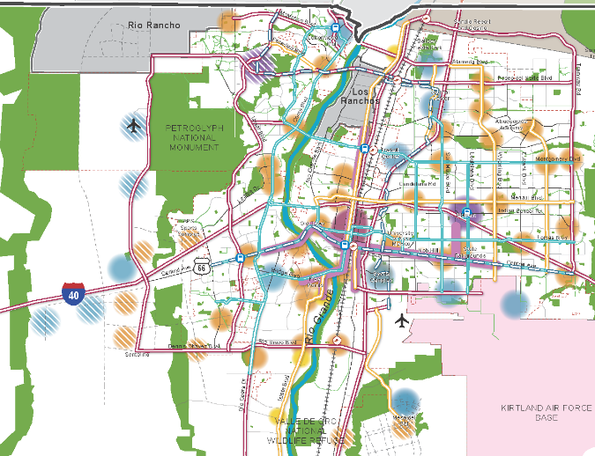
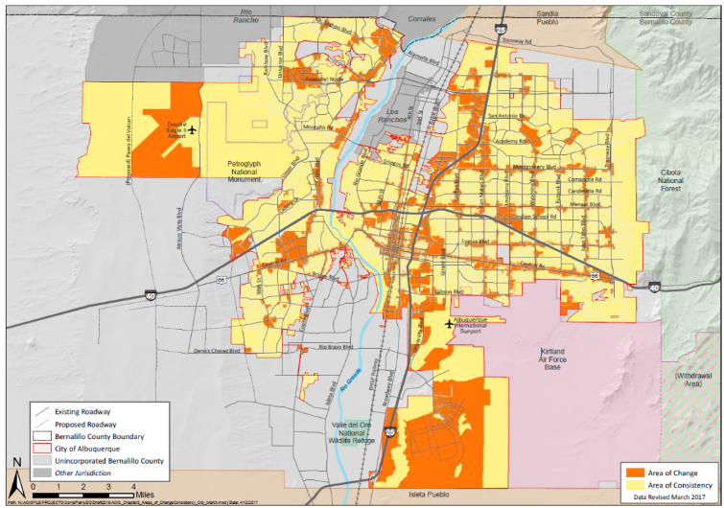
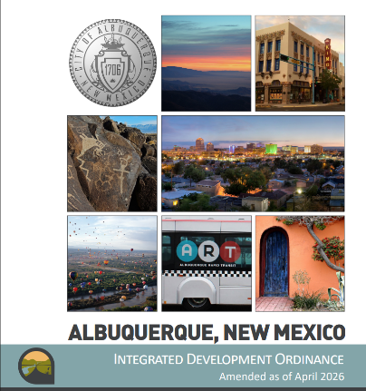
Planning + Zoning
ABC Comprehensive Plan
Integrated development ordinance
What we want + why:
Where to direct growth
What to protect
What actions to take
How to measure progress
How to get there:
Tailored rules
Centers + Corridors
Areas of Consistency
Overlay Zones
Special places
Transitions / Edge Protections
Between Areas of Change + Consistency
Next to neighborhoods
Policies
Vision
Centers
&
Corridors
Areas of Change
&
Consistency
Regulations
compplan.abc-zone.com
https://ido.abq-zone.com
Notes:
The WHY and the HOW

Slide 15

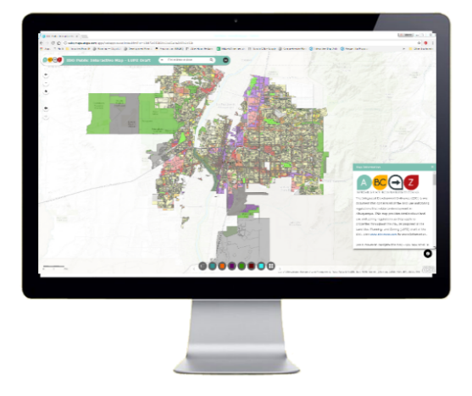

Zoning Code
Integrated
Development
Ordinance
1. General Provisions
Zone Districts
Overlay Zones
4. Use Regulations
Allowable Use Table
Use-specific Standards
Development Standards
Dimensional Standards Tables
General Regulations
6. Administration & Enforcement
7. Definitions & Acronyms
https://abq-zone.com
IDO Zoning Map
Uses
Zones
Standards
Processes
https://tinyurl.com/IDOzoningmap

Slide 16

Hierarchy of rules
In the order applied
Overlay Zones
Character, Historic, View Protections
Context
Incentives
Zoning
Residential
Mixed-use
Non-residential
Edge buffers
Centers & Corridors
Small-area & Area of Consistency rules
Distance separations
Proximity to residential
Planned Development
Development types
Uses
Building design standards
Edge buffers
https://abq-zone.com
IDO Zoning Map
https://tinyurl.com/IDOzoningmap
Notes:
Improved description of how rules are applied in Part 1. (Section 14-16-1-8)
Any update to improve quality standard citywide WON’T apply to tailored standard. (Sometimes that’s good, sometimes that’s not. Need to review carefully!)
Tradeoff is additional complexity for extra protections.
Zoning is not easy, but it IS more predictable now under the IDO.

Slide 17
Table 4-2-1
Table 4-2-1: Allowable Uses P = Permissive Primary C = Conditional Primary A = Permissive Accessory CA = Conditional Accessory CV = Conditional if Structure Vacant for 5+ years T = Temporary CT = Conditional Temporary Blank Cell = Not Allowed
Zone District >> Land Uses | Residential |  |  |  |  |  | Mixed-use |  |  |  | Non-residential |  |  |  |  |  |  | Use-specific Standards | Use-specific Standards
 | R-A | R-1 | R-MC | R-T | R-ML | R-MH | MX-T | MX-L | MX-M | MX-H | NR-C | NR-BP | NR-LM | NR-GM | NR-PO
 |  |  |  |  |  |  |  |  |  |  |  |  |  |  | A | B | C
PRIMARY USES THAT MAY BE ACCESSORY IN SOME ZONE DISTRICTS
RESIDENTIAL USES
Household Living
Group Living
CIVIC AND INSTITUTIONAL USES
COMMERCIAL USES
Agriculture and Animal-related
Food, Beverage, and Indoor Entertainment
Lodging
Motor Vehicle-related
Offices and Services
Outdoor Recreation and Entertainment
Retail Sales
Transportation
INDUSTRIAL USES
Manufacturing, Fabrication, and Assembly
Telecommunications, Towers, and Utilities
ACCESSORY AND TEMPORARY USES
ACCESSORY USES |  |  |  |  |  |  |  |  |  |  |  |  |  |  |  |  |  | 4-3(F)(1)
TEMPORARY USES
Temporary Uses That Require A Permit
Temporary Uses That Do Not Require A Permit
IDO Part 4
Allowable Uses
Use-
specific
Standards
Distance Separations
From Residential Uses: Liquor retail, Heavy Manufacturing, etc.
From Open Space: Car wash, Gas stations, Manufacturing, etc.
Between uses: Group Homes, Pawn Shops, Bail Bonds, etc.
Notes:
Between uses: Group Homes, Pawn Shops, Bail Bonds, Payday Loans, etc.
From Residential Uses: Retail Liquor, Heavy/Special Manufacturing, Auto repair, etc.
Zone changes: Looking at whether USS are enough to protect nearby development from expected impacts

Slide 18


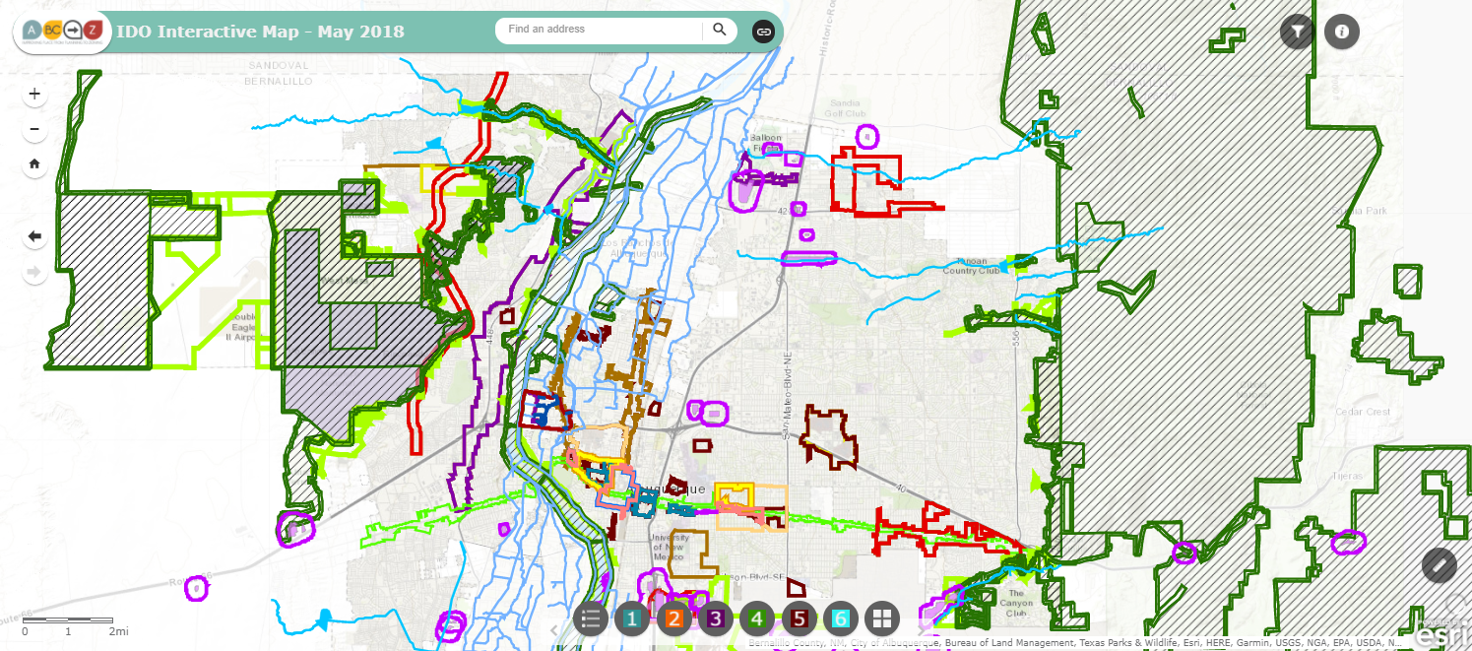


IDO Part 5
Development Standards
Context Rules
Rules that set quality standards for development
5-1 Dimensional Standards
5-2 Site Design + Sensitive Lands
5-3 Access + Connectivity
5-4 Subdivision of Land
5-5 Parking + Loading
5-6 Landscaping, Buffering, + Screening
5-7 Walls + Fences
5-8 Outdoor + Site Lighting
5-9 Neighborhood Edges
5-10 Solar Access
5-11 Building Design
5-12 Signs
5-13 Operation and maintenance
https://abq-zone.com
https://tinyurl.com/IDOzoningmap
Notes:
Between uses: Group Homes, Pawn Shops, Bail Bonds, Payday Loans, etc.
From Residential Uses: Retail Liquor, Heavy/Special Manufacturing, Auto repair, etc.
For Site Plan Review

Slide 19
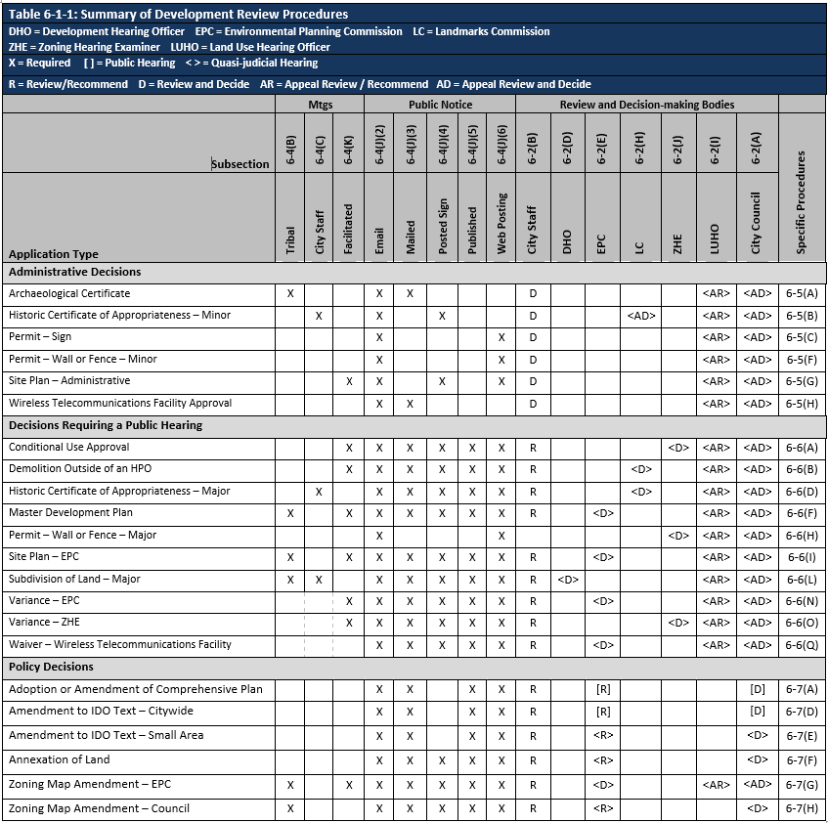
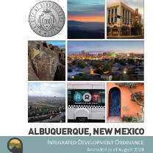


Review/decision
Table 6-1-1
Part 6
Some notice.
Administrative review.
Decided on IDO rules only.
Predictable
More notice.
Public hearing.
Decided on IDO rules only.
Lots of notice.
Public hearing.
Rules decided case-by-case.
Comp Plan AND IDO apply.
Flexible

Slide 20
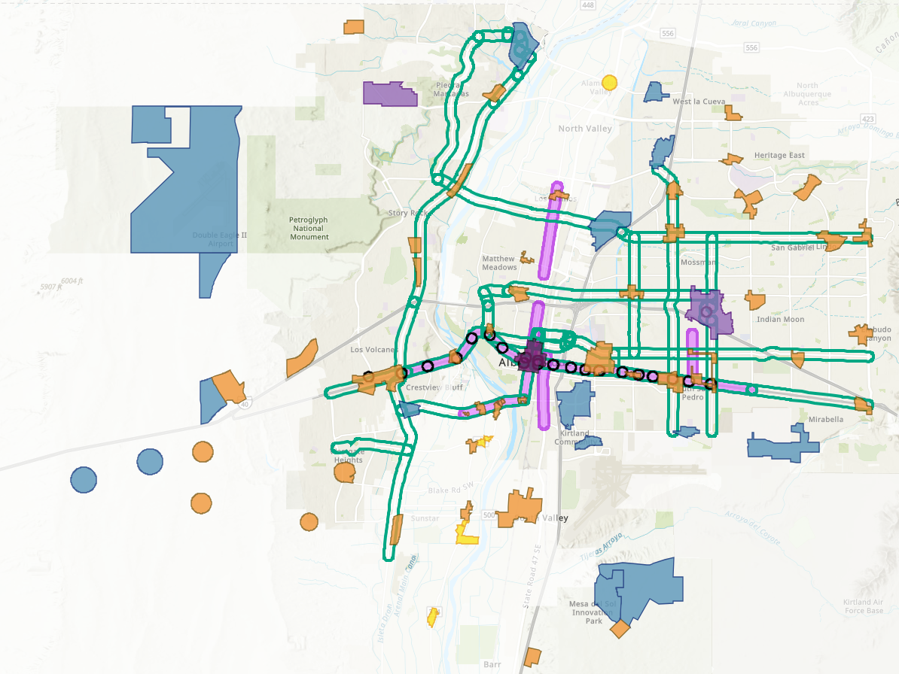
Lower Costs per Housing Unit
Require less land/parking to leave more money and space for constructing housing units
PASSED
R-1 Dimensional Standards – Removed larger minimum lot sizes and setbacks
Building Heights
R-ML and R-MH and Mixed-use Zone Districts
Added building height in AC-MT
Increased building height in UC-MS-PT
Parking
Citywide Parking Minimums
Reduced minimum requirements for multi-family
1 space / DU for workforce housing
Reduced parking minimums by 20% for most uses
Centers and Corridors:
Eliminated parking minimums in DT-UC-AC-MS-PT-MT
IDO Zoning Map
DT = Downtown
UC = Urban Center
AC = Activity Center
EC = Employment Center
MS = 660 feet from Main Street
PT = 660 feet from Premium Transit station
MT = 660 feet from Major Transit

Slide 21
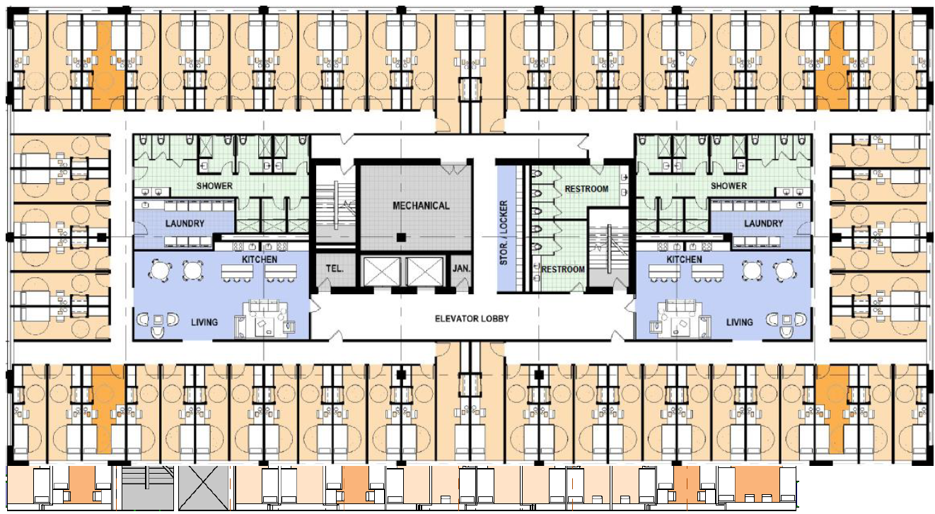
Increase Housing Choices
Take bold but gentle action to create more housing choices for families
PASSED
Dormitory – Allowed in all zone districts that allow multi-family dwellings
Examples:
Supportive / transitional housing
Non-residential conversions
Vertical mixed-use
“Albuquerque and Santa Fe could add hundreds of low-cost homes and curb homelessness with small, dormitory-style microapartments that have shared kitchens, bathrooms, and amenities.
The Pew/Gensler study found that each ‘co-living’ apartment would cost about $130,600 to build in Albuquerque and $184,400 in Santa Fe, well below the roughly $300,000 needed to build a typical studio apartment.”
Pew Charitable Trusts, Co-living and Affordability in ABQ (8/5/2025)

Slide 22
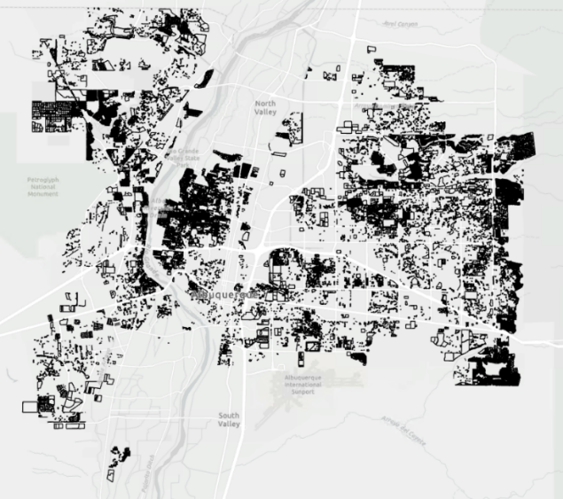

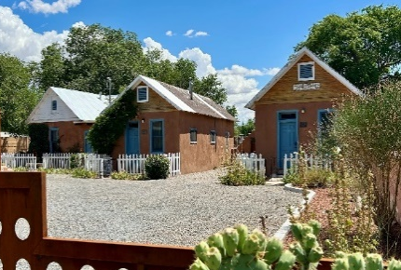
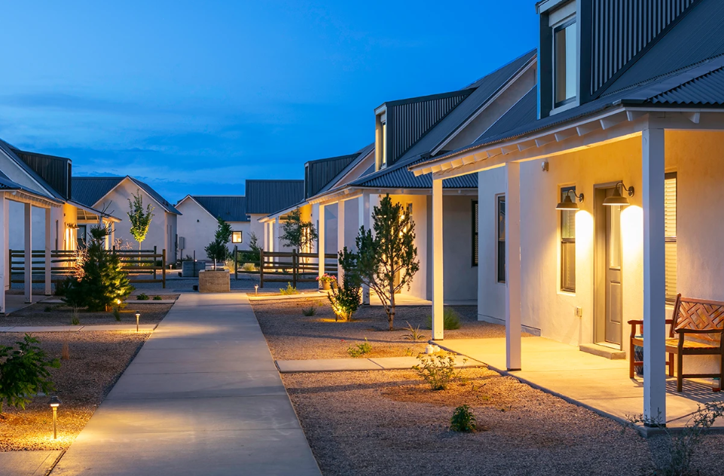
Increase Housing Choices
Take bold but gentle action to create more housing choices for families
PASSED
Cottage development – Allows multiple small single-family or duplexes in R-1 on lots 10,000+ s.f.
Examples:
Multigenerational family compounds / senior living / intentional communities
Build-to-rent
Affordable housing
10,000+ s.f. lots
 | Square Feet (s.f.) | Calculation Result
Start with an example lot size total | 10,000
Divide by minimum lot size in the zone district
R-1 | 3,500 | 2.86 | units
Multiply by an assumed s.f. per unit in a typical house | 2,000 | 5,714 | total s.f.
Divide by size limits in the zone district
Minimum size | 650 | 8 | cottage units
Maximum size | 1,200 | 4 | cottage units
1700 Old Town Rd.
Griegos Farms by Rembe Urban Design + Development

Slide 23
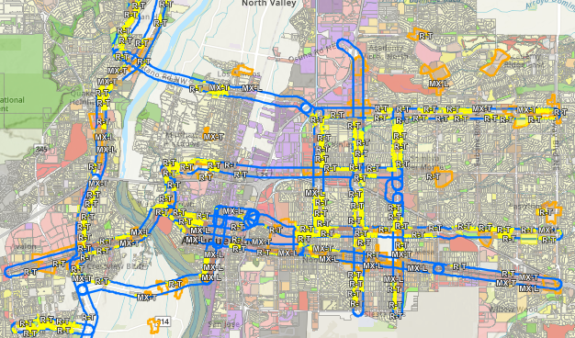
Increase Housing Choices
Take bold but gentle action to create more housing choices for families
NOT PASSED
Legislative Zoning Conversions for Major Transit (MT) and Activity Centers (AC)
R-1 → R-T – Adds townhouses as permissive (up to 3 units)
R-T → MX-T – Adds multi-family and non-residential as permissive
R-ML → MX-L – Adds non-residential as permissive
MT = 660 feet from Major Transit Corridor
AC = Activity Center
https://abq-zone.com/node/1937

Slide 24
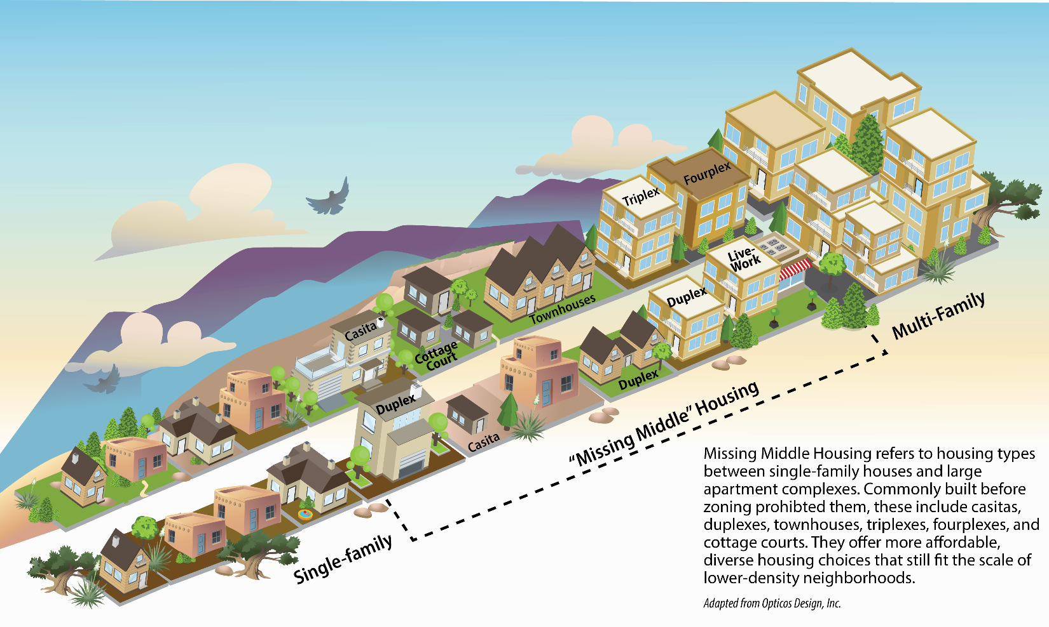
Increase Housing Choices
Take bold but gentle action to create more housing choices for families
NOT PASSED
Duplex – Allow duplexes citywide in R-1
Townhouse – Allow townhouses citywide in R-1 (up to 3 units)
Accessory Dwelling Units (ADUs) / Casitas – Allows attached ADUs citywide
Safe Outdoor Space – Remove requirements for plumbing and 24/7 security

Slide 25
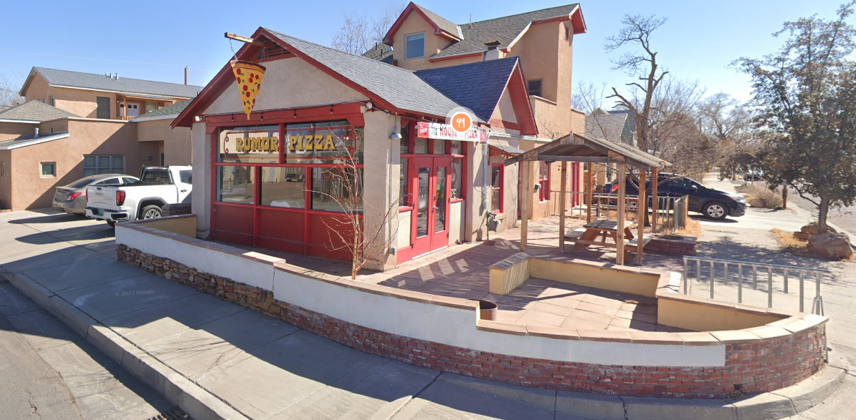
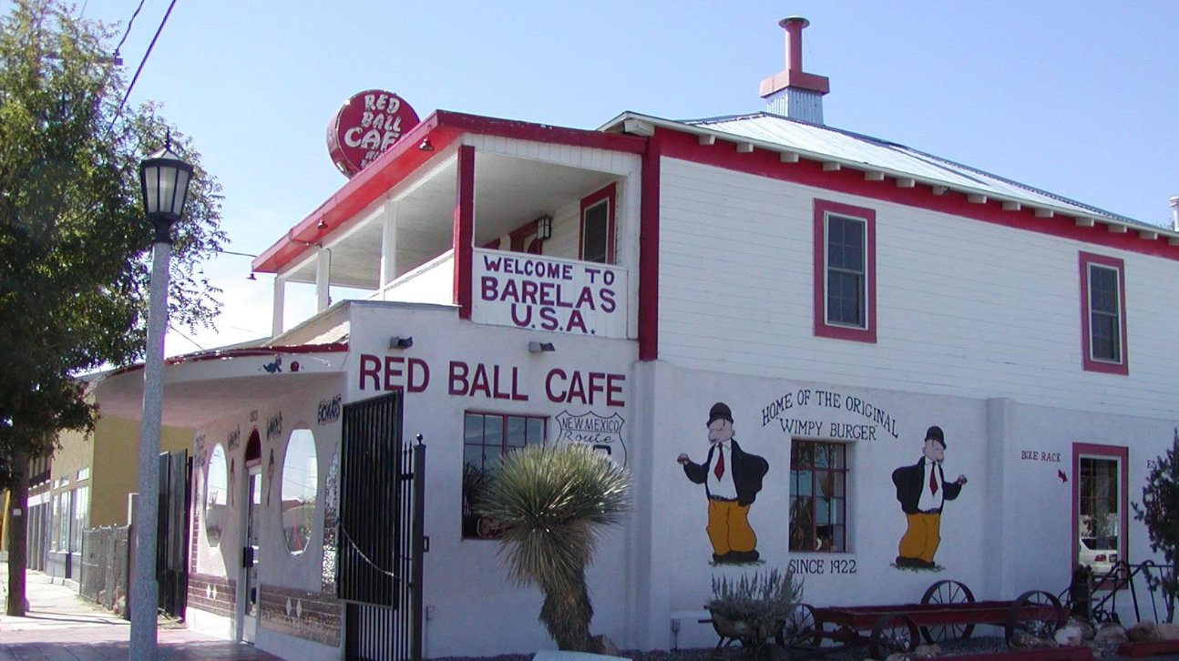
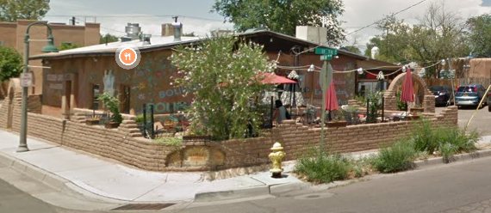
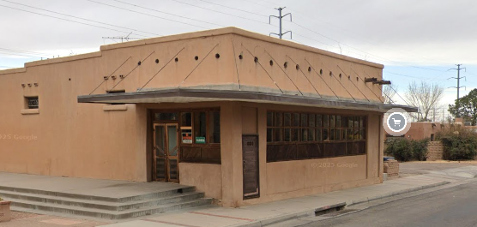
Allow Food near Neighborhoods
Create opportunities for small businesses, encourage walkability, and provide important daily goods such as food, household items, and medicine closer to the places where people
NOT PASSED
Bodegas / Tienditas: Allow retail, restaurant, grocery, and live-work on corner lots 5,000+ s.f. in residential zones
Conditional on local streets
Permissive on arterial / collectors
Not allowed to sell alcohol, cannabis, or nicotine

Slide 26
The debate
Will zoning changes result in housing construction?
For large-scale projects, will allowing more units help projects “pencil” and cover constructions costs?
Will individual people invest in incremental, missing middle housing?
Is all housing good housing?
Will outside developers “buy up” Albuquerque and tear down existing houses to redevelop at higher densities?
Would housing get built if the City required some units to be affordable (inclusionary zoning)?
Would too much housing lead to gentrification in communities of color?
Would the City be ready with tools / strategies to intervene, if so?
Will Albuquerque still be Albuquerque if more housing gets built?
Will Albuquerque have a future if we continue with the status quo?
What are we “ready” for?

Slide 27
EPC Application Reviews

Slide 28
How Do You Prepare for Hearings
and
How Much Time Does It Take to Review Staff Reports?
Notes:
MEGAN

Slide 29
Considering the Matter Before You
Review & Decision Criteria
EPC Findings & Conditions
Staff Report – What It’s for and How to Review It
Notes:
COON/MYERS

Slide 30
creating the staff report
Review and analyze application
Review against applicable IDO review and decision criteria and Comp Plan Goals and Policies
Produce findings of fact based on research
Make a recommendation based on the analysis

Slide 31
What is the staff report?
Research & Site History
Applicable Definitions
Applicable Goals, Policies, and Regulations
Staff Analysis of the Review and Decision Criteria
Site Plan Review
Neighborhood and Agency Comments
Findings of Fact
Conditions of Approval

Slide 32
Audience
EPC Commissioners
Owners, Developers, Applicants & Agents
Project Team
The General Public
The Public Record
Appeals

Slide 33
Commissioner Role in reviewing the staff report
Understanding the merits of the request
Studying staff’s analysis
Getting to know the Findings and Conditions
Being aware of Agency & Neighborhood comments/concerns

Slide 34
Review Approaches
Complete Approach
Read the entire report and gather information under each heading (the “kitchen sink” approach)
Deep Dive and Middle-of-the-Road Approaches
Review Analysis, including Comprehensive Plan Goals and Policies
Review Analysis, Background, Comp Plan and Zoning
Review Findings & Conditions
Overview Approach
Review Summary of Analysis, Agency Comments, and Findings
Notes:
Review
Request
history of the subject site,
applicable goals and policies,
Staff Analysis of review and decision criteria in the IDO & the Comp Plan Analysis
Recommended Findings of Fact and Conditions of approval when applicable

Slide 35
Report Review Approaches
Kitchen Sink | Deep Dive | Middle of the Road | Basic Overview
Cover page | Cover page | Cover page | Cover page
Request | Request | Request
EPC Role
Context
History
Transportation System
Corridor Designation
Trails/Bikeways
Transit
Public Facilities
Comp Plan | Comp Plan | Comp Plan
IDO/Zoning | IDO/Zoning
Reviewing Agencies | Reviewing Agencies
Neighborhood/Public | Neighborhood/Public | Neighborhood/Public | Neighborhood/Public
Conclusion | Conclusion | Conclusion
Findings | Findings | Findings | Findings
Conditions (if applicable) | Conditions (if applicable) | Conditions (if applicable) | Conditions (if applicable)
Submission of a $250.00 application and processing fee, charged for a 10-year period;
An annual charge of $1.00 per square foot for the area of the alley; and
The holder of the revocable permit must continually possess a $1,000,000 liability insurance policy indemnifying the City of Albuquerque.

Slide 36
Questions? Discussion

