Slide 1
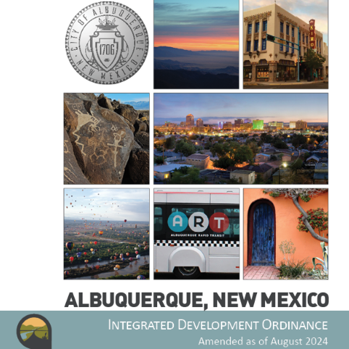
Integrated
Development
Ordinance
IDO Project Webpage:
https://ido.abq-zone.com
ULI Testing Session
July 2025
Mikaela Renz-Whitmore
Division Manager
mrenz@cabq.gov
Michael Vos
Regulatory Planning Team Lead
mvos@cabq.gov
Kate Clark
Senior Planner
kclark@cabq.gov

Slide 2
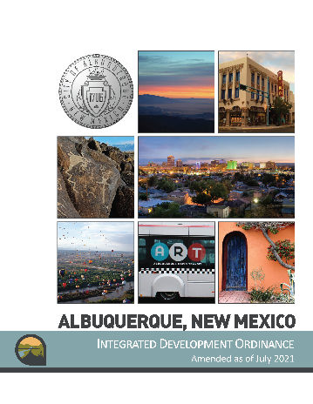
Thanks for
participating!
2025 IDO Update
Get to Know Your IDO
Handout (PDF)
Presentation (PDF)
Video
https://abq-zone.com/ido-updates-2025
Suggestions/comments
abctoz@cabq.gov
IDO Online
Public Meetings
Environmental
Planning
Commission
Land
Use
Planning
Zoning
City Council
https://ido.abq-zone.com
Date | Time | Topic
Wed, July 23 | 12:00 – 1:30 pm | All Updates
Tues, July 29 | 12:00 – 1:00 pm | Compost
Wed, August 6 | 6:00 – 7:30 pm | All Updates
Thurs, July 31 | 11:30 am – 1:00 pm | Housing
Tues, August 12 | 12:00 – 1:30 pm | All Updates
Mon, August 25 | 6:00 – 7:30 pm | All Updates
October 2025
January 2026
February 2026
Council’s
Committee

Slide 3

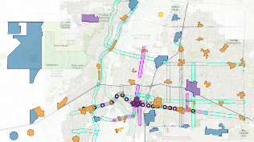

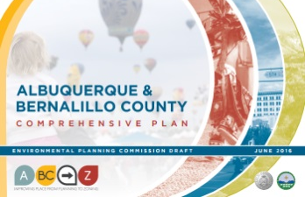
Planning + Zoning
ABC Comprehensive Plan
Integrated development ordinance
What we want + why:
  Where to direct growth
  What to protect
  What actions to take
  How to measure progress
How to get there:
  Tailored rules
    Centers + Corridors
    Areas of Consistency
    Overlay Zones
    Special places
  Transitions / Edge Protections
    Between Areas of Change + Consistency
    Next to neighborhoods
Policies
Centers & Corridors
Vision
EC
MT
MS
UC
AC
DT
Regulations
compplan.abq-zone.com
https://abq-zone.com
Notes:
In theory, at its best, zoning is a legal tool to implement our best plans
The WHY and the HOW
Why = goal/aspiration
How = minimum standards

Slide 4
Finding the balance
Protect
Neighborhoods, special places,
& City open space
Incentivize
High-quality development
in appropriate areas

Slide 5
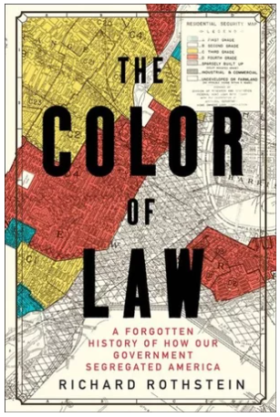
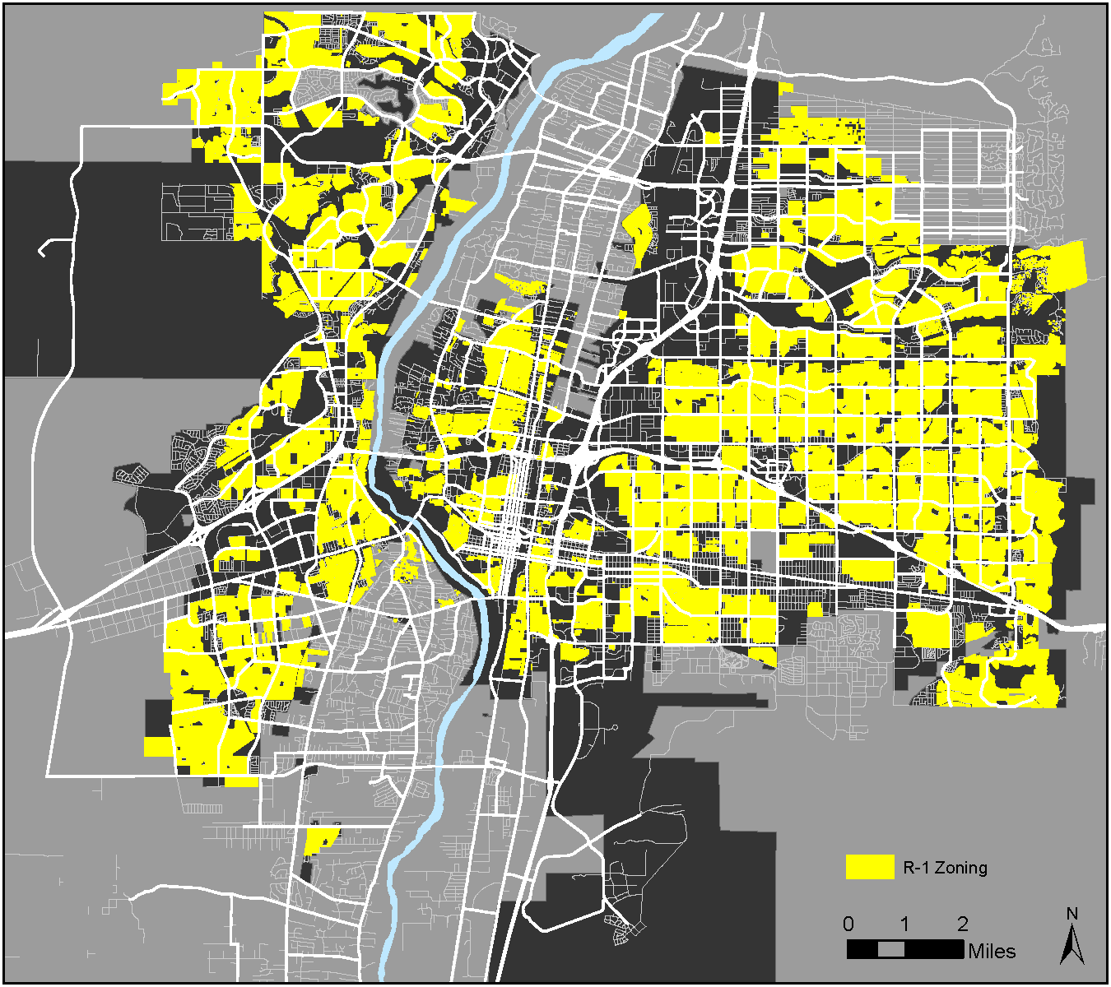
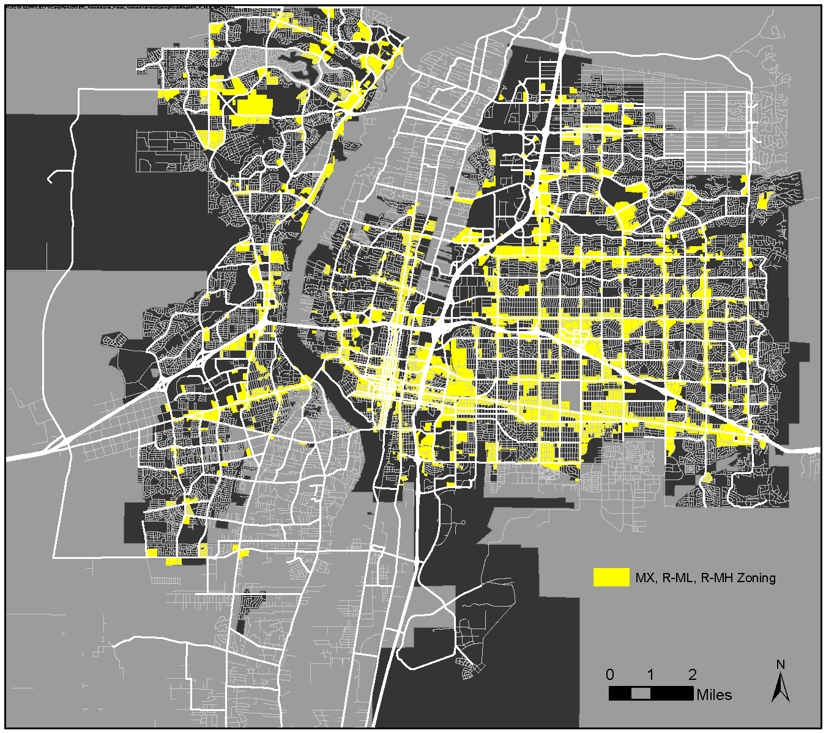
Residential zoning
1917: Supreme Court struck down racial zoning ordinances
1924: Standard State Zoning Enabling Act
1928: Albuquerque proposes the first zoning code
1959: City of Albuquerque established first zoning code
1975: CABQ replaced zoning code
2017: CABQ adopted IDO
2023: Housing Forward Allowed Casitas and Non-residential Conversions
Zoning History
Segregated by Design
Only houses / Casitas allowed (64%)
Apartments Allowed (22%)
2023
Notes:
Buchanan v. Warley (1917) – Louisville, Kentucky – violated 14th Amendment
Because of other societal injustices (racist systems and institutions – i.e. systemic racism), BIPOC have less wealth, so any rules that raise the cost of housing construction (and therefore housing prices) has the result of excluding BIPOC
Density
Housing types
Lot size
Setbacks
Minimum structure size

Slide 6
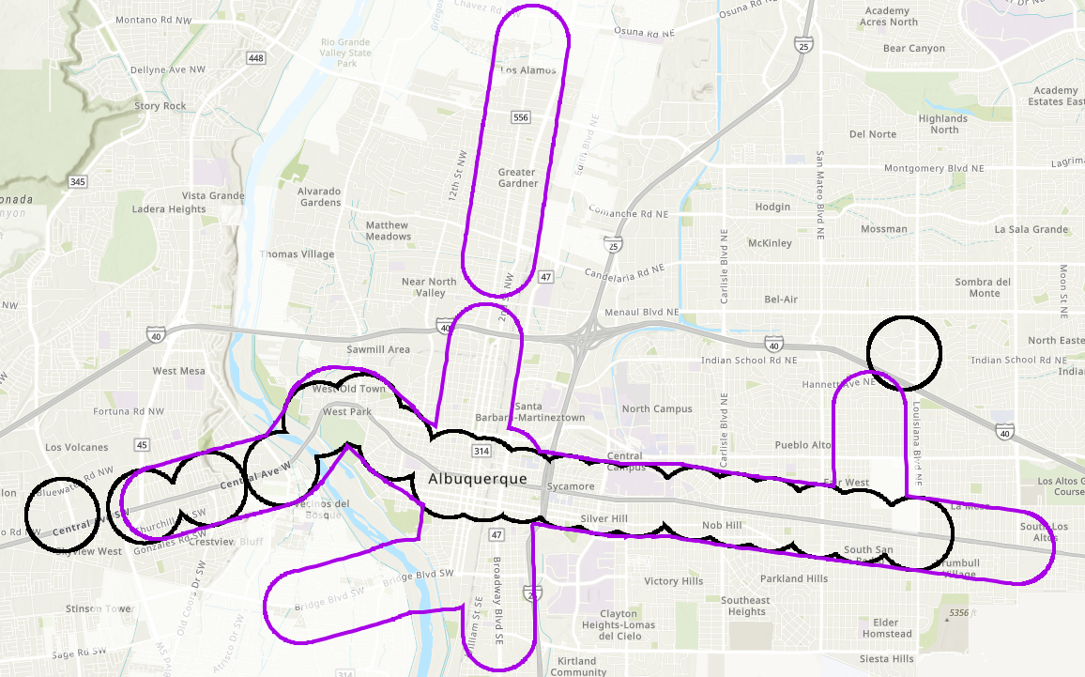
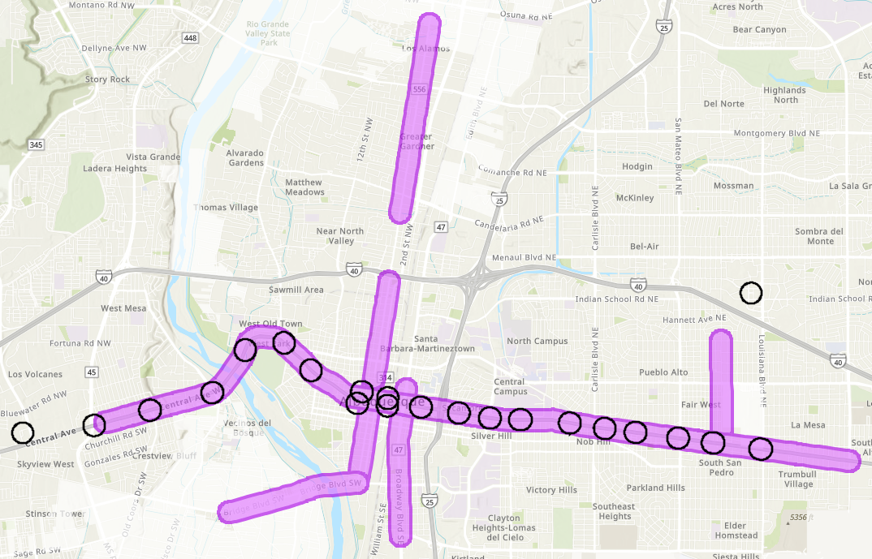
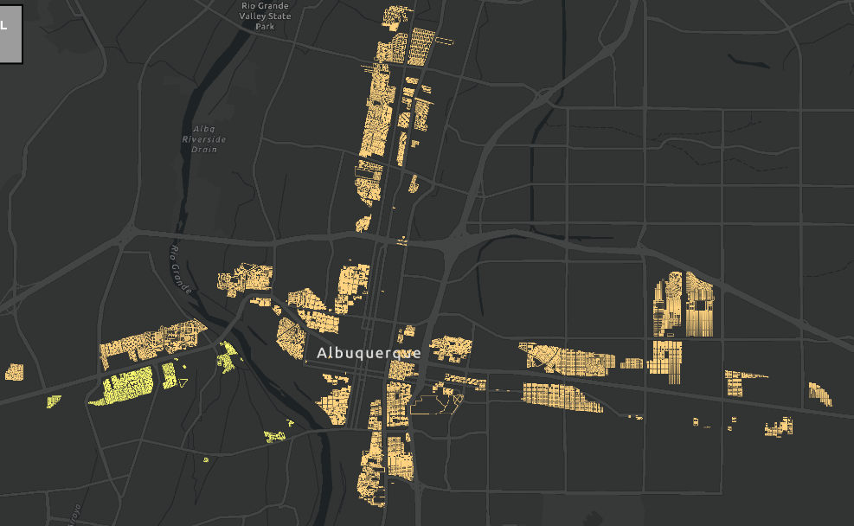
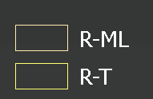
Legislative Upzones
O-24-69
Within ¼ Mile of MS / PT
Reflect additional housing options
(i.e., duplexes, townhouses, apartments)
with a matching zone district on the zoning map
MS = 660 feet from Main Street
PT = 660 feet from Premium Transit station
R-A/R-1/R-T → R-ML*
2025 IDO Update
* South of Central / west of the Rio Grande:
R-A/R-1 → R-T
R-A = Rural – Agricultural
R-1 = Single-family
R-T = Townhouse
R-ML = Multi-family Low-density
Notes:
¼ mile

Slide 7
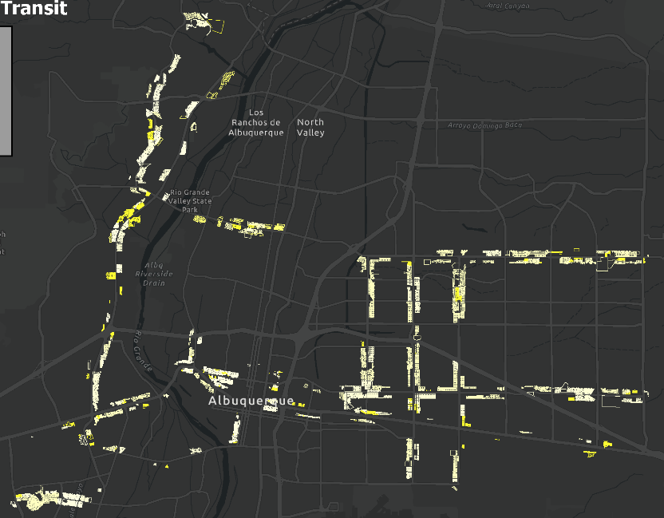
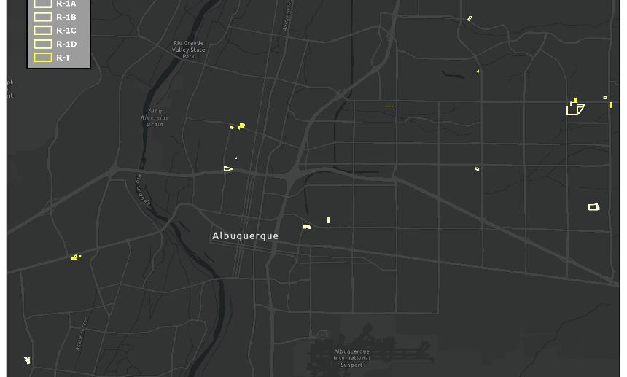
Housing changes
proposed
Legislative Upzones
2025 IDO Update
Conversions
in Major Transit Corridors
Allowing Missing Middle / Gentle Density
* Includes R-A, R-1, R-MC, R-T, R-ML, R-MH, MX-T, MX-M, MX-H
** Includes R-A, R-1, R-MC, R-T, R-ML, MX-T
*** Includes R-1A, R-T, R-ML, MX-T
**** Includes R-T, R-ML, R-MH, MX-T, MX-L, MX-M, MX-H
***** Includes R-ML, R-MH, MX-T, MX-L, MX-M, MX-H
Conversions
in Activity Centers

Slide 8
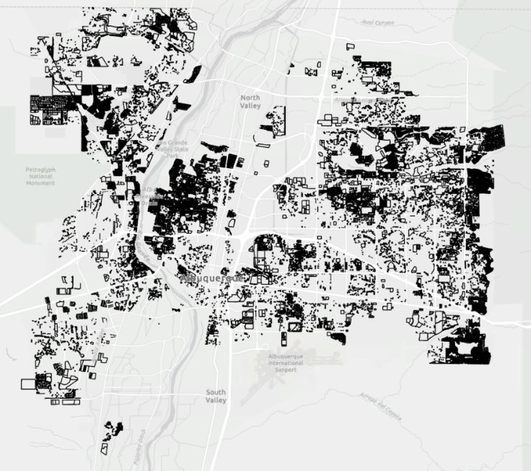
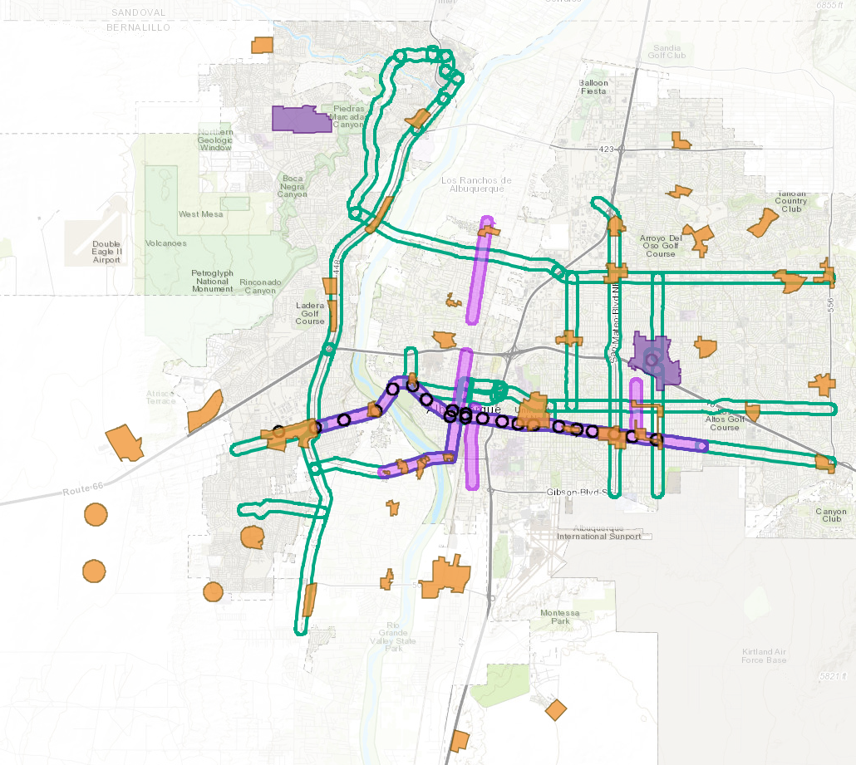
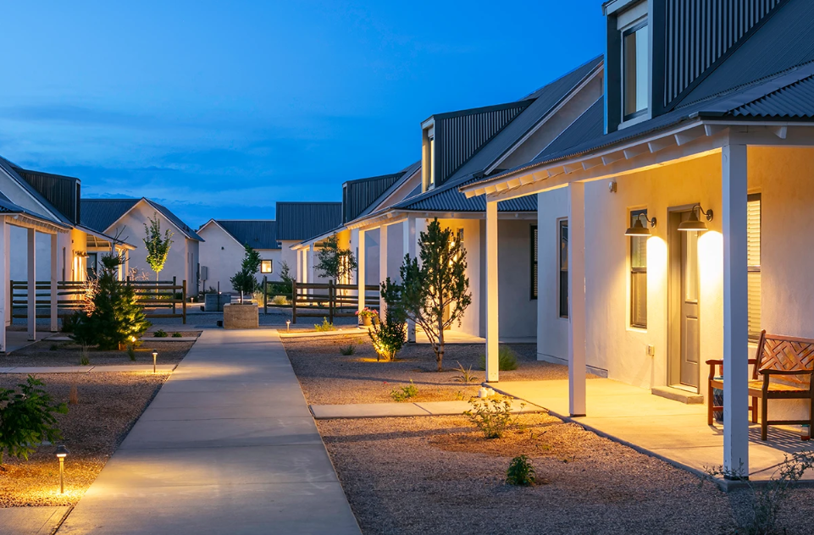
Housing reform
Over 30,000 housing units are needed by 2040.
Where will they go?
2025 IDO Update
Allowing Missing Middle / Gentle Density
Decreasing costs per unit
Disallowing single-family in MX-T
Allowing a duplex on corner lots 5,000+ s.f.
Allowing cottage development on Residential lots 10,000+ s.f.
Reduced minimum lot size and setbacks in R-1
Higher building heights
Reduced parking requirements
10,000+ s.f. lots
Centers +
Corridors
MX-T = Mixed-use Transition
Griegos Farms by Rembe Urban Design + Development

Slide 9
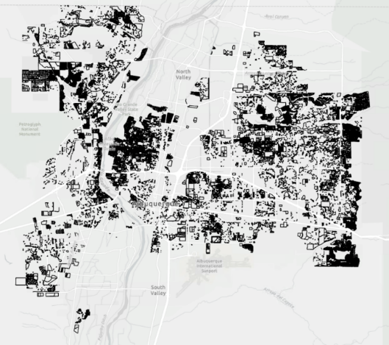
cottage development
4-3(B)(4)
Existing regulations
Proposed change
2025 IDO Update
Minimum project size:
General: 1 acre.
In or within 1,320 feet (¼ mile) of UC-MS-PT areas: 10,000 square feet.
More than 1,320 feet (¼ mile) of UC-MS-PT areas, if granted a Conditional Use approval pursuant to Subsection 14-16-6-6(A): 10,000 square feet.
Assumed square footage for calculation:
R-1D: 2,600 s.f.
Other: 2,000 s.f.
Minimum project size:
10,000 square feet
Assumed square footage for calculation:
2,000 s.f.

Slide 10
increasing building height
2025 IDO Update
Residential zone districts
centers + corridors
UC
MT
AC
MS

Slide 11
increasing building height
2025 IDO Update
mixed-use zone districts
centers + corridors
UC
MT
AC
MS

Slide 12
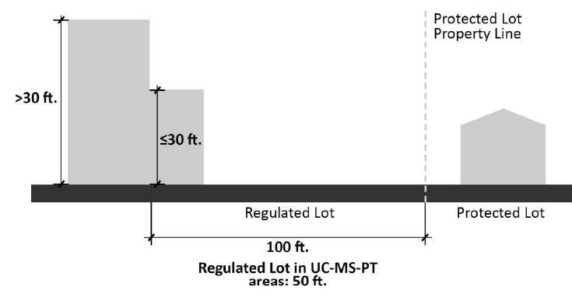
Reducing
Building Height Limits
Part 5
5-9(B)(2)
2025 IDO Update
proposed change
Adding Major Transit (MT) to UC-MS-PT
(i.e. 50 ft. for Neighborhood Edge)
Neighborhood Edge Building Height Step-down

Slide 13
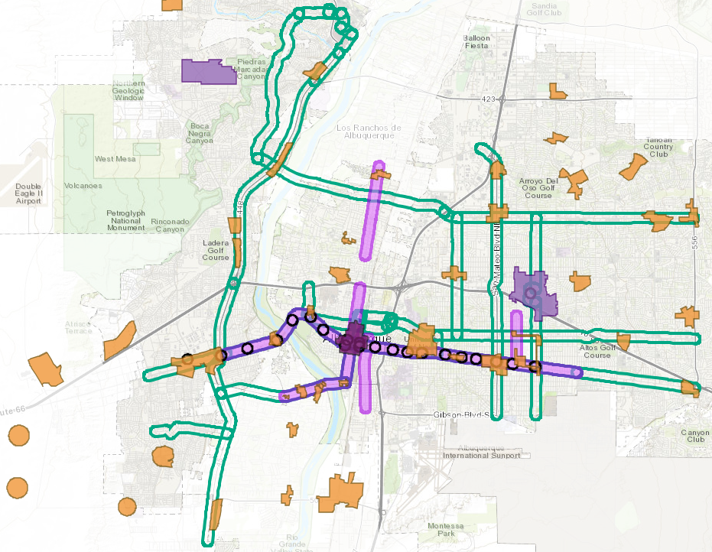
reducing
Off-street parking
2025 IDO Update
5-5
citywide
Centers + Corridors
No minimums!
Maximums only for non-residential development
DT = Downtown
UC = Urban Centers
MS = 660 feet from Main Street
PT = 660 feet from Premium Transit station
AC = Activity Centers
MT = 660 feet from Major Transit

Slide 14
get involved
2025 IDO Update
Get to Know Your IDO
Handout (PDF)
Presentation (PDF)
Video
https://abq-zone.com/ido-updates-2025
Suggestions/comments
abctoz@cabq.gov
IDO Online
Public Meetings
Environmental
Planning
Commission
Land
Use
Planning
Zoning
City Council
https://ido.abq-zone.com
Date | Time | Topic
Wed, July 23 | 12:00 – 1:30 pm | All Updates
Tues, July 29 | 12:00 – 1:00 pm | Compost
Wed, August 6 | 6:00 – 7:30 pm | All Updates
Thurs, July 31 | 11:30 am – 1:00 pm | Housing
Tues, August 12 | 12:00 – 1:30 pm | All Updates
Mon, August 25 | 6:00 – 7:30 pm | All Updates
October 2025
January 2026
February 2026
Council’s
Committee

Slide 15


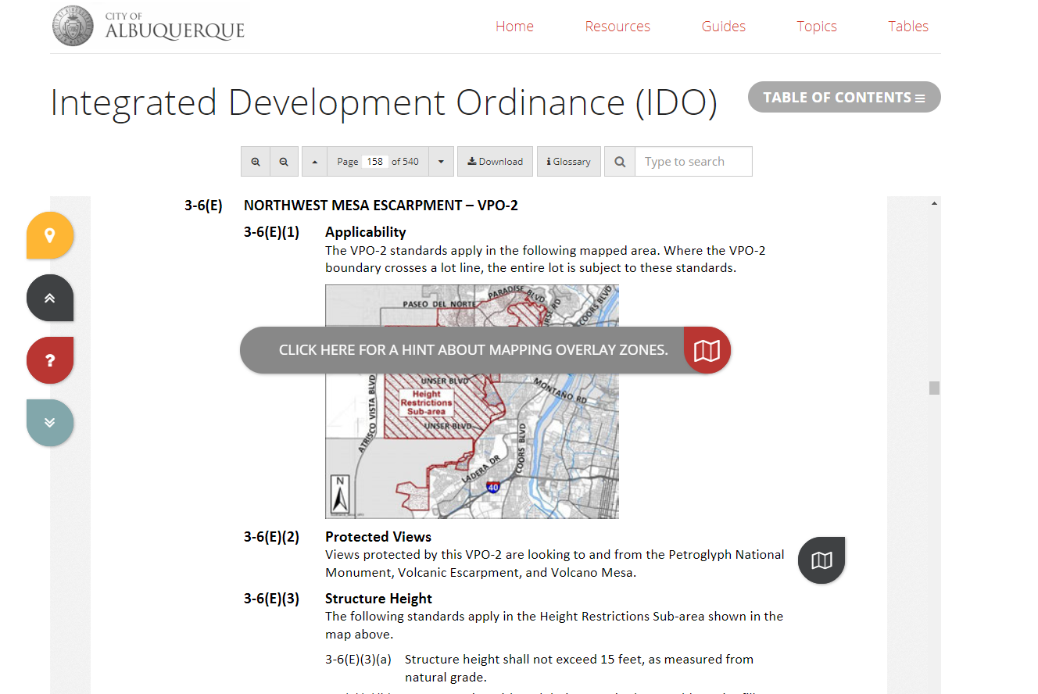
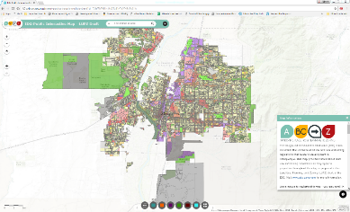


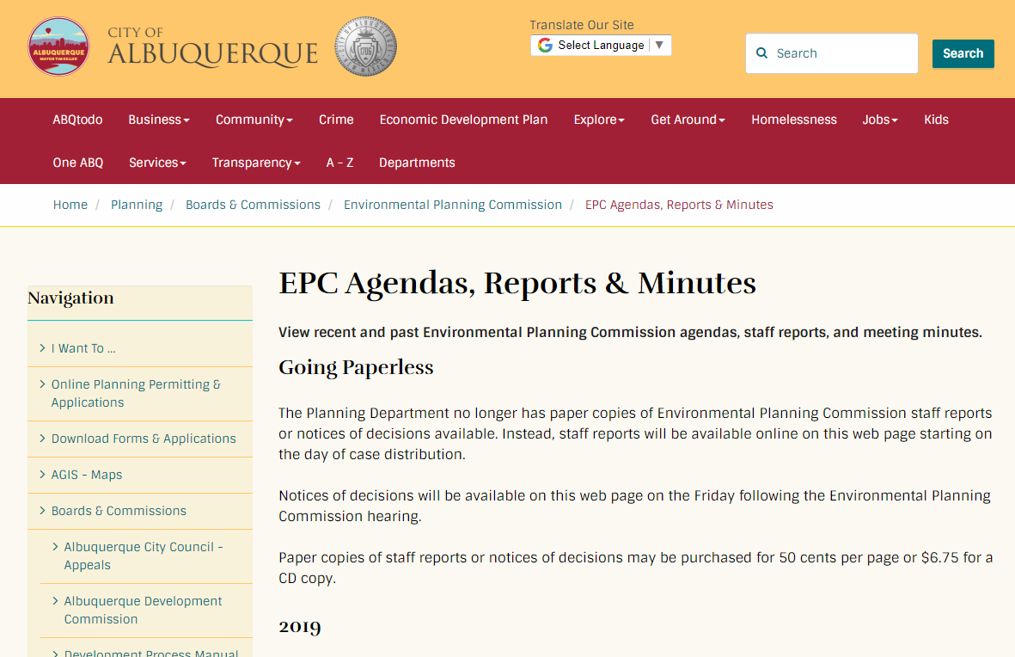
Interactive IDO
IDO Zoning Map
Mikaela Renz-Whitmore
Urban Design + Dev. Division Manager
mrenz@cabq.gov
Michael Vos
Regulatory Planning Team Lead
mvos@cabq.gov
Kate Clark
Senior Planner
kclark@cabq.gov
ABC-Z Project
abctoz@cabq.gov
abq-zone.com
tinyurl.com/idozoningmap
ABC Comp Plan
Planning Webpage
compplan.abq-zone.com
cabq.gov/planning

